Slide 1
ANNOUNCEMENTS -Pick up Notes from front -Turn in Parent Survey/ Media Release Form -Turn in Calculator Financial Form -Sit in assigned seat
WARM UP
Do in Monday box of Warm Up sheet from front.

Slide 2
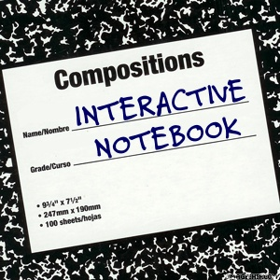
Setting Up Your Interactive Student Notebook
YOUR NAME & Desk #
Ms. Santos
Math II
“Check Out” Page
Syllabus
Vision & Goals
ISN Guidelines
ISN Grading Rubric
Table of Contents (Yellow - 4)
Tracker (Green - 2)
Vocabulary (Purple - 5)

Slide 3
Unit 1: Polynomials & Quadratics
#1 Adding and Subtracting Polynomials
#2 Multiplying Polynomials

Slide 6
Vocabulary
Terms: Parts of an expression separated by + or – signs
Variable: A quantity that can change, represented by a letter
Constant: A term with no variables
Monomial: the product of constants and variables
Polynomial: when monomials are combined
Examples of Polynomials:
Monomial: 4x²
Binomial: 4x² + 3xy
Trinomial: 4x² + 3xy – 2y⁵

Slide 7
Polynomials
We write polynomials so that the powers of one variable are in descending order
Example: 6x² + 5 – 8x – 2x³ → -2x³ + 6x² – 8x + 5
Now you try!
What is the correct way to write 8x² – 2x⁶ + 10 + 3x
→-2x⁶ + 8x² + 3x +10

Slide 8
#1 Adding & Subtracting Polynomials

Slide 9
Adding Polynomials
(4x² – x + 4) + (2x² + 5x + 2)
Problem | Steps
 | Distribute invisible 1s
 | 2. Combine like terms
 | 3. in descending order

Slide 10
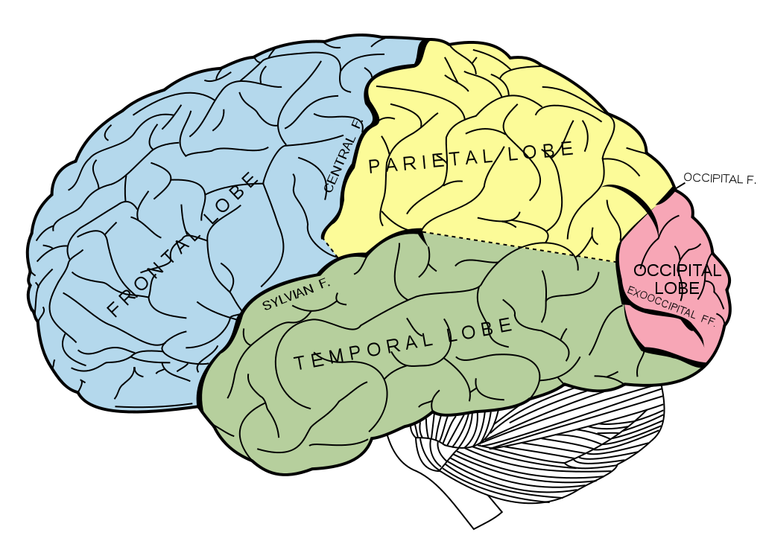
BRAIN BREAK

Slide 11
Subtracting Polynomials
(6p + 4p² + 5) – (2p² – 5p + 1)
Problem | Steps
 | 1. Distribute invisible 1 and -1
 | 2. Combine like terms
 | 3. Write in descending order

Slide 12
Adding & Subtracting Polynomials
Adding Polynomials | Subtracting Polynomials
Distribute invisible 1s Combine like terms Write in descending order | Distribute invisible 1 and -1 Combine like terms Write in descending order
4x² – x + 4 + 2x² + 5x + 2 | 6p + 4p² + 5 – 2p² + 5p – 1
4x² – x + 4 + 2x² + 5x + 2 | 6p + 4p² + 5 – 2p² + 5p – 1
6x² + 4x + 6 | 11p + 2p² + 4
 | 2p² + 11p + 4

Slide 13
Team Practice
22x²y + 18x
17r³ + 6xy
8d + 33y

Slide 14
Partner Practice
Juan is given the task of simplifying the expression (5x² – 8x +3) – (2x² + 6x – 2). He comes up with the answer 3x² – 2x + 5. What is wrong with his answer? Correct his mistake.
He forgot to distribute the negative sign (invisible -1).

Slide 15
BRAIN BREAK

Slide 16
Individual Practice
Mr. Santos wants to build a fence around his garden. His yard is (5x² – 7x + 14) feet wide and (6x² – 11x + 20) feet long. How much fencing (in terms of x) does he need to buy? Explain your answer.

Slide 17
Homework
HOMEWORK PACKET
#1 Adding & Subtracting Polynomials

Slide 18
Exit Ticket
1. Update TOC & glue notes onto page 1.
2. (Individual Practice Problem – COMPLETE IN MONDAY BOX!) Mr. Santos wants to build a fence around his garden. His yard is (5x² – 7x + 14) feet wide and (6x² – 11x + 20) feet long. How much fencing (in terms of x) does he need to buy? Explain your answer by showing all work AND writing at least 2 sentences explaining your work.

Slide 19
ANNOUNCEMENTS -Pick up Notes from front -Turn in Parent Survey/ Media Release Form -Turn in Calculator Financial Form - Pick up Warm Up sheet from file. - Sit in assigned seat
WARM UP
Do in Tuesday box of Warm Up sheet.
One of the community gardens being built outside the Freshman Academy has a length of (4x – 3) feet and a width of (5x – 12) feet. What is the perimeter of the garden?
Mr. Jones does not want to use more than 50 feet of fence to mark the edges of the garden. Assume x is 3 feet. Will the garden meet Mr. Jones’s criteria?
Update TOC.

Slide 20
1st & 3rd PERIODS ONLY Setting Up Your ISN
“Check Out” Page
Syllabus
Vision & Goals
ISN Guidelines
ISN Grading Rubric
Table of Contents (Yellow - 4)
Tracker (Green - 2)
Vocabulary (Purple - 5)
YOUR NAME & Desk #
Ms. Santos
Math II

Slide 21
4TH PERIOD ONLY Team Practice
22x²y + 18x
17r³ + 6xy
8d + 33y

Slide 22
#2 Multiplying Polynomials

Slide 23
Multiplying Binomials
(x + 3)(x + 4) | Steps - FOIL
 | 1. Multiply the FIRST terms
 | 2. Multiply the OUTTER terms
 | 3. Multiply the INNER terms
 | 4. Multiply the LAST terms
 | 5. Combine Like Terms & Write in descending order

Slide 24
Multiplying Polynomials
(x² + 4x - 2)(x + 6) | Steps – Box Method
 | Draw the box
x + 6 x² +4x -2 | 2. Label your rows and columns
x + 6 x² +4x -2 | 3. Multiply into the box
4x² + 6x² = 10x² -2x + 24x = 22x | 4. Combine Like Terms (Add the peanuts!)
x³ + 10x² + 22x – 12 | 5. Write in descending order
x³ | 6x²
4x² | +24x
-2x | -12

Slide 25
BRAIN BREAK

Slide 26
Multiplying Polynomials
Now you try!: Simplify (2x – 3)(4x + 2)

Slide 27
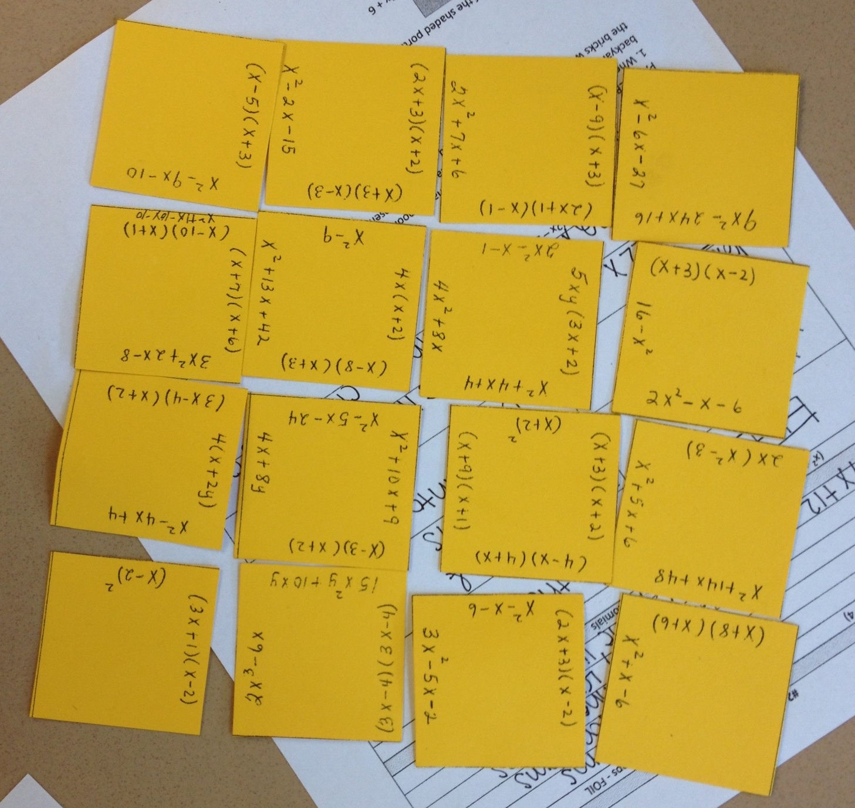
Team Practice – Multiplying Puzzle
Each group has a set of squares containing multiplied polynomials and their simplified answers. With your table group, work out the problems and match them with the answers until you have a completed grid.
When you finish, take a picture of the grid and text it to me at (940)784-3726. Include the names of everyone in your team & your team color!

Slide 28
Partner Practice
1. When Ms. Higgins (AFM & Precalc teacher) gets a house, she wants to have a pool in the backyard surrounded by brick. The shaded area below represents where the bricks would be. Find the area of bricked portion.
x + 2
x² +2x - 3
x – 2
x + 3

Slide 29
Partner Practice
2. What is the area of the shaded portion?
5x + 6
2x – 1
2x² + 4x – 1

Slide 30
BRAIN BREAK

Slide 31
Homework
HOMEWORK PACKET
#1 Adding & Subtracting Polynomials
#2 Multiplying Polynomials

Slide 32
Exit Ticket
Glue notes onto page 2.
One of the community gardens being built outside the Freshman Academy has a length of (4x – 3) feet and a width of (5x – 12) feet. In your Warm Up, you found the perimeter of this garden to be 18x – 30 ft. What is the area of the garden from your Warm Up?
Write a letter to the National Garden Fencing Association requesting the correct amount of fencing to enclose the garden, assuming x = 3 ft. (Hint: Refer to #2 from your Warm Up!)

Slide 33
Warm Up On Loose (Leaf)
ANNOUNCEMENTS
Take out homework for me to stamp
Turn in Crazy Ones Extra Credit if you did it!
Simplify the following:
6x³(5 + 3x)
4b(-5b – 3)
5y³(y² + 4)
Then update your table of contents when you’re done. (just #2) Example is on the yellow chart paper. (Date is 8/29)

