Slide 1
ANNOUNCEMENTS
-Pick up your assigned calculator
-Pick up all materials from front desk
WARM UP
Update TOC.
Update Data Tracker (Green Tab) – Find your # in the chart below and fill in the bar graph for your Unit 1, Unit 2, & Unit 3 mastery.
File # | Unit 1 % | Unit 2 % | Unit 3 %
1 | 89 | 53.5 | 14
2 | 9 | - | 23
3 | 0 | 66 | 17
4 | - | - | -
5 | 24 | 71 | 52
6 | 71.5 | 53 | 48
7 | - | - | -
8 | 11 | - | 48
9 | 28 | 29 | 32
10 | - | 57 | 0
11 | 4 | 39 | 25
12 | 59 | 71 | -
13 | 24 | 56 | 30
14 | 7 | 39 | -
15 | 0 | 56 | 25
16 | 39 | 56 | 25
17 | 67 | 58 | 20
File # | Unit 1 % | Unit 2 % | Unit 3 %
18 | 7 | 47 | 0
19 | 72 | 80 | 91
20 | - | 70 | 37
21 | 28 | 67 | 45
22 | 0 | - | -
23 | 87 | 72 | 118.5
24 | 7 | - | 10
25 | 0 | 0 | -
26 | 0 | 33 | 0
27 | - | 0 | 10
28 | 46 | 53 | 92.4
29 | - | - | -
30 | 11 | 11 | -
31 | 33 | 72 | -

Slide 2
ANNOUNCEMENTS
-Pick up your assigned calculator
-Pick up all materials from front desk
WARM UP
Update TOC.
Update Data Tracker (Green Tab) – Find your # in the chart below and fill in the bar graph for your Unit 1, Unit 2, & Unit 3 mastery.
File # | Unit 1 % | Unit 2 % | Unit 3 %
1 | - | - | -
2 | 26 | 41 | 57
3 | 43 | 32 | 45
4 | - | - | -
5 | 57 | 51.5 | -
6 | 78 | 89 | 43
7 | 28 | 44 | 53
8 | 0 | 3 | 0
9 | 63 | 29 | 40
10 | 89 | 105.5 | 100
11 | 72 | 44 | 87
12 | 28 | 41 | 25
13 | 30 | 47 | 55
14 | 35 | - | 27
15 | 28 | 41 | 33
16 | 20 | 12 | 45
17 | 37 | 56 | 13
File # | Unit 1 % | Unit 2 % | Unit 3 %
18 | 70 | 71 | 40
19 | 28 | 71 | 45
20 | 59 | 47 | 40
21 | - | - | 13
22 | 7 | 0 | 10
23 | 57 | 64.2 | 45
24 | - | 15 | 30
25 | 95 | 68 | 25
26 | 76 | 107 | 92.6
27 | - | - | 0
28 | 57 | 77 | 43
29 | 36 | 55 | 100
30 | 98 | 104 | 65
31 | 35 | 56 | -
32 | - | 24 | -
33 | - | - | -
34 | - | - | -

Slide 3
ANNOUNCEMENTS
-Pick up your assigned calculator
-Pick up all materials from front desk
WARM UP
Update TOC.
Update Data Tracker (Green Tab) – Find your # in the chart below and fill in the bar graph for your Unit 1, Unit 2, & Unit 3 mastery.

Slide 4



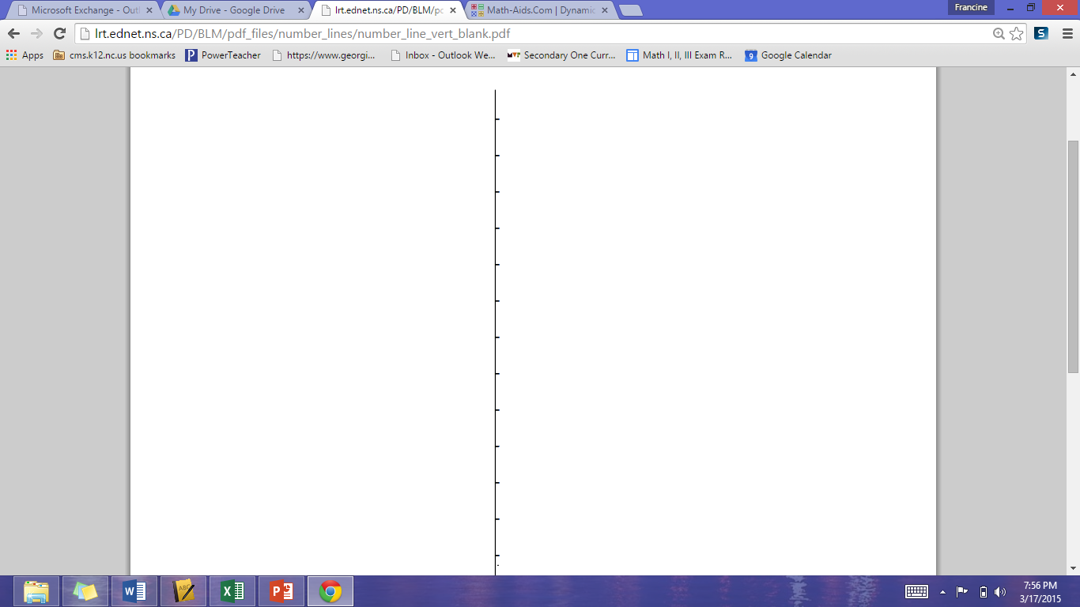

CRITICAL THINKING: FIND THE MIDPOINT OF EACH PAIR OF POINTS
1) (0,0) & (6,12) 2) (2,4) & (6,12) 3) (3, 6) & (6,12) 4) (-3,-6) & (6,12)
12
11
10
9
8
7
6
12
11
10
9
8
7
6
5
4
3
2
1
0
12
11
10
9
8
7
6
5
4
12
11
10
9
8
7
6
5
4
3
2
1
0
-1
-2
-3
-4
-5
-6
Notes:
PURPOSE: You will be able to come up with the Midpoint Formula without me telling you.
What’s the mid(dle) point of x/y? (3,6)
How did you get that? Divide big # by 2
What’s the relationship between the two x-/y-coordinates and the midpoint? Same distance, half of the whole thing
What’s similar/different from the last problem?
2. What’s the mid(dle) point of x’s/y’s? CALL OUT (4,8)
Is it still big # divided by 2? No
How can we use both x-/y-coordinates to find our midpoint? TURN & TALK add both x-/y-coordinates together then divide by 2 SHARE OUT
Possible incorrect response: 6 - 2 = 4, 12 – 4 = 8 (DO NOT WRITE ON BOARD)
3. Use the formula you and your partner came up with in the last problem to find the midpoint first.
Reinforce/check answers with number lines
4. Let’s use the formula [(x1+x2)/2], [(y1+y2)/2] to find the midpoint together. WORK OUT ON BOARD
Reinforce/check with number lines

Slide 5
#1 Distance Formula &
Midpoint Formula

Slide 6
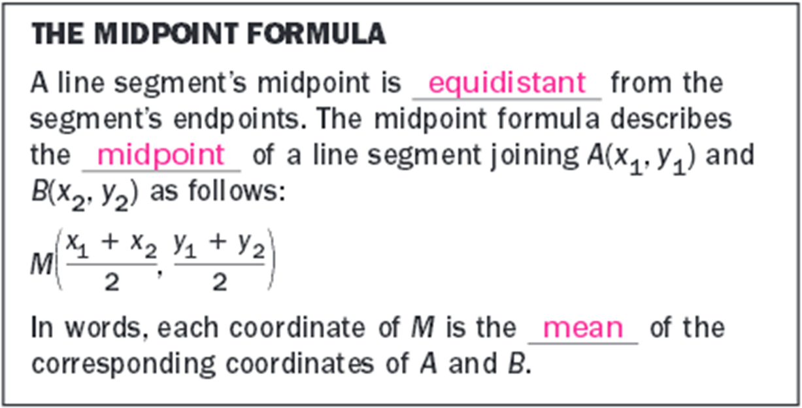
Copy down in Formulas Tab (Purple tab) & Notes

Slide 7
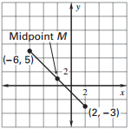
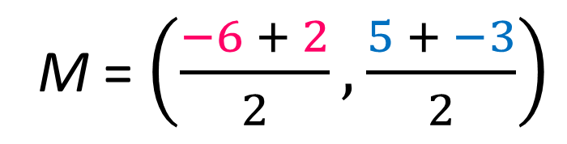
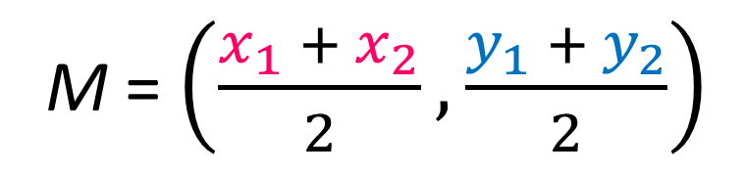
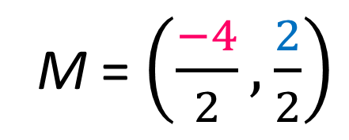
Example 3: Find the midpoint of a line segment.
Find the midpoint of the line segment joining (-6, 5) and (2, -3).
Let (x₁, y₁) = (-6, 5) and (x₂, y₂) = (2, -3).
M = $\left(\frac{x_{1} + x_{2}}{2}, \frac{y_{1} + y_{2}}{2}\right)$
M = $\left(\frac{−6 + 2}{2}, \frac{5 + −3}{2}\right)$
M = $\left(\frac{−4}{2}, \frac{2}{2}\right)$
= (-2, 1)

Slide 8
PRACTICE PROBLEMS
3. Find the midpoint of the line 4. Find endpoint C given endpoint
segment joining (-6, 5) and (1, 1). A(- 5, 6) and midpoint B(3, 2).
(-2.5, 3)

Slide 9
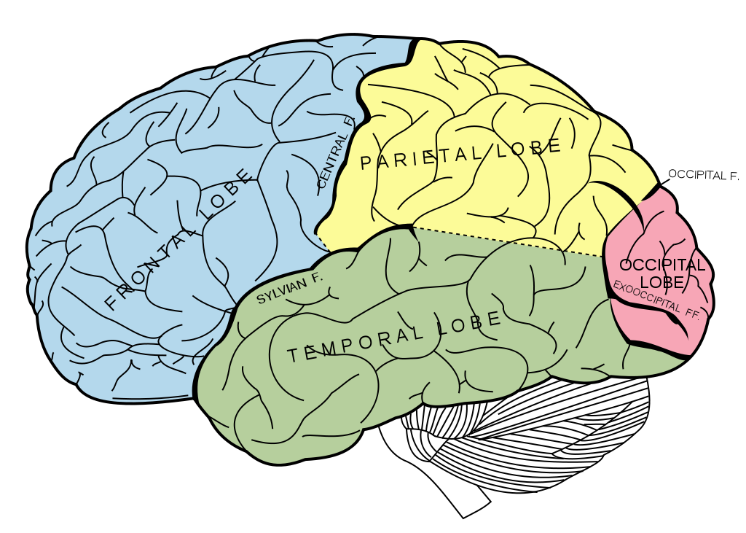

BRAIN BREAK

Slide 10
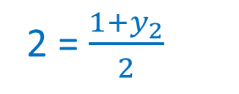
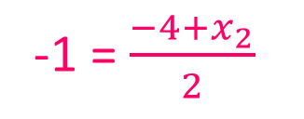
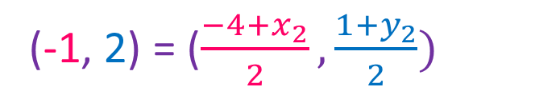
Example 4: Find an endpoint given an endpoint and the midpoint
Given endpoint A(-4, 1) and midpoint B(-1, 2). Find the coordinates for endpoint C.
--Write an equation using the given endpoint and midpoint.
(x_{m}, y_{m}) = (-1, 2)
(x₁, y₁) = (-4, 1)
(x₂, y₂) = endpoint C
(-1, 2) = ($\frac{−4+x_{2}}{2},\frac{1+y_{2}}{2})$
--Set up two equations, one for the x-coordinate and one for the y-coordinate.
-1 = $\frac{−4+x_{2}}{2}$
2 = $\frac{1+y_{2}}{2}$
-2 = -4 + x
4 = 1 + y
2 = x
3 = y
C(2,3)

Slide 11
PRACTICE PROBLEMS
3. Find the midpoint of the line 4. Find endpoint C given endpoint
segment joining (-6, 5) and (1, 1). A(- 5, 6) and midpoint B(3, 2).
(11, -2)

Slide 12
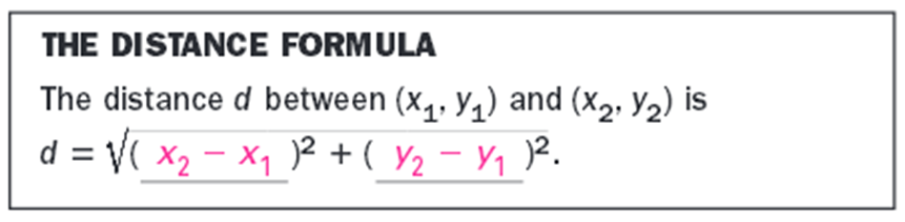
Copy down in Formulas Tab (Purple tab) & Notes

Slide 13
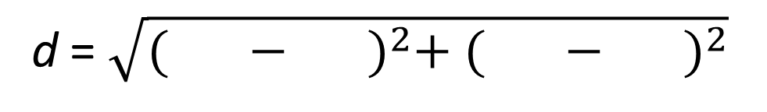
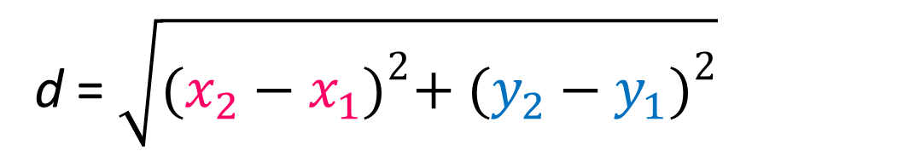
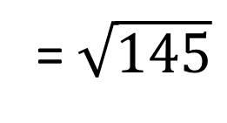
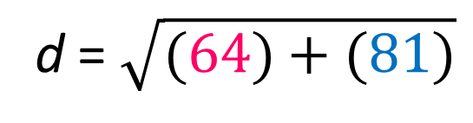
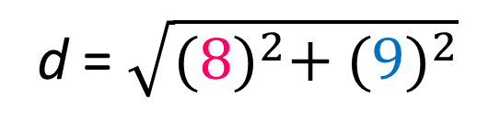
Example 1: Find the distance between two points
Find the distance between (-5, -3) and (3, 6).
Let (x₁, y₁) = (-5, -3) and (x₂, y₂) = (3, 6).
d = $\sqrt{{(x_{2}−x_{1})}^{2}+ {(y_{2}−y_{1})}^{2}}$
d = $\sqrt{{( − )}^{2}+ {( − )}^{2}}$
3
-5
6
-3
d = $\sqrt{{(8)}^{2}+ {(9)}^{2}}$
d = $\sqrt{(64)+(81)}$
= $\sqrt{145}$

Slide 14
PRACTICE PROBLEMS
1. Find the distance between 2. The vertices of a triangle are T(2, 1),
(-7, 3) and (5, -2). U(4, 6), and V(7,3). Classify DTUV as
scalene, isosceles, or equilateral.
13

Slide 15
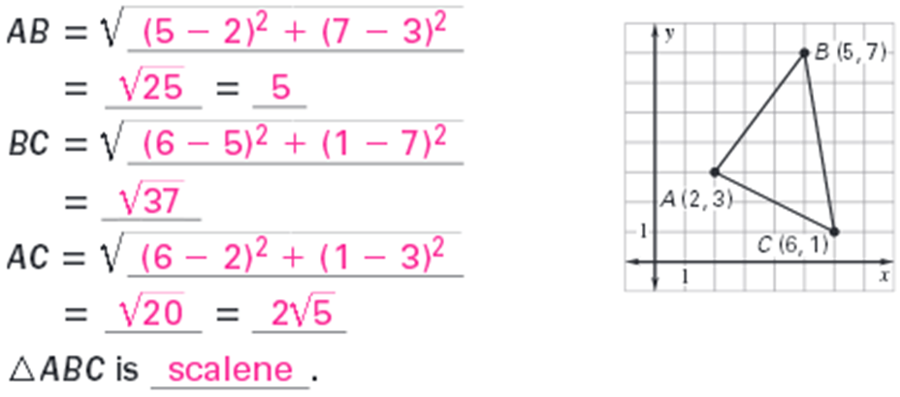


Example 2: Classify a triangle using the distance formula.
Classify ΔABC as scalene, isosceles, or equilateral.
5
$$\sqrt{37}$$
REMEMBER!
Scalene → ______ sides equal
Isosceles → ______ sides equal
Equilateral → ______ sides equal
$$2\sqrt{5}$$
0
2
3

Slide 16
PRACTICE PROBLEMS
1. Find the distance between 2. The vertices of a triangle are T(2, 1),
(-7, 3) and (5, -2). U(4, 6), and V(7,3). Classify DTUV as
scalene, isosceles, or equilateral.
isosceles

Slide 17
BRAIN BREAK

Slide 18
Homework
#1 Distance & Midpoint Formula in HW Packet

Slide 19
Exit Ticket
Use the triangles to the right to find the coordinates needed to solve the following:
Find the distance of DF.
Find the midpoint of SQ.

