Slide 1
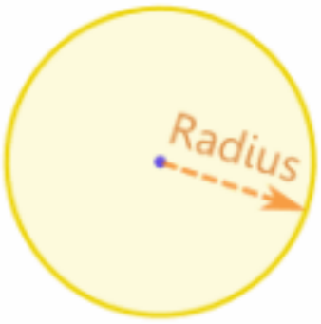
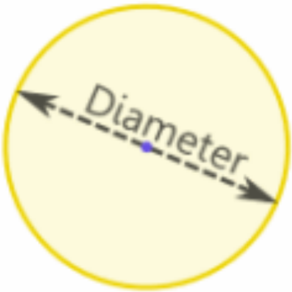
ANNOUNCEMENTS -Pick up your assigned calculator -Sit in old seats
WARM UP
Copy the following into your Vocab Section (Purple tab!)
Radius – the distance from the center of a circle to an endpoint
Diameter – the distance between two endpoints of a circle that passes through the center
Circle – the set of all points that are the same distance from the center
Update your TOC.

Slide 2
#1 Equations of a Circle

Slide 3
Homework
#1 in HW Packet

Slide 4
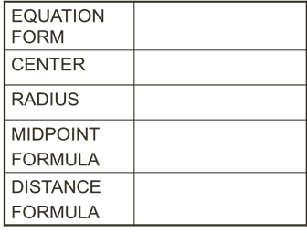
(x – h)² + (y – k)² = r²
(h, k)
r
$$\left(\frac{x_{1}+x_{2}}{2},\frac{y_{1}+y_{2}}{2}\right)$$
$$\sqrt{{(x_{2}−x_{1})}^{2}+{(y_{2}−y_{1})}^{2}}$$

Slide 5
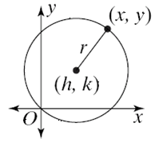
Key Information
The center of the circle: ______________
The radius of the circle: ______________
Any point on the circle: _______________
The equation of the circle: ______________________________
(h,k)
r
(x, y)
(x – h) ² + (y – k) ² = r²
r is the radius of the circle, so if we take the square root of the right side of this equation, we’ll know how big the radius is.

Slide 6
Writing Equations of Circles
(x – h)² + (y – k)² = r²
(x – 4)² + (y – 7)² = 25
(x + 3)² + (y – 8)² = 38.44
(x – 2)² + (y + 9)² = 11
x² + (y – 6)² = 7
(x + 1.9)² + (y – 8.7)² = 9

Slide 7
Error Analysis
A student says that the center of a circle with equation: (x – 2)² + (y + 3) ² = 16 is (-2, 3). What is the student’s error? How should the equation be written in order for the student to be correct?
(x + 2)² + (y – 3) ² = 16

Slide 8
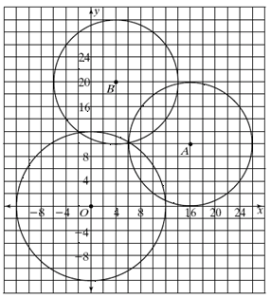
Finding the Equation of a Circle, Given the Graph
CIRCLE A
Center: _________
Radius: _________
Equation: ________________________
CIRCLE B
Center: _________
Radius: _________
Equation: ________________________
CIRCLE O
Center: _________
Radius: _________
Equation: ________________________
(16, 10)
10
(x – 16)² + (y – 10)² = 100
(4, 20)
10
(x – 4)² + (y – 20)² = 100
(0, 0)
12
x² + y² = 144

Slide 9
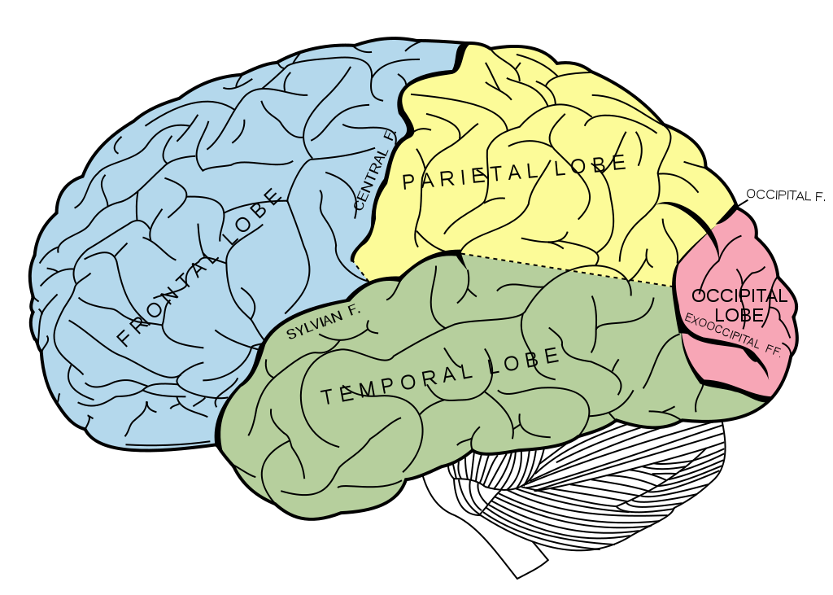
BRAIN BREAK #1

Slide 10
Graphing Circles

Slide 11
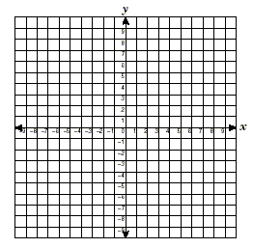
Graphing Circles
(x – 3)² + (y – 2)² = 9
Center: ________
Radius: ________
(x – 5)² + y² = 36
Center: ________
Radius: ________
(x + 4)² + (y – 1)² = 25
Center: ________
Radius: ________
(3, 2)
3
(5, 0)
6
(– 4, 1)
5

Slide 12
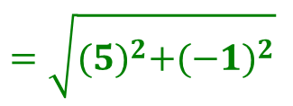
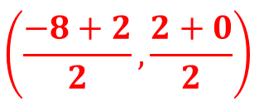
Application Problem: Suppose you know the endpoints of a circle. How do you determine the equation of the circle, if you don’t know the radius or center?
CIRCLE with ENDPOINTS at (-8, 2) and (2, 0).
We need to find the CENTER!
$$\left(\frac{x_{1}+x_{2}}{2},\frac{y_{1}+y_{2}}{2}\right)$$
Use the Midpoint Formula!
$$\left(\frac{−8+2}{2},\frac{2+0}{2}\right)$$
= $\left(−3,1\right)$
We need to find the RADIUS!
$$\sqrt{{(x_{2}−x_{1})}^{2}+{(y_{2}−y_{1})}^{2}}$$
($−$8, 2)
Use the Distance Formula!
$\left(−3,1\right)$
$$\sqrt{26}$$
$$\sqrt{{(2−(−3))}^{2}+{(0−1)}^{2}}$$
$$=\sqrt{{(5)}^{2}+{(−1)}^{2}}$$
(2, 0)
$$=\sqrt{25+1}$$
$$=\sqrt{26}$$
(x – h) ² + (y – k) ² = r²
(x – (–3))² + (y – 1)² = $\sqrt{26}$²
(x + 3)² + (y – 1)² = 26

Slide 13
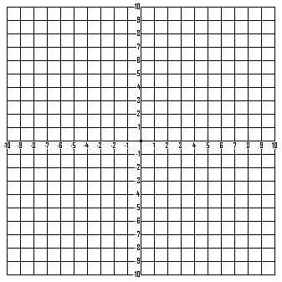
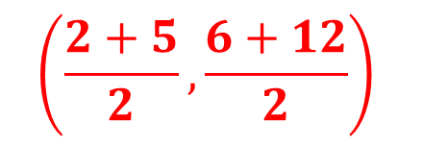
PRACTICE PROBLEM: Find the center, the radius, and write the equation for the circle whose diameter has endpoints at (2, 6) and (5, 12).
Center: (3.5, 9)
$$\left(\frac{2+5}{2},\frac{6+12}{2}\right)$$
Radius: $\sqrt{11.25}$
$$\sqrt{{(3.5−2)}^{2}+{(9−6)}^{2}}$$
Equation: (x – 3.5)² + (y – 9)² = 11.25

Slide 14
BRAIN BREAK #2

Slide 15
Homework
#1 in HW Packet

Slide 16
Exit Ticket
Write the standard equation for a circle with the following:
center (2, 3); radius = 5
center (0,-1); radius = $\sqrt{7}$
What is the center and radius of each circle?
(x – 4)² + (y – 3)² = 16
(x + 7)² + y² = 10

