Slide 1
ANNOUNCEMENTS
-Pick up your assigned calculator
-Pick up Unit 3 HW Packet
-Check your file for School Beautification Project grades
WARM UP
Copy down the following into your
Vocabulary Section! (purple tab)
  Domain: the set of all possible input values (usually
  “x”) which produce a valid output
  Range: the set of all possible output values (usually “y”
  or “f(x)”) which results from using a particular function
  Even Function: occurs when the graph is symmetric
  with respect to the y-axis; when f(x) = f(-x)
  Odd Function: occurs when the graph is symmetric with respect to the origin; when –f(x) = f(-x)
Label “Unit 3” on page 19
Glue Transformation Rules chart to top of page 20.
Update TOC.

Slide 2
#1 Parent Functions & Transformations:
Absolute Value & Quadratic

Slide 3
Absolute Value Discovery!
Before I teach you about algebraic transformations (changing the graphs of functions), I want you to try to discovery the rules on your own!
#1 in HW Packet (only Absolute Value Discovery)
20 min

Slide 4
I. Use a table of values to graph y = x.
x | -5 | -4 | -3 | -2 | -1 | 0 | 1 | 2 | 3 | 4 | 5
y
-5
-4
-3
-2
-1
0
1
2
3
4
5
What shape is the graph?
____________________________________________
line

Slide 5
II. Use a table of values to graph y = |x|.
x | -5 | -4 | -3 | -2 | -1 | 0 | 1 | 2 | 3 | 4 | 5
y
5
4
3
2
1
0
1
2
3
4
5
What shape is the graph?
______________________
Why is the graph this shape?
___________________________________________________________________________
v
For all input values inside absolute value bars, the outputs are positive.

Slide 6
So what did you discover about transformations?!

Slide 7
TRANSFORMATION RULES
f(x) | Parent function
f(x + h) | Horizontal shift h-units to the left
f(x – h) | Horizontal shift h-units to the right
f(x) + k | Vertical shift k-units up
f(x) – k | Vertical shift k-units down
a f(x), a > 1 a f(x), a < 1 | Vertical stretch of f(x) → gets narrower Vertical compression of f(x) → gets wider
-f(x) | Vertical reflection/flip of f(x) (over x-axis)

Slide 8
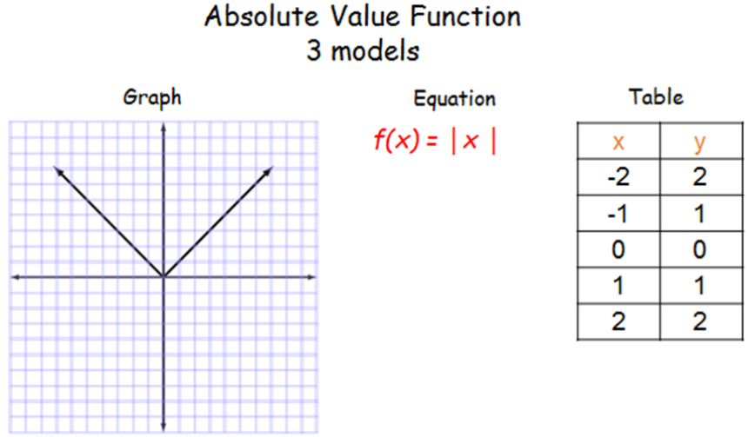
Domain: (-∞, ∞)
Range: [0, ∞)
Even or Odd

Slide 9
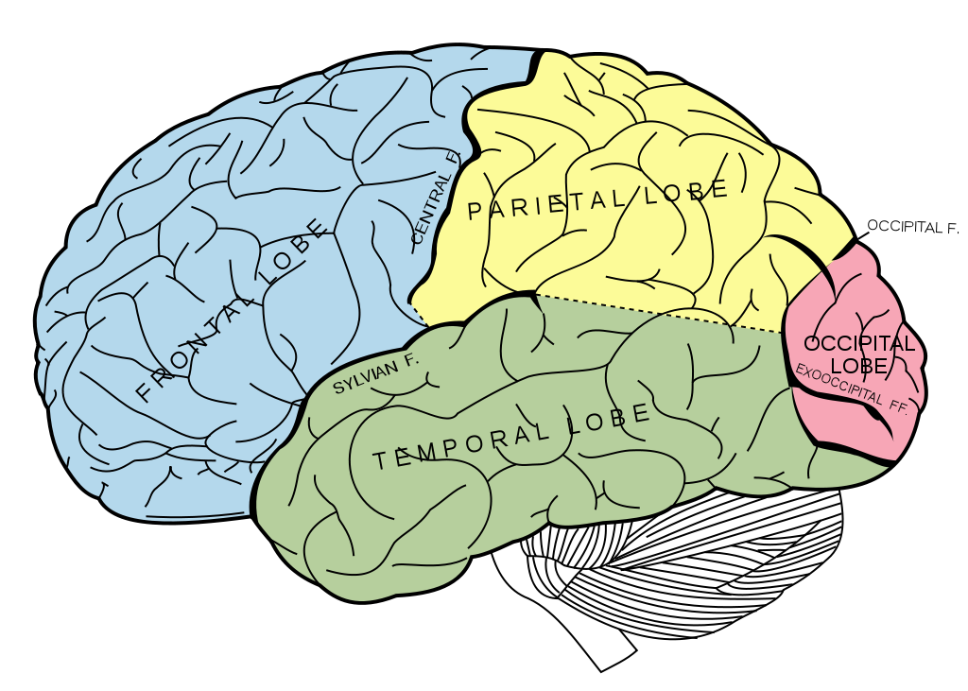

BRAIN BREAK

Slide 10
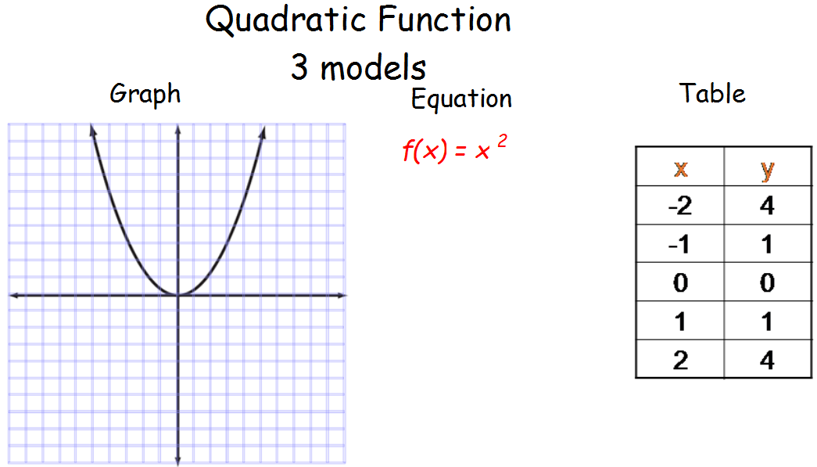
Domain: (-∞, ∞)
Range: [0, ∞)
Even or Odd

Slide 11
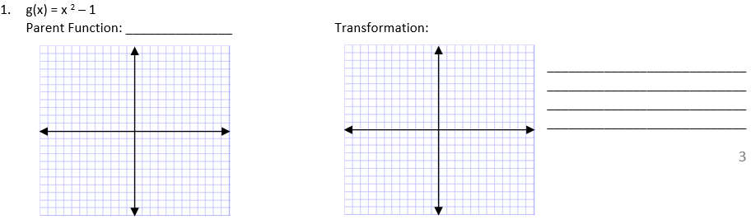
PRACTICE: HW Packet – Page 3
QUADRATIC: Directions: Identify each parent function, graph the transformation, and describe the transformation in words.

Slide 12
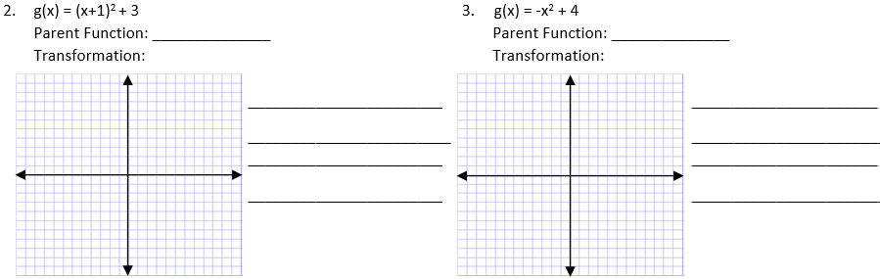
PRACTICE: HW Packet – Page 4
QUADRATIC: Directions: Identify each parent function, graph the transformation, and describe the transformation in words.

Slide 13
BRAIN BREAK

Slide 14
Homework
#1 PARENT GRAPHS & TRANSFORMATIONS in HW Packet (finish Absolute Value Discovery AND Quadratic Transformations)

Slide 15
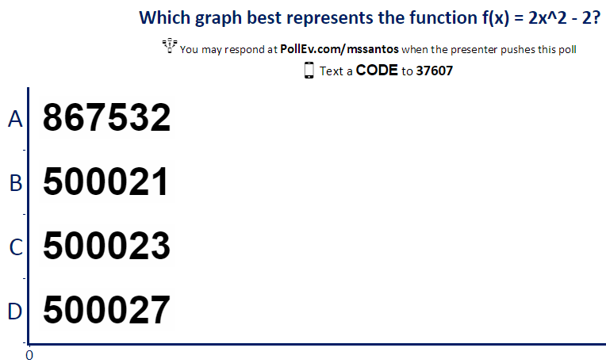
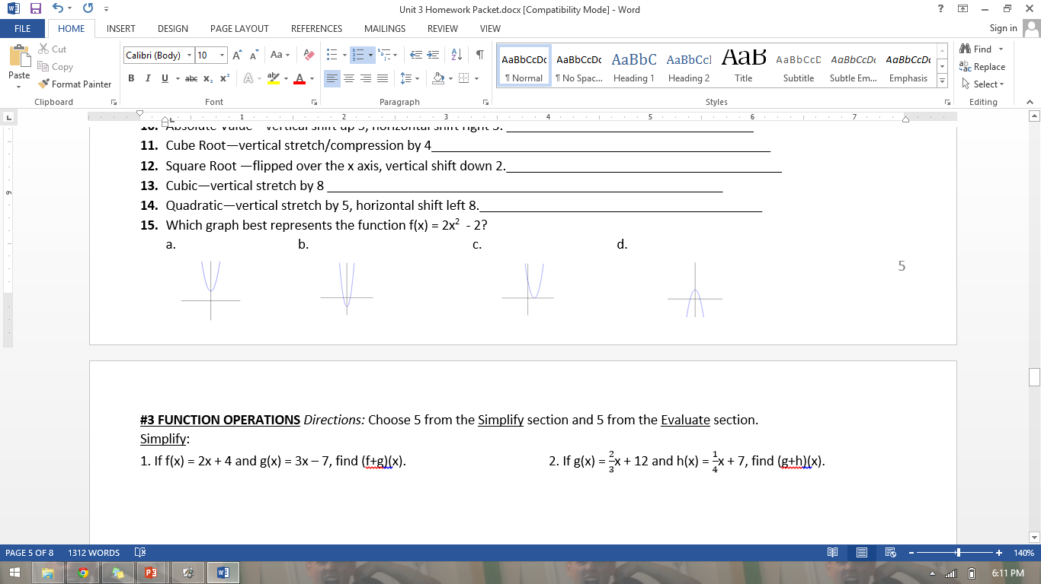
Exit Ticket

Slide 16
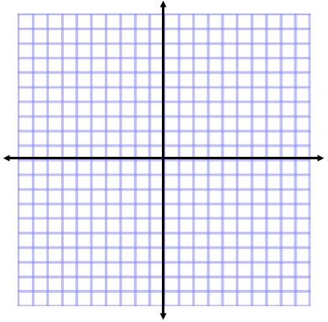
ANNOUNCEMENTS
-Pick up your assigned calculator
-Take out HW to stamp
-Turn in your Unit 2 corrections
WARM UP
f(x) = -|x+2| - 5
What is the parent function?
Describe the transformations.
Graph the transformation.
Update TOC.
f(x) = |x|
Flip over x-axis,
Left 2 units,
& Down 5 units

Slide 17
#1 Parent Functions & Transformations:
Square Root, Cube Root, & Cubic

Slide 18
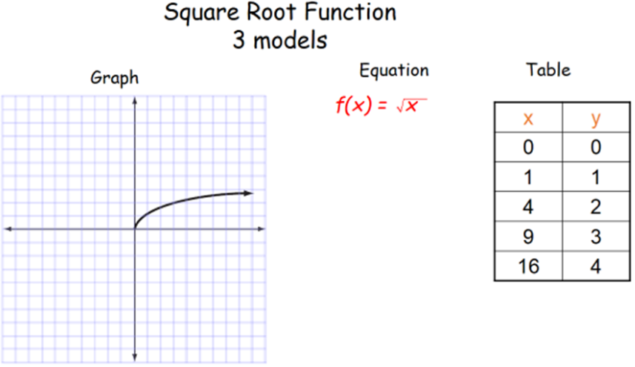
Domain: [0, ∞)
Range: [0, ∞)
Even or Odd
NEITHER!

Slide 19
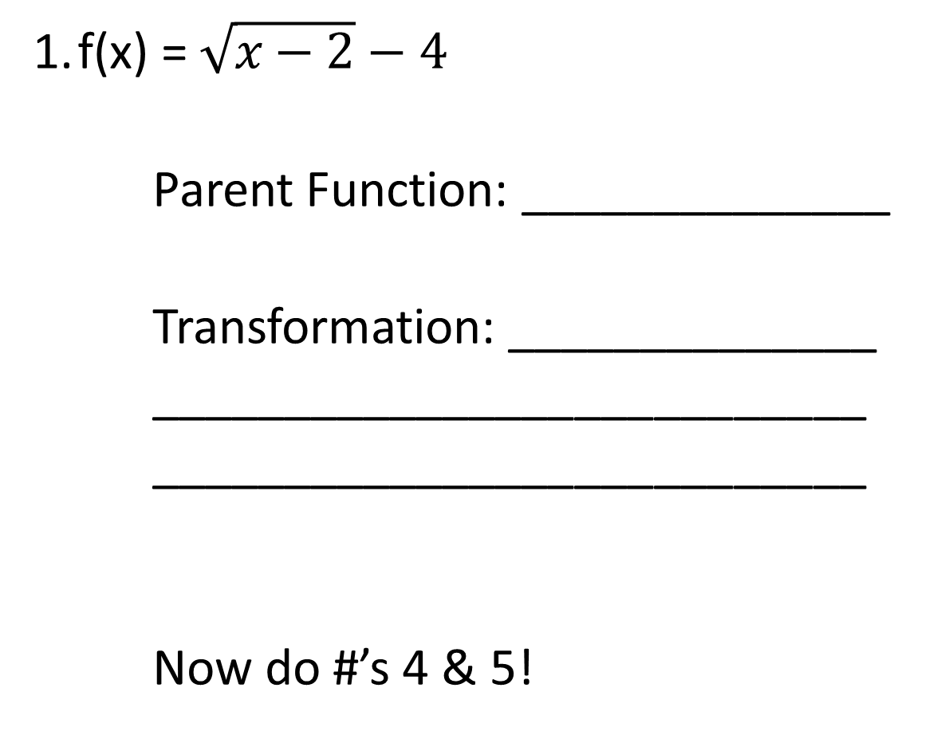
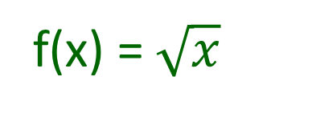
HOMEWORK PACKET!
f(x) = $\sqrt{x−2}−4$
Parent Function: ______________
Transformation: ______________
___________________________
___________________________
Now do #’s 4 & 5!
f(x) = $\sqrt{x}$
shift right 2 units
and shift down 4 units

Slide 20
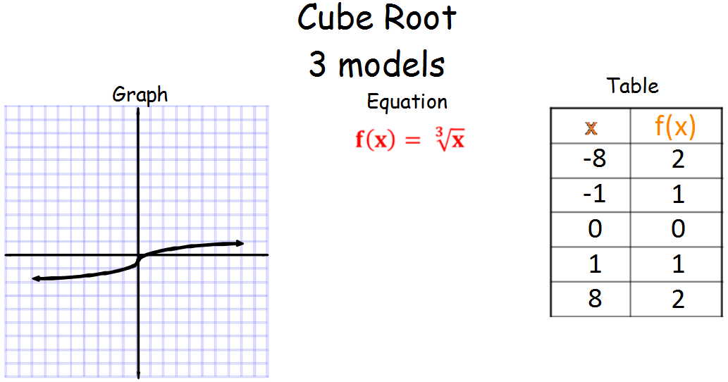
–
–
Domain: (-∞, ∞)
Range: (-∞, ∞)
Even or Odd

Slide 21
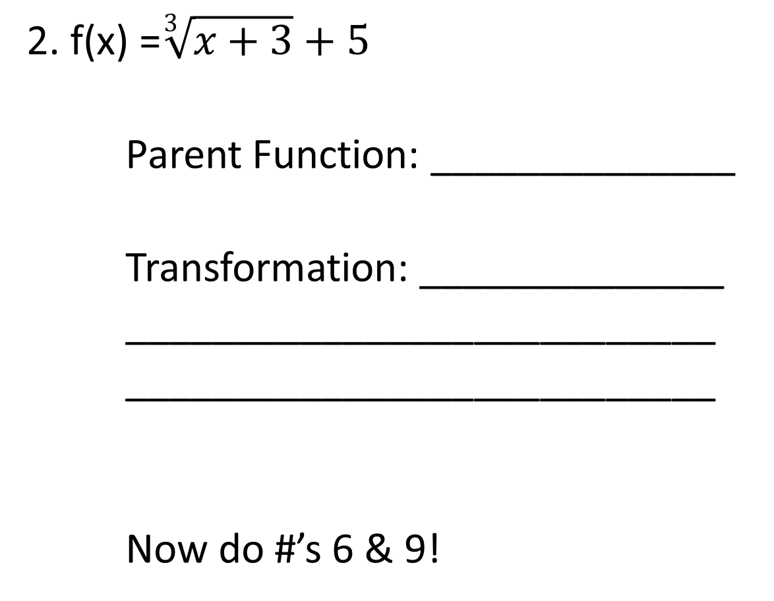
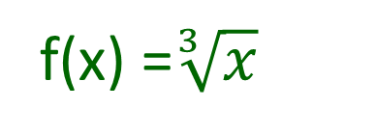
HOMEWORK PACKET!
2. f(x) =$\sqrt[3]{x+3}+5$
Parent Function: ______________
Transformation: ______________
___________________________
___________________________
Now do #’s 6 & 9!
f(x) =$\sqrt[3]{x}$
shift left 3 units
and shift up 5 units

Slide 22
BRAIN BREAK

Slide 23
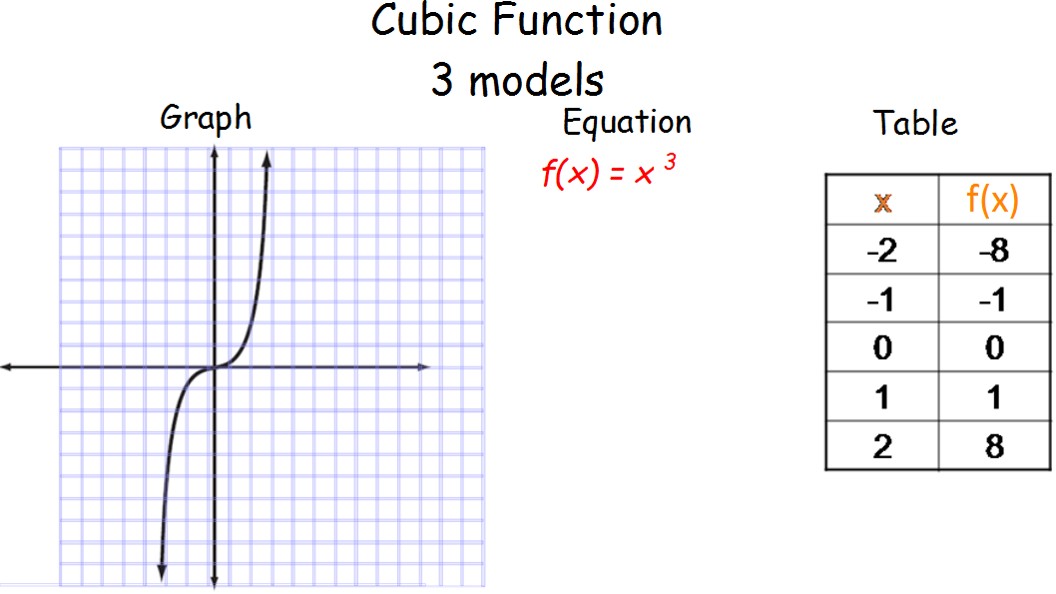
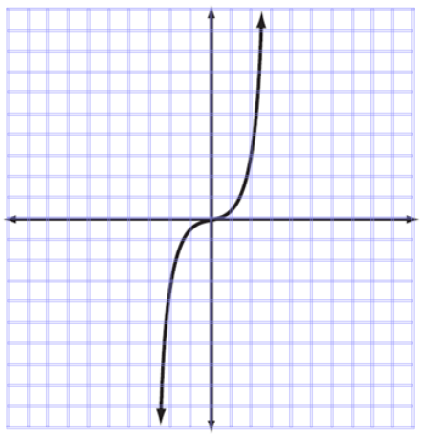
Domain: (-∞, ∞)
Range: (-∞, ∞)
Even or Odd

Slide 24
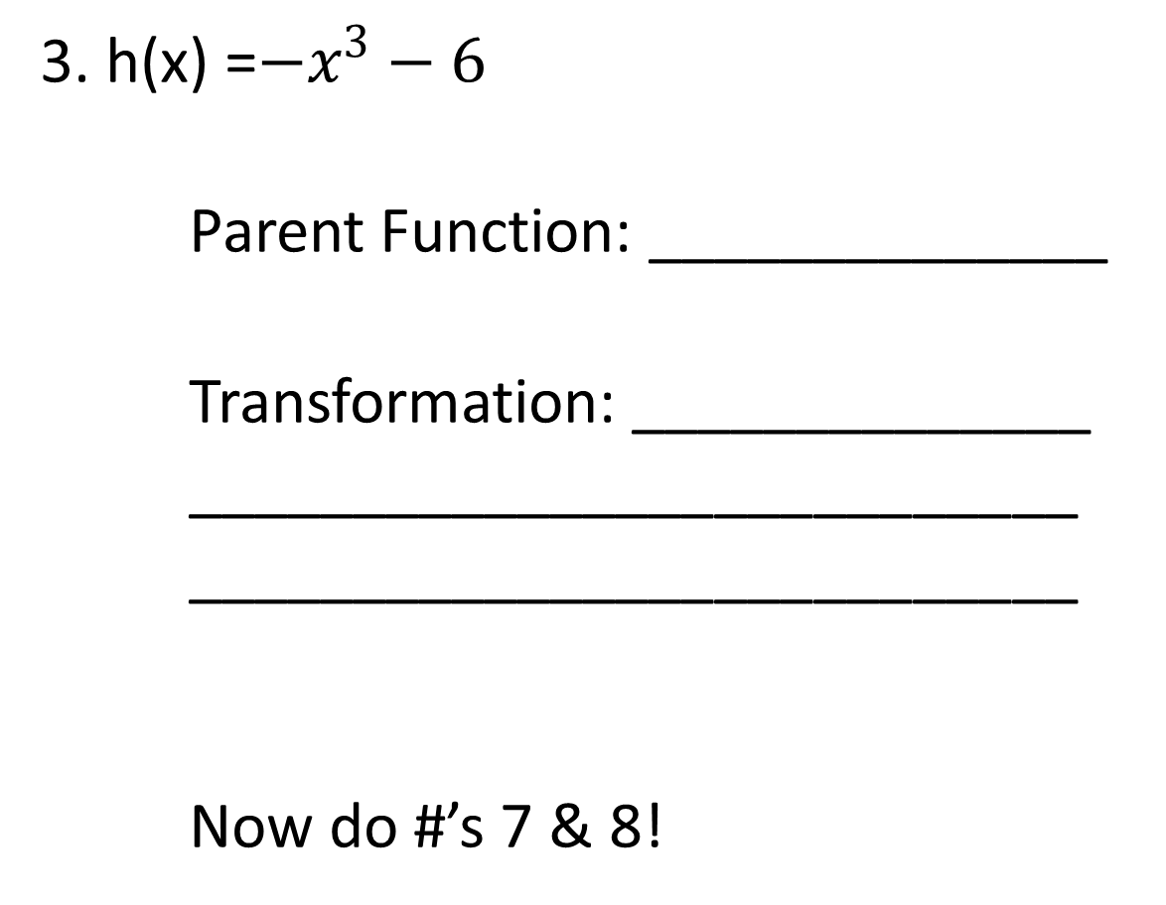
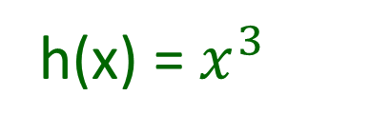
HOMEWORK PACKET!
3. h(x) =${−x}^{3}−6$
Parent Function: ______________
Transformation: ______________
___________________________
___________________________
Now do #’s 7 & 8!
h(x) =${ x}^{3}$
reflect over the x-axis
and shift down 6 units

Slide 25
BRAIN BREAK

Slide 26
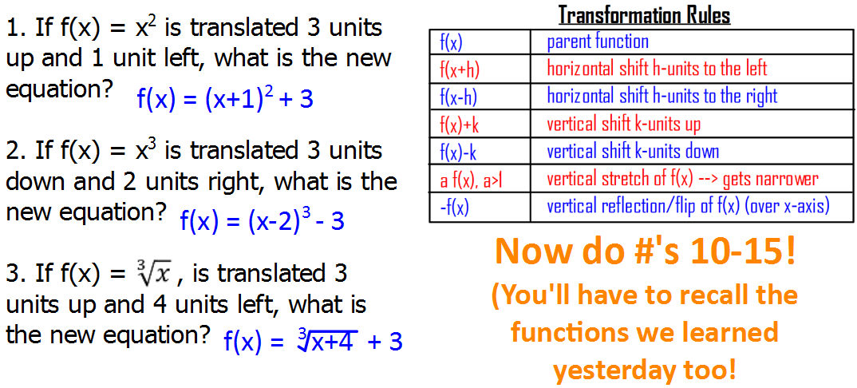
TRANSLATING PARENT FUNCTIONS
Now do #’s 10-14!
(You’ll have to recall the functions we learned yesterday too!)

Slide 27
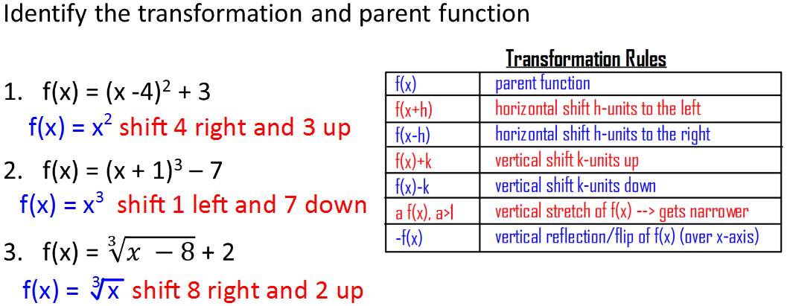
IDENTIFYING TRANSFORMATIONS

Slide 28
Homework
#1 PARENT GRAPHS & TRANSFORMATIONS: SQUARE ROOT, CUBE ROOT, & CUBIC (PAGE 4) in HW Packet (whatever you didn’t finish)

Slide 29
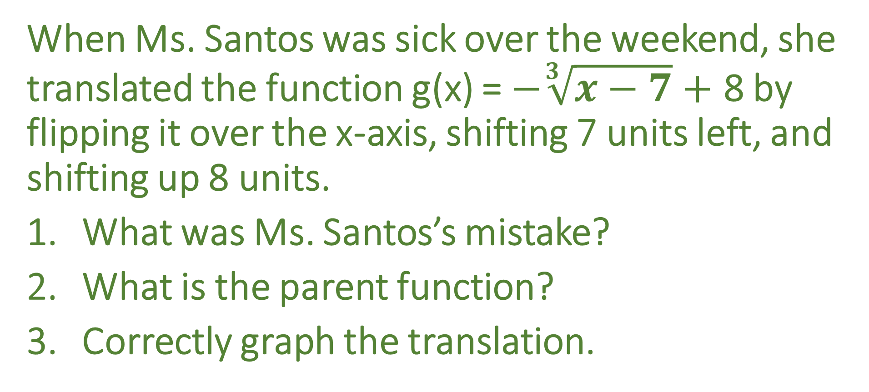
Exit Ticket
When Ms. Santos was sick over the weekend, she translated the function g(x) = $−\sqrt[3]{x−7}+$ 8 by flipping it over the x-axis, shifting 7 units left, and shifting up 8 units.
What was Ms. Santos’s mistake?
What is the parent function?
Correctly graph the translation.

Slide 30
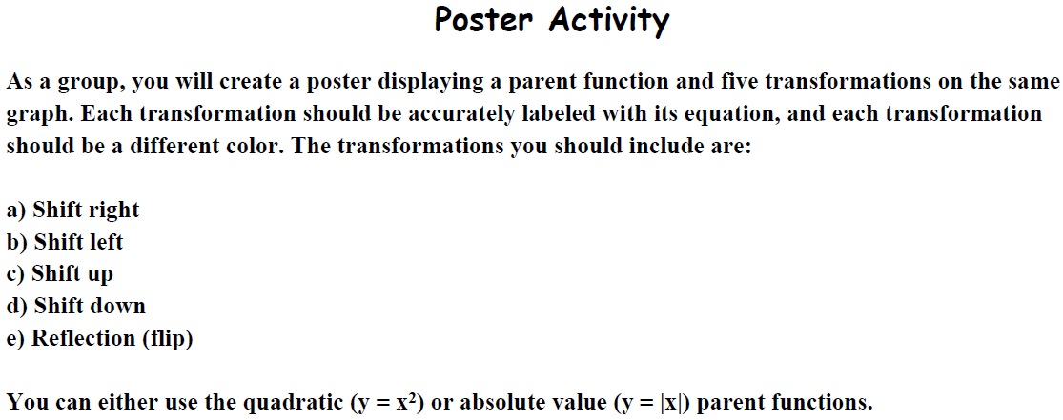
20 min.
With a partner,

