Slide 1
ANNOUNCEMENTS -Pick up your assigned calculator -Turn in Unit 5 HW Packet
WARM UP
Use the distance formula to find the distance between points A and B on the following coordinate plane. (Hint: page in notes → d = $\sqrt{{(x_{2}−x_{1})}^{2}+{(y_{2}−y_{1})}^{2}})$
Update your TOC. Glue #1 notes onto pg. 44.
(0,5)
(4, 0)

Slide 2
#1 Pythagorean Theorem

Slide 3
What is a right triangle?
It is a triangle which has an angle that is 90º degrees. The two sides that make up the right angle are called legs. The side opposite the right angle is the hypotenuse.

Slide 4
Review!
6
12
10
7
$$\sqrt{95}$$
8

Slide 5
Example: The measures of the sides of a right triangle are 6, 9, and $\sqrt{45}$. Is this a right triangle?
First ask yourself, “What is the longest side?” Take any square roots to get the decimals!
Second, list the sides in order from least to greatest. The biggest side is your hypotenuse!
Then plug into the Pythagorean Theorem and see if it works!
Yes, it is a right triangle!
$$\sqrt{45}=6.7$$
6, $\sqrt{45}$, 9
6² + $\sqrt{45}$² = 9²
36 + 45 = 81

Slide 6
Practice Problem: A triangle has sides measuring $\sqrt{39}$, 7, and 3. Is this a right triangle?
No, it is not a right triangle!
(Make sure you work this out on your notes to show Ms. Santos during the brain break!)

Slide 7
a²
b²
c²
a
c
b
5
4

Slide 8
Raise your hand when you have the answers to both. Ms. Santos will come by to check your work. Then you can take your brain break!

Slide 9
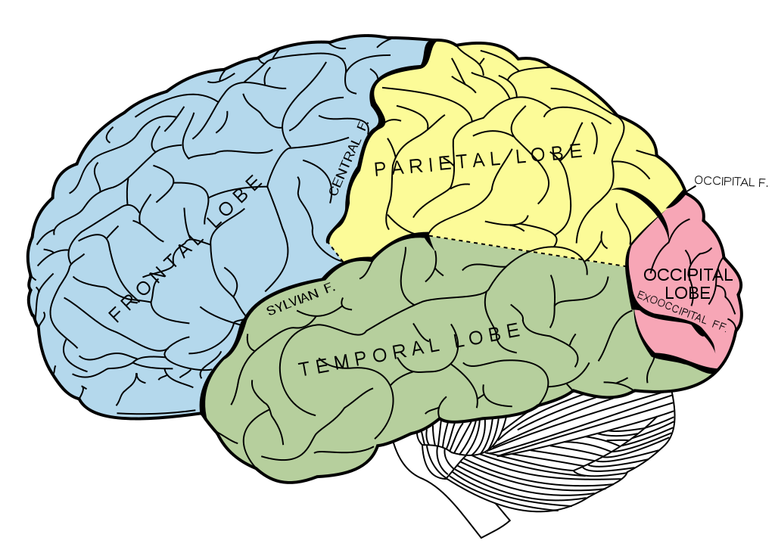
BRAIN BREAK

Slide 11
Unit 6 New Celebration Format
Instead of having one big Celebration of Knowledge at the end of the unit, we are going to have mini celebrations instead of the warm up each day.
You will have the first 5 minutes of class to review the notes from the day before.
When the 5 minutes are up, you will have 15 minutes to complete the celebration questions that correspond to the previous day’s lesson.
As you are completing the celebration questions, I will pass back the questions from the day before, so you can see what you got. You will need to return them to me when you turn in your current questions.
You will get all the questions back on the last day of the unit to do any necessary corrections, if your total grade is less than an 85% (Standard) or 93% (Honors).
If you are absent (unexcused) or late to class and missed the Celebration Questions, you will receive a 0 and have to make it up during lunch, after school, or on the last day of the unit.

Slide 12
Homework
None! Work on Unit 5 Celebration Corrections!

Slide 13
Exit Ticket
Name two methods to determine the distance between two points on a coordinate plane.
Which method do you prefer and why?

Slide 14
BRAIN BREAK

