Slide 1
ANNOUNCEMENTS -Pick up your assigned calculator -Find your NEW Team to sit at! -Pick up all materials from front -Unit 1 Corrections due today!
WARM UP
Glue both sheets from front (not HW Packet) onto page 10 of ISN.
Update TOC. Include a line labeling “Unit 2.”

Slide 2
Housekeeping Items!
Page 10 – Linear-Quadratic Systems
Green Tab – Objective Tracker & Unit Tracker

Slide 3
CELL PHONE POLICY
NO PHONES except during brain breaks! (3 min each x3)
HEADPHONES OUT:
Instruction – when Ms. Santos is teaching
Projects
Quizzes
Celebrations
HEADPHONES IN: (1 ear only)
Warm Up
Exit Ticket
Individual Practice
Group Work

Slide 4
#1 Rational Expressions & Restrictions

Slide 5
Vocabulary!
Restriction: occurs when a rational expression is undefined; when the denominator equals zero; also called extraneous root/solution

Slide 6
Example: For what value of x is $\frac{x^{2}−2x−15}{4x−20}$ undefined?
4x – 20 = 0
+20 +20
x ≠ 5
4x = 20
4 4
x = 5

Slide 7
Find the Restrictions: $\frac{y^{2}+3y+2}{y^{2}−1}$
y² – 1 = 0
y ≠ 1
(y + 1)(y – 1) = 0
y + 1 = 0 y – 1 = 0
-1 -1
+1 +1
y = -1
y = 1

Slide 8

Partner Practice
1. $\frac{5x−10}{5x}$ 2.$\frac{2x^{2}+x}{{3x}^{2}+2x}$ 3. $\frac{a^{2}−9}{a^{2}+2a−15}$ 4. $\frac{x−4}{4−x}$
x ≠ 0
x ≠ 0, -²/₃
a ≠ -5, 3
x ≠ 4

Slide 9

SIMPLIFYING Rational Expressions
Method 1: Divide out Common Factors
x ≠ 7
$$\frac{5x}{5(x−7)}$$
STEPS to DIVIDE OUT COMMON FACTORS:
Identify any factors which are common to both the numerator and the denominator.
Cancel out the common factors.
x .
x-7 .

Slide 10
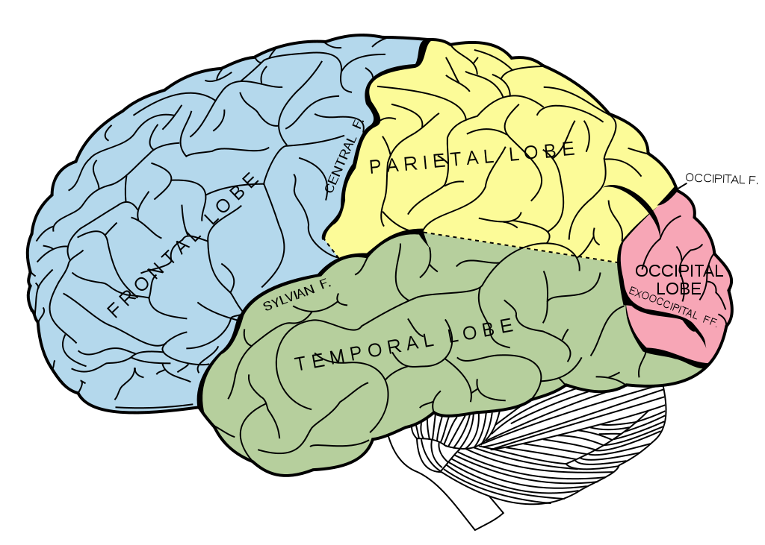
BRAIN BREAK #1

Slide 11

SIMPLIFYING Rational Expressions
Method 2: Factoring the Numerator and the Denominator
x ≠ 0
$$\frac{3x^{2}+9x}{12x^{3}}$$
STEPS to FACTORING THE NUMERATOR AND DENOMINATOR:
Factor the numerator
Factor the denominator
Cancel out the common factors.
Simplify!
3x(x+3) .
3▪4▪x▪x▪x
x+3 .
4x²

Slide 12
Whiteboard Practice!
#4 in HW Packet
Individually, work out the problems on your whiteboard one at a time, numbering each problem as you work.
Be sure to identify any restrictions, and box your final answer.
Hold up your board when you finish the problem and wait for a “yes” thumbs up or “no” thumbs down from Ms. Santos
If you got a thumbs up, write the final answer in your HW Packet and move on to the next problem.
If you got a thumbs down, rework the problem and try again.

Slide 13
BRAIN BREAK #1

Slide 14
Homework
#1 in HW Packet (show work for whatever you didn’t finish)

Slide 15
Exit Ticket
Use the expression $\frac{{3x}^{2} −27}{x^{2} −9}$ to answer the following:
Simplify the expression.
Scottie Pippen found the restriction to be x = 3. Is he right or wrong? If he is wrong, what was his error?
When is the expression undefined?

