Slide 1
ANNOUNCEMENTS -Find your new team -Pick up your assigned calculator
WARM UP
Use prior knowledge to define and draw an example of each of the following angles on your WHITEBOARD:
Acute Right Obtuse Straight
< 90º = 90º > 90º but < 180º = 180º
ON YOUR WARM UP SHEET: Write down the name of one of your classmates who you think embodies all 5 TRAIL traits the best and explain why you chose that person. (The TRAIL traits are Teamwork, Resourcefulness, Attitude, Integrity, & Leadership – poster next to door)
Create a cover page for Quarter 2 on page 31. Decorate it and color it however you want!
Update TOC.

Slide 2
ARE YOU READY FOR THE ACT?!
62% of the questions from your midterm were taken directly from old ACTs!
Midterm Corrections due Monday, 4/13 (the day we come back from spring break!!)
1st Period
63%
3rd Period
66%
4th Period
82%

Slide 3
KAHOOT!!
On your laptop, tablet, or iPad…
Open up a web browser (it doesn’t matter which one) and go to kahoot.it
Enter in the Game Pin: 1111
Enter your name (real name please!) & enjoy the music suspenseful music while we wait for everyone to join the game!

Slide 4
Homework
#1 Types of Angles in HW Packet – (If your file # is odd, do odds only. If your file # is even, do evens only.)

Slide 5
#1 Types of Angles

Slide 6
Complementary
Supplementary
34º
Complementary
124º
68º
158º
Neither
Notes:
90 – 56 = 34
180 – 56 = 124
90 – 22 = 68
180 – 22 = 158

Slide 7
90º = 3x + 5 + 2x
90 = 5x + 5
85 = 5x
17º = x
∠LMN = 3(17)+5º
= 51 + 5 = 56º
∠UVW = 2(17)º
= 34º
∠KLM = 30º
∠KLB = 60º
∠ABC = 65º
∠DBE = 115º

Slide 8
vertex
noncommon
intersecting
adjacent
adjacent & linear
not adjacent
∠1 & ∠6, ∠2 & ∠5
∠1 & ∠2, ∠5 & ∠6, ∠1 & ∠5, ∠2 & ∠6, ∠3 & ∠4
∠3

Slide 9
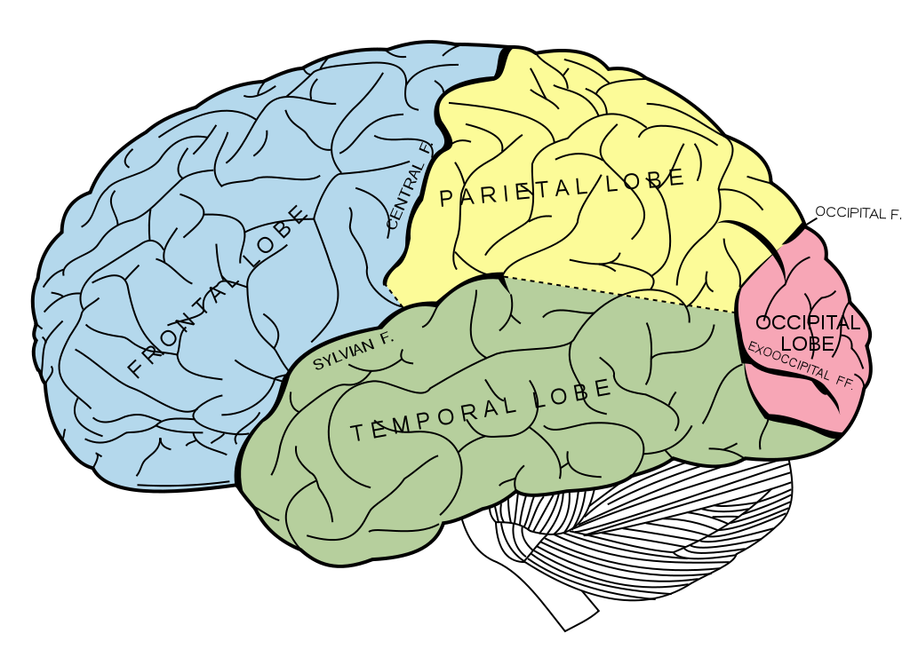
BRAIN BREAK

Slide 10
12º
x + 30 = 5x – 10
30 = 4x – 10
40 = 4x
10º = x
(10) + 30 = 40º
5(10) – 10 = 40º
x = 12º
x = 43º

Slide 11
∠PQR
Notes:
EXAMPLE 1: 31 + 52 = 83
EXAMPLE 2: 176 – 130 = 46
EXAMPLE 3: 145 = 10x + 2x + 13
145 = 12x + 13
132 = 12x
11 = x
2(11) + 13 = 35
EXAMPLE 4: 17x + 8 = 42 + 12x – 4
17x + 8 = 38 + 12x
5x + 8 = 38
5x = 30
x = 6
17(6) + 8
110

Slide 12
∠KLU = 90º
∠IJA = 92º
x = 9º
x = 5º
Notes:
5: 110 – 20 = 90
6: 153 – 61 = 92
7: 16x + 4 = 110 + 3x + 11
16x + 4 = 3x + 121
13x + 4 = 121
13x = 117
x = 9
8: 175 = 17x – 3 + 17x + 8
175 = 34x + 5
170 = 34x
5 = x

Slide 13
BRAIN BREAK #2

Slide 14
Homework
#1 Types of Angles in HW Packet – (If your file # is odd, do odds only. If your file # is even, do evens only.)

Slide 15
Exit Ticket
Copy the following into your Vocab Section! (Purple tab!)
Complementary Angles: sum of angle measures is 90º
Supplementary Angles: sum of angle measures is 180º
Adjacent Angles: angles that have the same vertex and share a common side
Linear Angles: adjacent angles whose noncommon sides are opposite rays
Vertical Angles: nonadjacent angles formed by two intersecting lines

