Slide 1
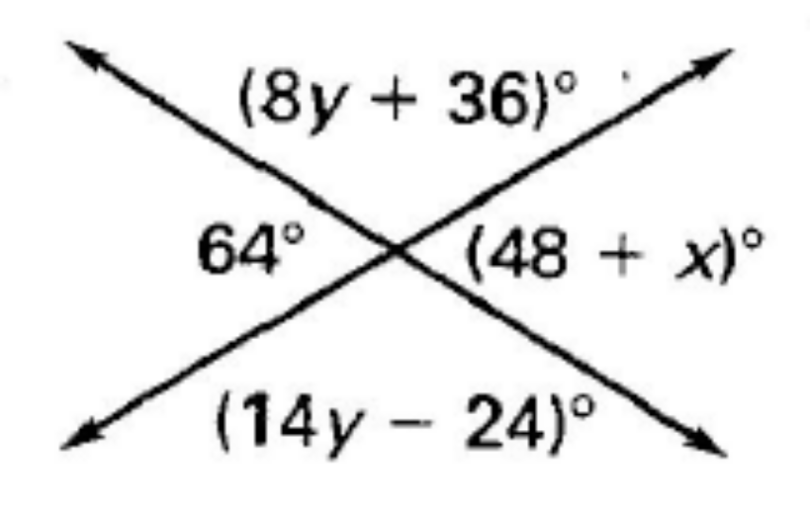
ANNOUNCEMENTS -Pick up your assigned calculator -Take out your homework to stamp
WARM UP
Find the values of x and y.
Copy down the following vocabulary words (purple tab!)
Congruent: the same
Parallel Lines: lines that are the same distance apart and will never intersect; example:
Transversal: a line that intersects two or more lines in the same plane; example:
Update your TOC and glue notes onto page 32.

Slide 2
#2 Angle Relationships

Slide 3
In the diagram, a and b are parallel lines.
This mean they never intersect.
You can also use the parallel symbol to say this: a||b.
Line c is called the transversal because it passes through both parallel lines.

Slide 4
Angles in matching corners (same side of transversal and same side of their parallel line)
∠1 & ∠5
∠2 & ∠6
∠3 & ∠8
∠4 & ∠7
Angles that are on opposite sides of the transversal and inside the parallel lines
∠3 & ∠6
∠4 & ∠5
Angles that are on the same side of the transversal and inside the parallel lines
∠3 & ∠5
∠4 & ∠6
Angles that are on opposite sides of the transversal and outside the parallel lines
∠1 & ∠7
∠2 & ∠8

Slide 6
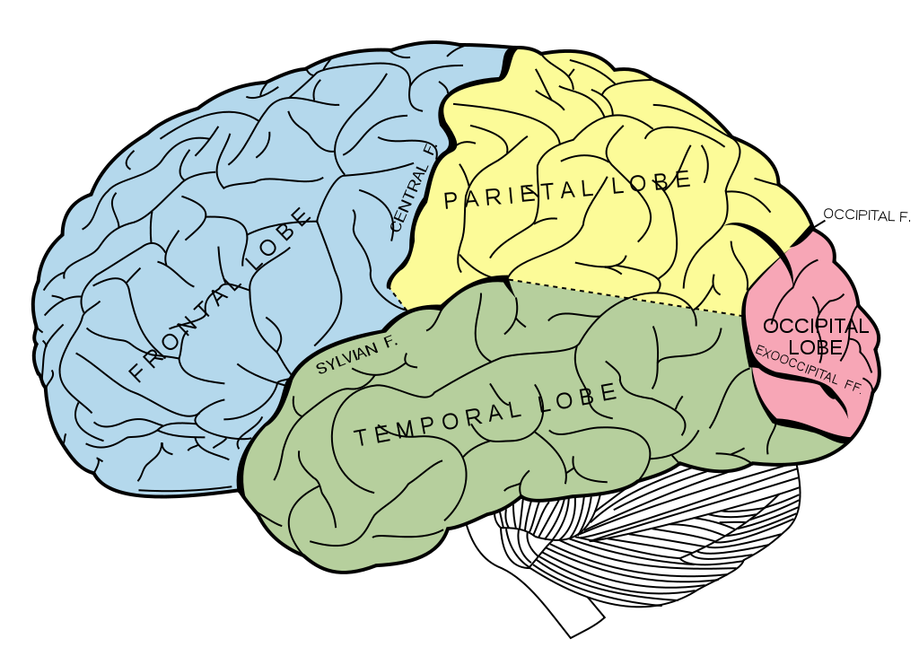
BRAIN BREAK #1

Slide 7
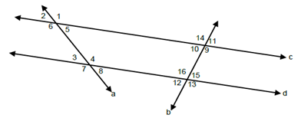

Slide 9
26 minutes long
Each question has 2 parts: 1 geometry question & 1 episode question
You can get all the correct answers from the episode.
Homework tonight will be to mathematically prove your answers are correct by showing all work and/or writing the theorem or postulate we learned today that proves the answer is right.

Slide 10
Homework
#2 Angle Relationships in HW Packet – Show all work and/or write the postulate or theorem that mathematically proves your answer is correct.
Hint: Use the postulates or theorems learned today and the types of angles learned yesterday as your mathematical proof (congruent angles, supplementary angles, vertical angles, corresponding angles, alternate exterior angles, same-side interior angles, alternate interior angles)

Slide 11
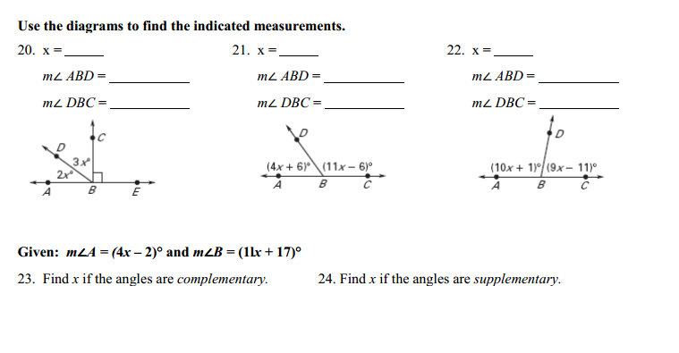
Exit Ticket

Slide 12
BRAIN BREAK #2

