Slide 1
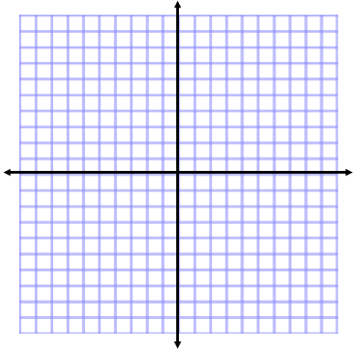
ANNOUNCEMENTS -NO CALCULATORS -Team Leaders, log on to the laptop! -Take out HW to stamp -Turn in Unit 2 Corrections!
WARM UP
f(x) = (x + 2)³ - 4
What is the parent function?
Describe the transformations.
Graph the transformation.
Update TOC.

Slide 2
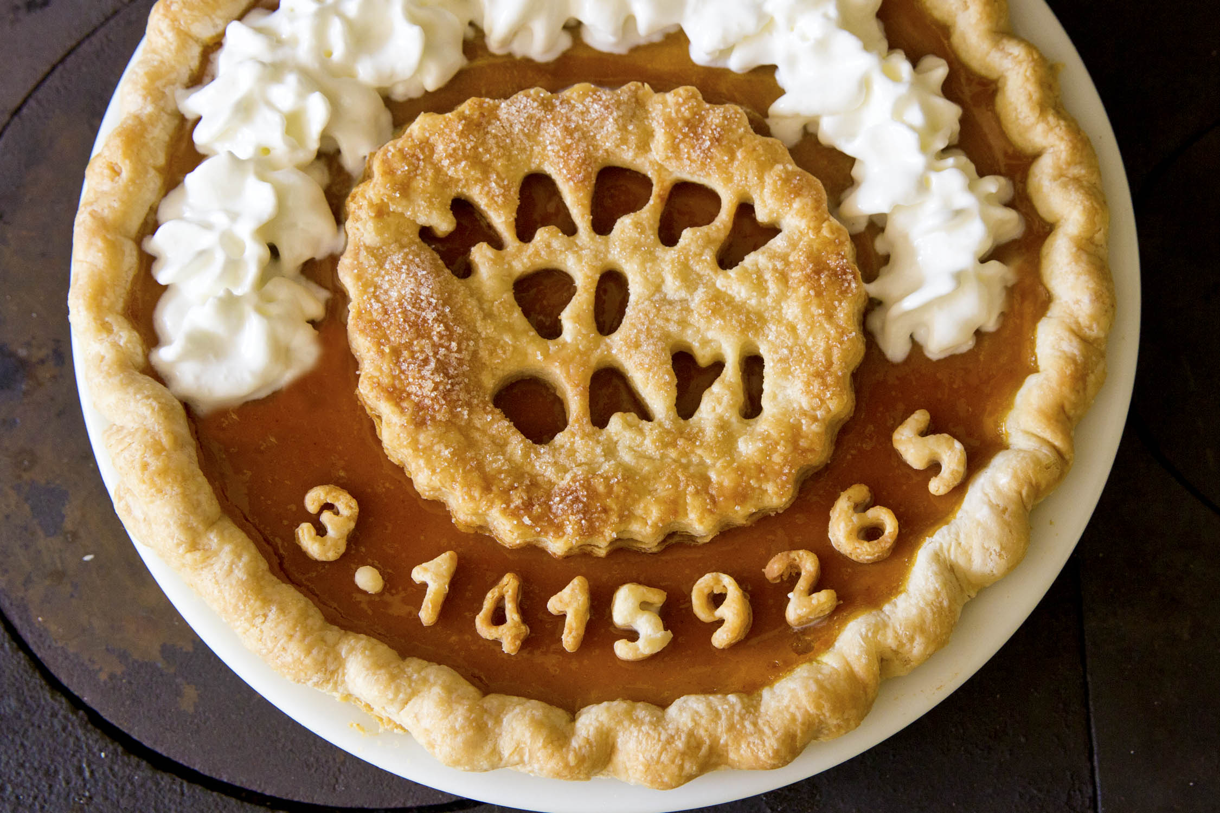
This Friday….

Slide 3
Mini Team Lessons
Team Leaders log on to the laptops.
Open up Mozilla Firefox
Go to my website: wmhsmath2santos.weebly.com
Hover over Quick Links
Click on PowerPoints & Notes
Download Unit 3 #2 Function Operations PPT
With your teams, go through the first part of the lesson and fill out your notes.
STOP AFTER YOU HAVE

Slide 4
ANNOUNCEMENTS -Pick up your assigned calculator -Take out HW to stamp -Turn in Unit 2 Corrections! -Turn in Video Permission Form. We will be video taping on Thursday!
WARM UP
f(x) = (x + 2)³ - 4
What is the parent function?
Describe the transformations.
Graph the transformation.
Update TOC.

Slide 5
HOMEWORK QUESTIONS?

Slide 6
#2 Function Operations

Slide 7
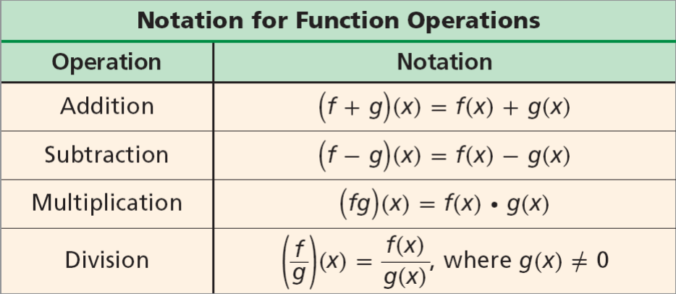

Slide 8
SIMPLIFYING FUNCTION OPERATIONS
Example 1: Adding Functions Given f(x) = 4x² + 3x – 1 and g(x) = 6x + 2, find (f+g)(x). f(x) + g(x) (4x² + 3x – 1) + (6x + 2) 4x² + 3x – 1 + 6x + 2 4x² + 9x + 1 | Example 2: Subtracting Functions Given f(x) = 5x – 6 and g(x) = x² – 5x + 6, Find (f–g)(x). f(x) – g(x) (5x – 6) – (x² – 5x + 6) 5x – 6 – x² + 5x – 6 –x² + 10x – 12

Slide 9
Back to Unit 1 – Multiplying Polynomials
x²(x + 4)
x(x + 4)
3(x + 4)
(x² + x + 3)(x + 4)

Slide 10
SIMPLIFYING FUNCTION OPERATIONS
Example 3: Multiplying Functions Given f(x) = 6x² – x – 12 and g(x) = 2x – 3, find (fg)(x). f(x) ▪ g(x) (6x² – x – 12)(2x – 3) 6x²(2x – 3) = 12x³ – 18x² -x(2x – 3) = -2x² + 3x -12(2x – 3) = -24x + 36 12x³ – 20x² – 21x + 36

Slide 11
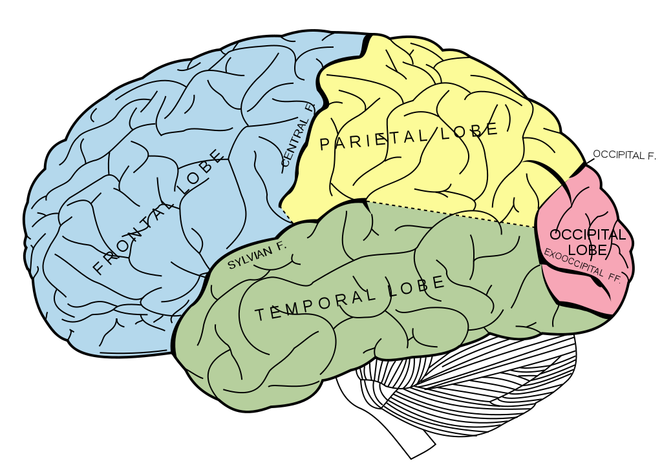
BRAIN BREAK

Slide 12
I Have… Who Has? Card Game
Before we can play the game, your team needs to perform the following function operations. List each problem directly in your notebook no page 21.
LIST OF FUNCTIONS
f(x) = 2x+1
g(x) = -4x-5
h(x) = x – 7
j(x) = 3x
k(x) = 3x + 9
m(x) = x² – 4
n(x) = x² + 10
p(x) = 7x² - 20
Red & Yellow
(j▪k)(x)
(m▪j)(x)
(h + p)(x)
(k + h)(x)
(p – m)(x)
Blue & Pink
(g – j)(x)
(j + f)(x)
(p▪g)(x)
(f + p)(x)
Orange
(p▪j)(x)
(h + p)(x)
(j▪k)(x)
(k – h)(x)
Green & Purple
(g▪j)(x)
(j + f)(x)
(n▪g)(x)
(f + p)(x)
(p – n )(x)

Slide 13
I Have… Who Has? Card Game
LIST OF FUNCTIONS
f(x) = 2x+1
g(x) = -4x-5
h(x) = x – 7
j(x) = 3x
k(x) = 3x + 9
m(x) = x² – 4
n(x) = x² + 10
p(x) = 7x² - 20
DIRECTIONS
EXAMPLE
Everyone in your team needs 1 card. If you have extra cards, some people may need to hold more than 1 card.
Wrap around the team by asking and answering the questions on your card.
Every card will be used.
The same person should end up starting and finishing the game.
Team Leader starts.
4 minutes to solve your problem. Then we begin the game!
I have…1. Who has 2x2?
I have…4. Who has 6/2?
I have…3. Who has 7 – 2?
I have…5. Who has 1+1?
I have…2. Who has 3-2?

Slide 14
EVALUATING FUNCTION OPERATIONS
Example 5: Adding Functions Given f(x) = 4x² + 3x – 1 and g(x) = 6x + 2, find (f+g)(3). 4x² + 9x + 1 4(3)² + 9(3) + 1 4(9) + 27 + 1 36 + 27 + 1 64 | Example 6: Subtracting Functions Given f(x) = 5x – 6 and g(x) = x² – 5x + 6, Find (f–g)(16). -x² + 10x – 12 -(16)² + 10(16) – 12 -256 + 160 – 12 -108

Slide 15
EVALUATING FUNCTION OPERATIONS
Example 7: Multiplying Functions Given f(x) = 6x² – x – 12 and g(x) = 2x – 3, find (fg)(-2). 12x³ – 20x² – 21x + 36 12(-2)³ – 20(-2)² – 21(-2) + 36 12(-8) – 20(4) + 42 + 36 -96 – 80 + 42 + 36 -98 | Example 8: Dividing Functions Given f(x) = x + 2 and g(x) = x² – 4, find $\left(\frac{g}{f}\right)(3)$ . x – 2 (3) – 2 1

Slide 16
BRAIN BREAK

Slide 17
Homework
#3 in HW Packet (choose 5 from each section)

Slide 18
Exit Ticket
Explain how Combining Like Terms, Multiplying Polynomials, and Simplifying Rational Expressions are related to Function Operations.
Let f(x) = x² + 1 and g(x) = 3x + 5. Choose one of the following to evaluate.

