Slide 1
ANNOUNCEMENTS
-Pick up your assigned calculator
-Take out your HW to stamp
WARM UP
Use the triangles to the right to find the coordinates needed to solve the following:
Find the distance of EF.
Find the midpoint of RQ.
Update TOC.

Slide 2
#2 Translations

Slide 3
Vocabulary!
Pre-image: the original figure prior to a transformation
Translation: a slide of a figure, moving all vertices in the same direction

Slide 4
Translations Discovery
Before we take the notes, let’s see if you can come up with the rules yourselves!
20 min to work independently on this discovery.

Slide 5
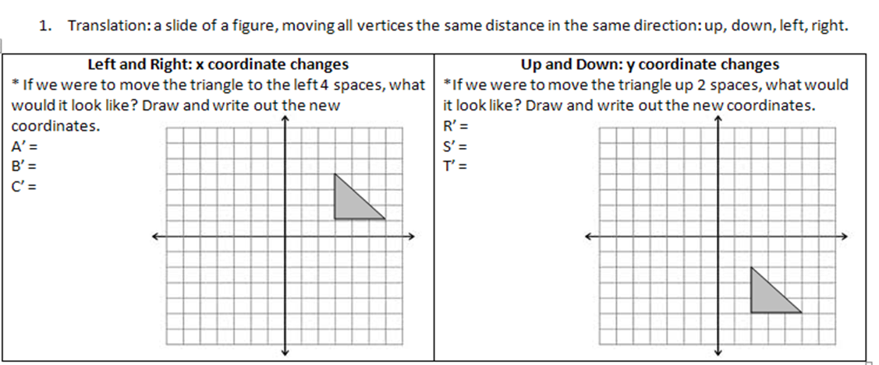
(2,-3)
(-1,1)
(2,-1)
B’
B
(5,-3)
(-1,4)
(2,1)
A’
A
C
C’
S’
S
R’
T’
R
T

Slide 6
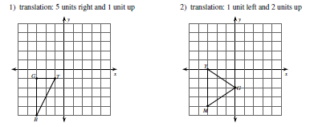
Example Problems: Graph the image of the figure using the transformation given.
G’
T’
R’

Slide 7
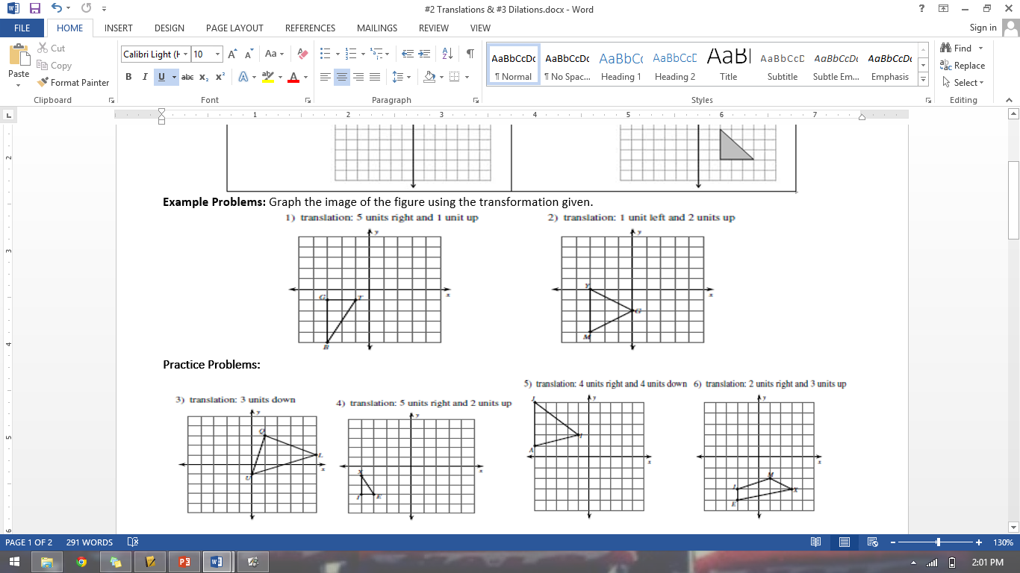
Practice Problems

Slide 8
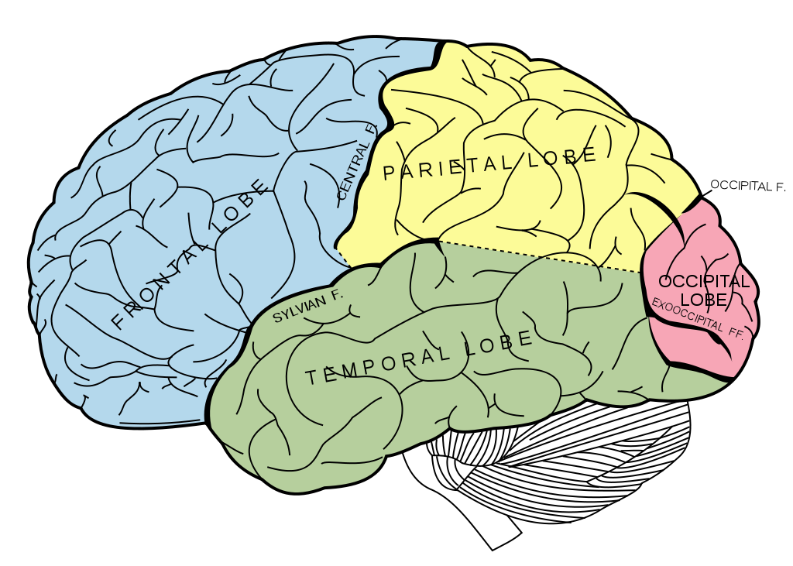

BRAIN BREAK

Slide 9
Rules can be represented verbally and symbolically.
Symbolic Notation: For example, if a rule tells me to translate a figure left 3 and up 5, the symbolic notation would be would be (x,y)→ (x-3, y+5). This means we subtract 3 from x because we move left, and add 5 to y to move up.
YOU TRY: Translate each rule into symbolic notation:
a. Move right 6 and down 1 b. Move left 4 c. Move up 3, left 2
(x + 6, y – 1)
(x – 4, y)
(x – 2, y + 3)

Slide 10
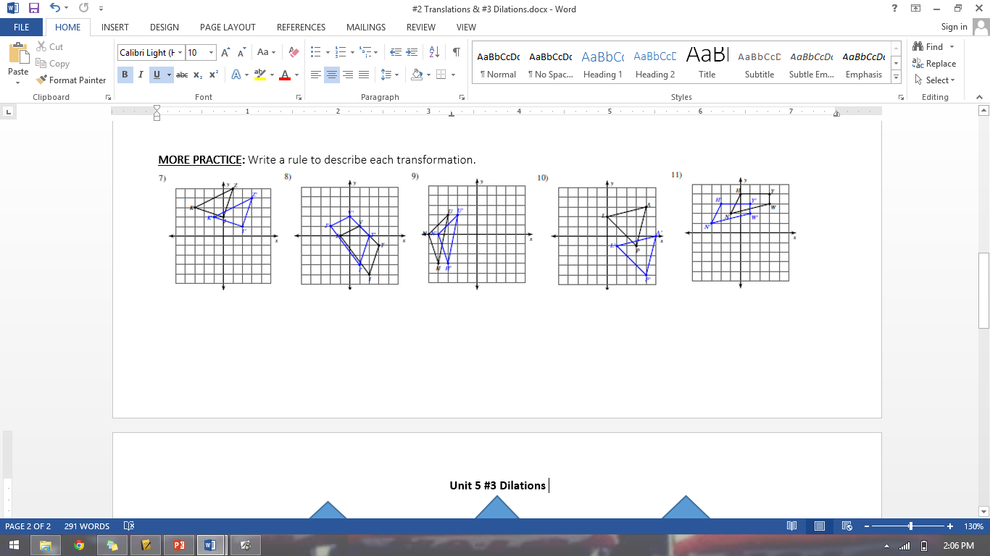
MORE PRACTICE: Write a rule to describe each transformation.
(x + 1, y)
(x + 2, y – 1)
(x – 1, y + 1)
(x + 1, y – 3)
(x – 2, y + 1)

Slide 11
#3 Dilations

Slide 12
Vocabulary!
Dilation: a transformation that changes the size of a figure
Scale Factor: tells how large or small to make a figure; represented by “r”

Slide 13
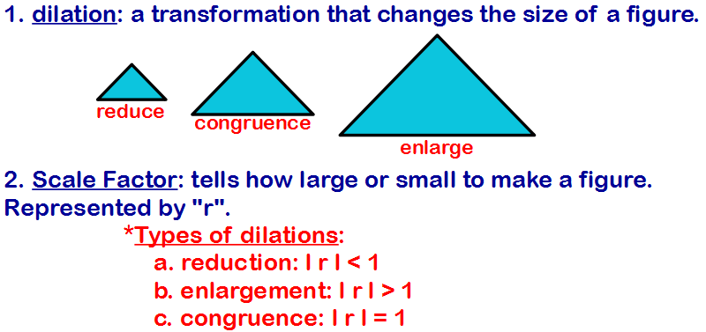

Slide 14
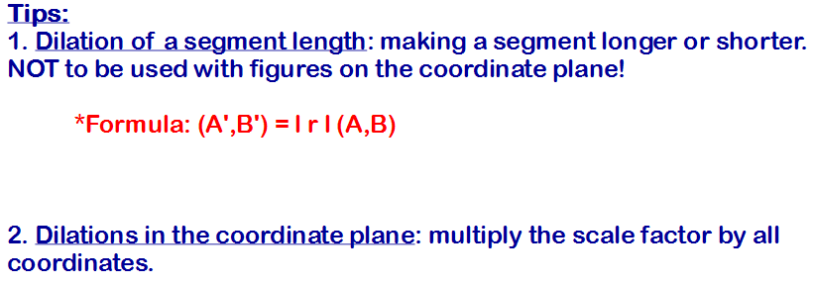

Slide 15
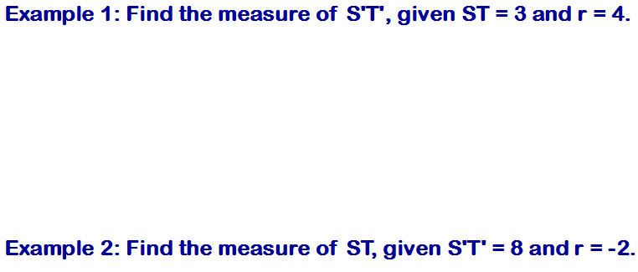
S’T’ = |r|ST
S’T’ = |4|(3)
S’T’ = (4)(3)
S’T’ = 12
S’T’ = |r|ST
8 = |-2|ST
8 = (2)ST
4 = ST

Slide 16
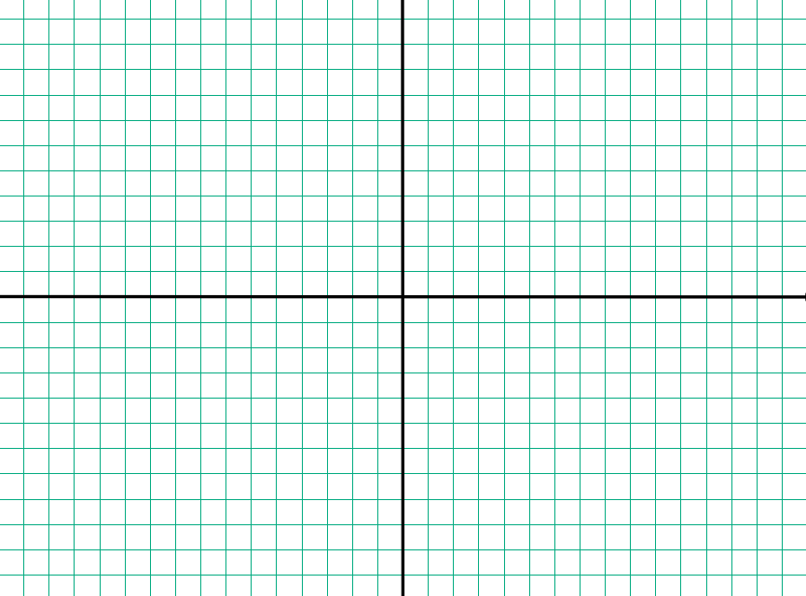
Example 3: Dilate ΔLMN: L(-2,1) M(4,-1) N(4,3) by a scale factor of ¹/₂
L’ = -2(½), 1(½)
L’(-1, 0.5)
M’ = 4(½), -1(½)
M’(2, -0.5)
N’ = 4(½), 3(½)
N’(2, 1.5)
N
N’
L
L’
M’
M

Slide 17
BRAIN BREAK

Slide 18
Homework
#2 Translations (all 6)
#3 Dilations (choose 6)

Slide 19

Exit Ticket
Use the triangles to the right to find the coordinates needed to solve the following:
Translate ΔIJK using the rule (x+1, y+4).
Dilate ΔLMN using a scale factor of $\frac{1}{2}$.
Write the new
coordinates. Graph is bonus.
Write the new
coordinates. Graph is bonus.

