Slide 1
ANNOUNCEMENTS -Pick up assigned calculator -Take out your HW to be stamped
WARM UP
Copy the following into your Vocab Section (Purple tab!)
Cross Section – the intersection of a plane and a solid
Pick a partner and sit at a team with your partner! EVERYONE NEEDS A PARTNER!!
Update your TOC.

Slide 2
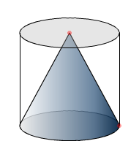
State Final Volume Question (Do on page 65)
A cone is enclosed inside a cylinder. The cone and the cylinder have equal bases and equal heights. If the volume of the cone is 30 cm³, what is the volume of the cylinder?
Volume of a cone =$\frac{1}{3}{Πr}^{2}h$
Volume of a cylinder = ${r}^{2}h$
The only difference between the two formulas is the $\frac{1}{3}$. This means the volume of the cone is $\frac{1}{3}$ the volume of the cylinder. So if we multiply the cone’s volume by 3, then we will have the cylinder’s volume.
Volume of cylinder = 90cm³

Slide 3
HOMEWORK QUESTIONS?

Slide 4
#3 Cross Sections

Slide 5
Homework
#3 in HW Packet (Match the descriptions on the left with the correct two- or three-dimensional figure on the right, by drawing lines connecting the pairs that go together. Then choose two problems from #7-10 to solve.)

Slide 9
Examples

Slide 10
Take out the letters in the plastic baggies and give one letter to each person in the team! If you have less than 4 students in a team, some people will have more than one letter!

Slide 16
Practice Problems
circle
rhombus
triangle
triangle
rectangle
square

Slide 17
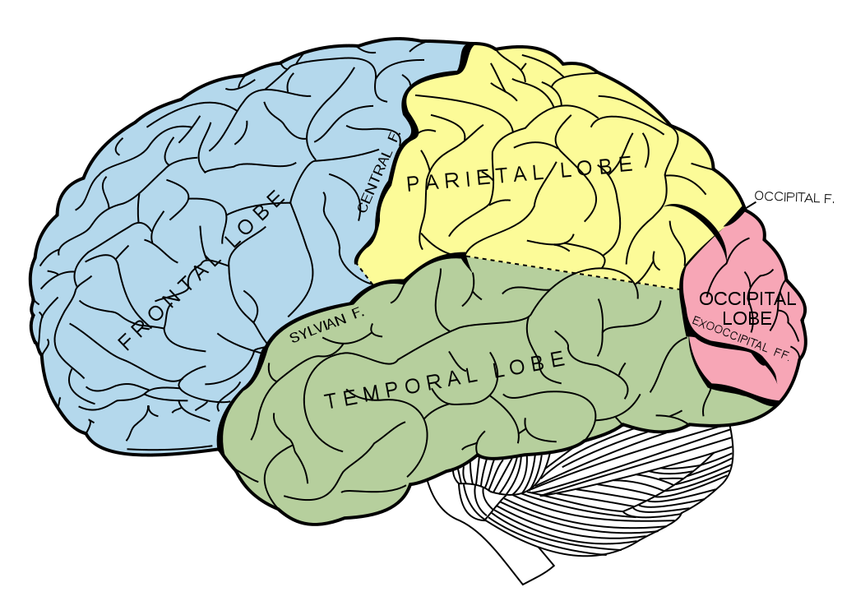
BRAIN BREAK

Slide 18
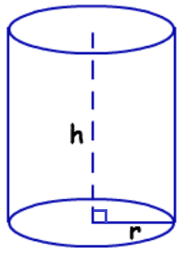
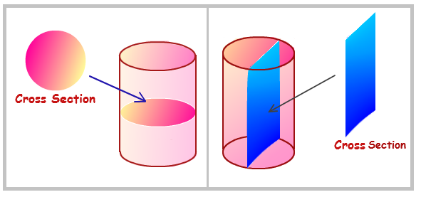
Application Problem 1: Given a cylinder with diameter 16cm and height 32cm, find the area of a cross section that is parallel to its base.
Area = ∏r²
d = 16
r = $\frac{16}{2}$
= 8
A = ∏(8)²
A = 64∏cm²
A = 200.96cm²

Slide 19
Application Problem 2: If an equilateral triangle with perimeter 36in is rotated, find the volume of the 3-dimensional shape that is formed.
$$V=\frac{1}{3}{Πr}^{2}h$$
36in
36in
36in

Slide 20
Homework
#3 in HW Packet (Match the descriptions on the left with the correct two- or three-dimensional figure on the right, by drawing lines connecting the pairs that go together. Then choose two problems from #7-10 to solve.)

Slide 21
BRAIN BREAK

Slide 22
Unit 7 Partner Celebration Poster!
With one partner…
Start working on the first page of your Celebration.
Do all work on looseleaf first. Then put start putting it on the poster when you have your final answer.
Poster requirements…
All questions must be answered.
All work must be shown on the poster. (Try to not to write too big!)
Can use front and back of poster.
Due Friday, May 15 at the end of class!

Slide 23
ANNOUNCEMENTS -Take out your HW to be stamped
WARM UP
Copy the following into your Vocab Section (Purple tab!)
Variation – the relationship between a constant and a variable
Hold your note card long ways. Write “A, B, C, D” on it going vertically down.
Update your TOC.

Slide 24
#4 Inverse Variation & Density

Slide 25
Homework
#4 in HW Packet (all)

Slide 27
y = $\frac{k}{x}$

Slide 28
Example: Find the constant, k. The number of hours, h, it takes for a block of ice to melt varies inversely as the temperature, t. If it takes 2 hours for a square inch of ice to melt at 65º, find the constant of proportionality.
Start with the formula:
Substitute the values:
Then solve for k:
h = $\frac{k}{t}$
2 = $\frac{k}{65}$
(65)
(65)
k = 130

Slide 29
Example 1: In kick boxing, it is found that the force, f, needed to break a board, varies inversely with the length, l, of the board. If it takes 5 lbs of pressure to break a board 2 feet long, how many pounds of pressure will it take to break a board that is 6 feet long?
Set up the formula:
Find the missing constant, k, using the first set of data given.
Using the formula and constant, k, find the missing value in the problem.
f = $\frac{k}{l}$
5 = $\frac{k}{2 }$
k = 10
f = $\frac{10}{6 }$
f = 1.67
lbs.

Slide 30
Example 2: In a formula, Z varies inversely as p. If Z is 200 when p = 4, find Z when p = 10.
Set up the formula:
Find the missing constant, k, using the first set of data given.
Using the formula and constant, k, find the missing value in the problem.
Z = $\frac{k}{p}$
200 = $\frac{k}{4 }$
k = 800
(4)
(4)
Z = $\frac{800}{10}$
Z = 80

Slide 31
BRAIN BREAK

Slide 32
Example 3: If x and y vary inversely and x = 1 when y = 11, find x when y = 5.5. Example 4: If x and y vary inversely and x = 2.5 when y = 100, find x when y = 25.
x = 2
x = 10

Slide 33
Find an equation of variation where y varies inversely as x.
y = 5 when x = 2 2. y = 3 when x = 10
5 = $\frac{k}{2}$
3 = $\frac{k}{10}$

Slide 34
Solve. Assume y varies inversely as x.
3. y = 9 when x = 6. 4. y = 4 when x = 6. 5. y = 9 when x = 12.
Find y when x = 2. Find y when x = 12 Find y when x = 3.
y = 27
y = 2
y = 36

Slide 35
BRAIN BREAK

Slide 37
What is the density of an object with a mass of 120g and a volume of 7mL?
What is the volume of 220 grams of an object with a density of 55g/cm³?
We have an object with a density of 620g/cm³ and a volume of 75cm³. What is the mass of this object?
d = $\frac{120g}{7ml}$
d = 17.14g/ml
55 = $\frac{220}{v}$
v = 4cm³
620 = $\frac{m}{75}$
m = 46500g

Slide 38
Inverse Variation with Density *Hint: solve problems just like inverse variation problems* Example 1: The volume, V, of a certain gas varies inversely with the amount of pressure P, placed on it. The volume of this gas is 175 cm³ when 3.2 kg/cm² of pressure is placed on it. What amount of pressure must be placed on 400 cm³ of this gas?
V = $\frac{k}{p}$
400 = $\frac{560}{p}$
175 = $\frac{k}{3.2 }$
(3.2)
p = $\frac{560}{400}$
(3.2)
k = 560
p = 1.4 kg

Slide 39
Practice Problem 1: The volume V of gas varies inversely to the pressure P. The volume of a gas is 200 cm3 under pressure of 32 kg/cm2. What will be its volume under pressure of 40 kg/cm2?

Slide 40
Practice Problem 2: The volume, V, of a gas varies inversely as the pressure, p, in a container. If the volume of a gas is 200cc when the pressure is 1.6 liters per square centimeter, find the volume (to the nearest tenth) when the pressure is 2.8 liters per sq centimeter.

Slide 41
Homework
#4 in HW Packet (all)

Slide 42
Exit Ticket
For each of the solids below, sketch two cross sections. One horizontal and one vertical. Then identify each of the cross sections with a name (pentagon, triangle, rectangle, circle, etc.

