Slide 1
ANNOUNCEMENTS -Pick up your assigned calculator -Take out HW to stamp
WARM UP
f(x) = 14x – 27 and g(x) = -5x + 2
What is (f – g)(x)?
What is (f∙g)(x)?
Update TOC.

Slide 2
HOMEWORK QUESTIONS?

Slide 3
#3 Evaluating Piecewise & Step Functions

Slide 4
Vocabulary!
Piecewise Function: a combination of one or more functions.

Slide 5
What is a piecewise function?
A Piecewise Function is a function that is a combination of one or more functions. The rule for a piecewise function is different for different parts, or pieces, of the domain.
For instance, movie ticket prices are often different for different age groups. So the function for movie ticket prices would assign a different value (ticket price) for each domain interval (age group).

Slide 6
<
>

Slide 7
Evaluating Piecewise Functions: Evaluating piecewise functions is just like evaluating functions that you are already familiar with
2 – 1 = 1

Slide 8
Evaluating Piecewise Functions: Evaluating piecewise functions is just like evaluating functions that you are already familiar with
(-2)² + 1 = 5

Slide 9
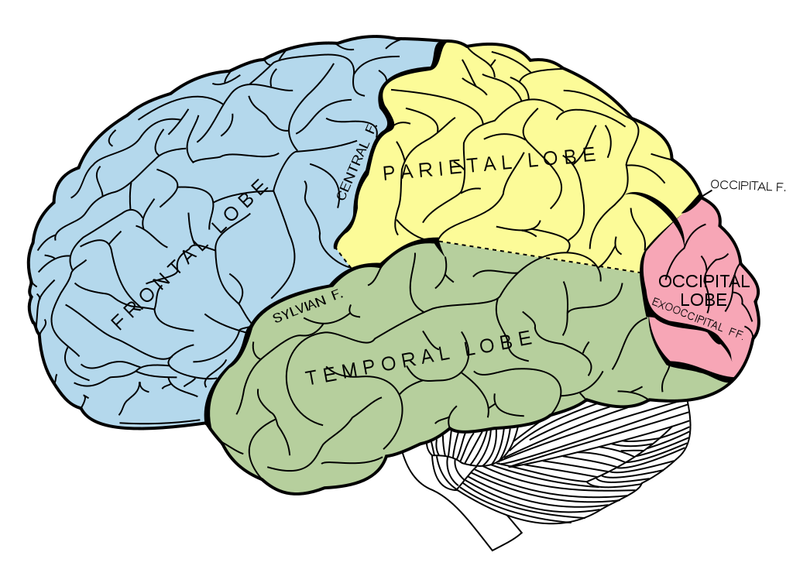
BRAIN BREAK

Slide 10
Practice Problems
-3
12
2
-14
1
4
-12
-6

Slide 11
Writing Piecewise Functions
35,
if 0 < x < 15
2(60) + 40
120 + 40
$160
40,
if 15 < x < 40
2x + 40,
if x > 40

Slide 12
13
-3
0
0
2
-3
0
-2
4
6
4
9
140
220
140
60

Slide 13
BRAIN BREAK

Slide 14
Homework
#3 in HW Packet (all)

Slide 15
Exit Ticket
Evaluate the following for f(x) =
f(10)
f(2)
f(0)

