Slide 1
ANNOUNCEMENTS -Pick up materials from front desk - Take out HW to be stamped
WARM UP
Use the
rectangle to
answer the
following:
What is the perimeter of the rectangle?
What is the area of the rectangle?
What is the area of the triangle formed by the blue lines?
4. Update TOC.

Slide 2
Homework Questions?

Slide 3
Unit 1: Polynomials & Quadratics
#3 Factoring Quadratics

Slide 4
Launch
Expressions like x² + 3x + 2 have a special name. What is that name?
Quadratic!
Write down everything you know about these kinds of expressions.

Slide 5
Factoring Quadratic Expressions
Today we are going to relearn how to factor quadratic expressions.
You may have learned this before, but we’re going to really focus on understanding the process.

Slide 6
Standard Form = Ax² + Bx + C
A, B, and C are the coefficients
A cannot be 0
x is the variable

Slide 7
Teach Me How to Factor!
http://wmhsmath2santos.weebly.com/

Slide 8
CATEGORY 1:

Slide 9
Factoring Quadratic Expressions
STEPS for FACTORING:
Identify A, B, and C of your trinomial.
1.) Factor: x² + 6x + 8
Find all factors of “a∙c” (two numbers that multiply to give you “c”) and choose the pair that adds or subtracts to give you “b”.
Rewrite your trinomial, using the pair from Step #2 instead of “b”. (Keep “a” and “c” the same!)
Group the first two and the last two terms.
Pull out the GCF of each group. (*You should end up with the same polynomials in both sets of parenthesis!)
Keep one set of binomials (inside the parenthesis) and put your GCFs (outside terms) together for the second set.
Box your final answer!

Slide 10
Factoring Quadratic Expressions
EXAMPLE PROBLEMS:
2.) m² + 12m + 32 3.) 3x² + 8x + 5

Slide 11
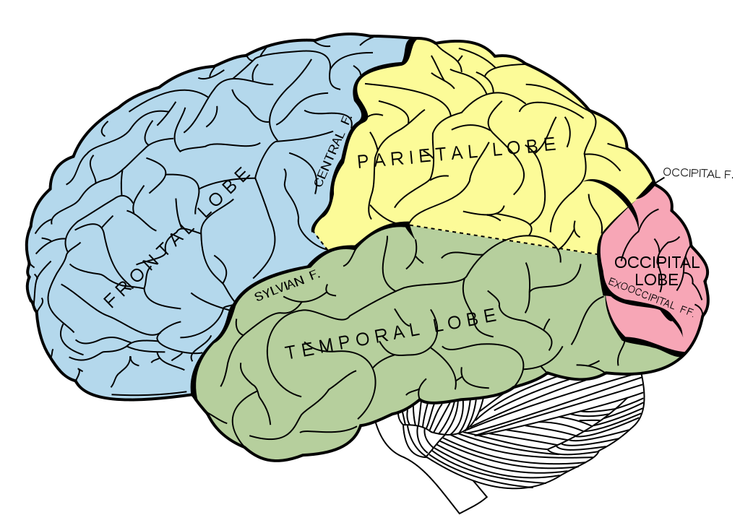
BRAIN BREAK

Slide 12
CATEGORY 2:

Slide 13
Factoring Quadratic Expressions
STEPS for FACTORING:
Identify a, b, and c of your trinomial.
Find all factors of “a∙c” and choose the pair that adds to give you ‘b”.
Rewrite your trinomial, using the pair from Step #2 instead of “b”.
Group the first two and the last two terms.
Pull out the GCF of each group.
Keep one set of binomials and put your GCFs together for the second set.
Box your final answer!
1.) Factor: x² – 6x + 8

Slide 14
Factoring Quadratic Expressions
EXAMPLE PROBLEMS:
2.) x² – 3x + 2 3.) 2x² – 13x + 15

Slide 15
CATEGORY 3:

Slide 16
Teach Me How to Factor
http://www.youtube.com/watch?v=OFSrINhfNsQ (2:26)
We’ve got one more case, so we have to take a look. We 'bout to factor the case with two signs This one’s the hardest, so listen to my rhyme If you got three terms and a minus at the end The signs will be different where they go that depends The larger of your number gets the sign from the middle This problem’s not too bad if you study just a little Now pick up your pencil I don’t want to hear you fussin’ Teachers swear I got them students with the brains all a-bustin

Slide 17
Factoring Quadratic Expressions
STEPS for FACTORING:
Identify a, b, and c of your trinomial.
Find all factors of “a∙c” and choose the pair that adds to give you ‘b”.
Rewrite your trinomial, using the pair from Step #2 instead of “b”.
Group the first two and the last two terms.
Pull out the GCF of each group.
Keep one set of binomials and put your GCFs together for the second set.
Box your final answer!
1.) Factor: x² - 2x – 15

Slide 18
Factoring Quadratic Expressions
EXAMPLE PROBLEMS
2.) 3x² + x – 10 3.) 5x² - 7x – 6

Slide 19
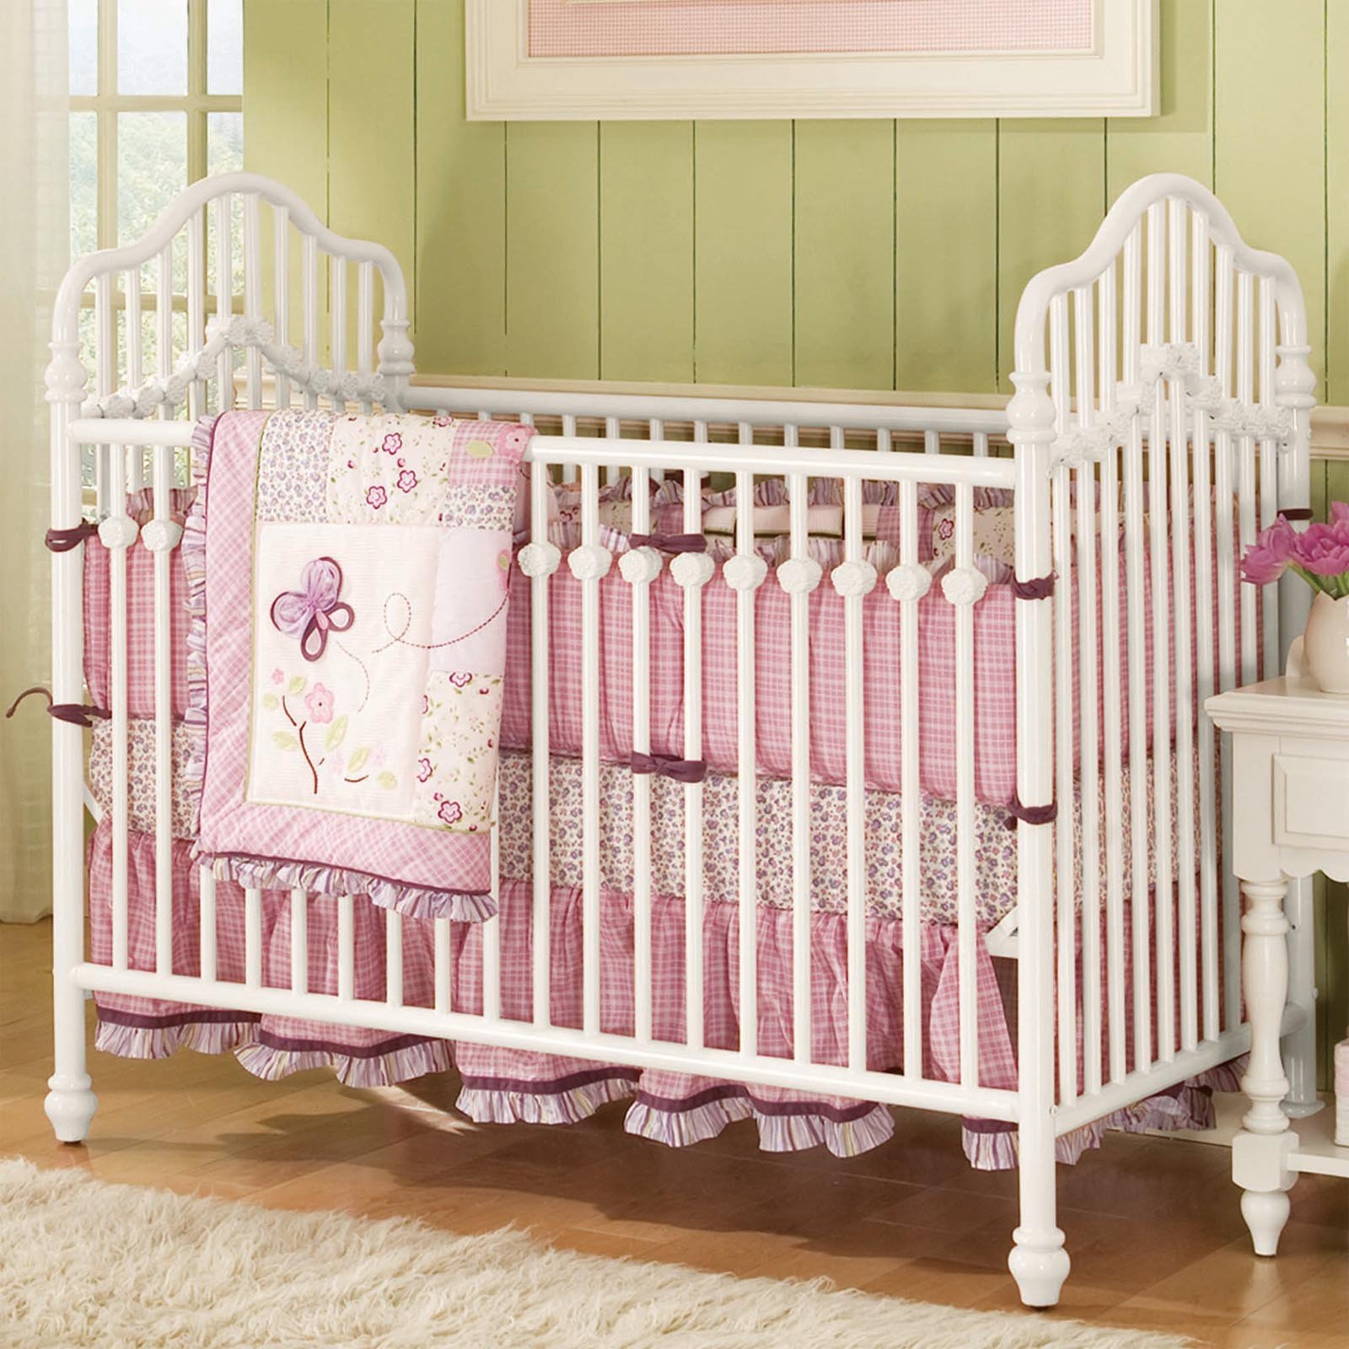
Let’s Apply!
Mr. Leichner is building a crib for his 7 month old baby Jillian. The crib will have a surface area of 3x² +20x – 7. Jillian is sick with a 103.7 fever, so Mr. Leichner is home with the baby. Sign the Get Well card to make her better!!
What are the length and width of the crib?
What would the area of the crib be if x = 3 in?

Slide 20
BRAIN BREAK

Slide 21
ALGEBRA CONNECT!
You vs. everyone in your team.
Your goal is to factor enough squares to get a BINGO (6 horizontal, 6 vertical, or 6 diagonal) before anyone else at your team does.
Roll the dice twice – 1st roll corresponds to the row, 2nd roll corresponds to the column. The cross section is the problem you have to factor.
The first problem will be decided by Ms. Santos. Everyone starts on the same problem!
Once you finish the problem, grab the dice and roll for your next problem.
First person at each team to get BINGO and have them all correct, wins 5 College Credits!
Work can be done in the boxes themselves or on page 3 of your notebook.

Slide 22
Partner Practice
1. The area of a rectangle is x² + 7x + 6. What are the length and the width?
2. The area of a triangle is ½(2x²+5x+3). What are the height and base of the triangle?

Slide 23
Independent Practice (Girls do odds, Boys do evens)
c² + 12c + 35
5x² – 13x + 6
2x² - x – 3
x² + 12x + 20
4x² - 21x + 5
x² + 2x – 15
x² – 16x + 64
5x² + 8x + 3

Slide 24
Homework
NONE, but if you want to get a head start on tomorrow’s homework…
#3 Factoring Quadratics

Slide 25
Exit Ticket
Two community gardens are being built outside Freshman Academy. The area of the first garden is 20x² – 63x + 36. The second community garden has an area of 2x² + 9x + 4.
By how much is the perimeter of the first garden larger than the perimeter of the second garden?
Write a 3-sentence email to National Community Garden Association asking for the correct length of wood you will need to build a fence surrounding both gardens. Assume x is 2 feet.
Glue notes onto page 3.

Slide 26
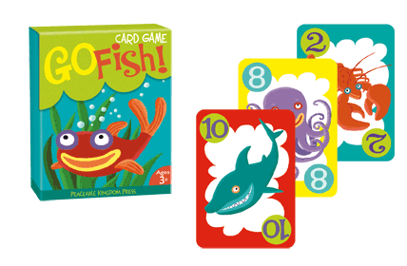
Go Fish!
Let’s play Go Fish!
In your teams, deal out the cards and play go fish with quadratics!

