Slide 1
ANNOUNCEMENTS -Pick up your assigned calculator -Take your HW out to stamp
WARM UP
3. Update TOC.

Slide 2
#3 Rational Exponents & Logarithms

Slide 5
A cube root of any negative number is negative.

Slide 8
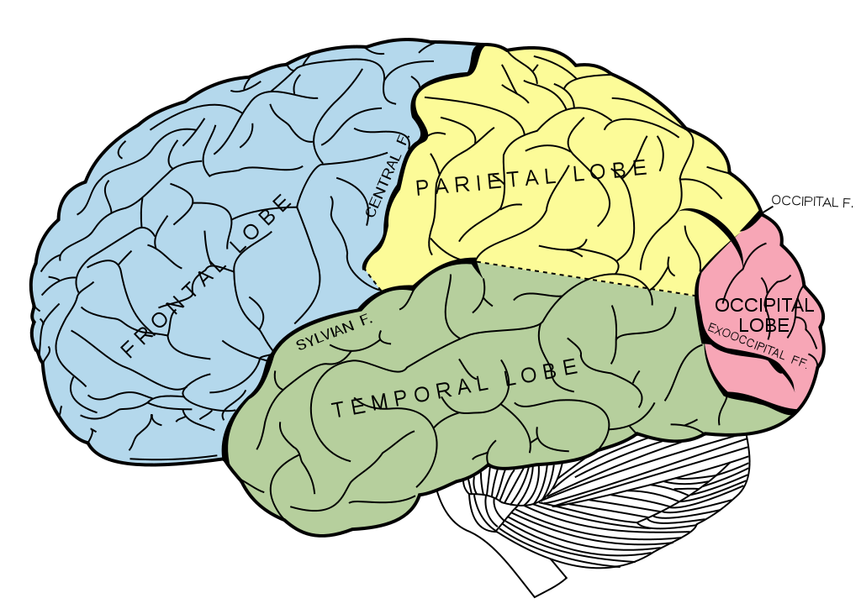
BRAIN BREAK

Slide 9
Homework
#3 Logarithms & Rational Exponents
10 rational exponents and radical problems

Slide 10
#3 Rational Exponents & Logarithms

Slide 13
Example 2

Slide 14
Practice Problems
3. 2⁻³ = $\frac{1}{8}$ 4. 7² = 49 5. 5⁰ = 1 6. 10⁻² = $\frac{1}{100}$
log₂ =-3 log₇49 = 2 log₅1 = 0 log₁₀ = -2

Slide 15
Now let’s go the other way!
Example 1

Slide 16
Example 2

Slide 17
Practice Problems
10² = 100 5⁻³ = 27 = 3

Slide 18
Now let’s try solving!
1. Solve for x: log₆ x = 2 2. Evaluate. log₃ 27 = y
6² = x
x = 36
3^{y} = 27
3^{y} = 3▪3▪3
3^{y} = 3³
y = 3

Slide 19
BRAIN BREAK

Slide 20
Homework
#3 Logarithms & Rational Exponents
4 log problems
Directions: Change the following logs to exponential form.
1. log₄16 = 2 2. log₅ 125 = 3 3. log₂32 = 5 4. log₆ 1296 = 4

Slide 21
#4 Literal Equations

Slide 22
HUMAN EQUATIONS
Common Formulas
Slope-intercept form | y = mx + b
Area of a triangle | A = ½bh
Area of a circle
Distance Formula | D = RT
Simple Interest | A = IRT
Volume of a cylinder | V= πr²h
Perimeter of a rectangle | P = 2L + 2W
Area of a rectangle | A = LW
Perimeter of a square | A = 4s
Volume of a prism | V = LWH
Volume of a cone
Measure of angles in a triangle | a + b + c = 180º
Pythagorean Theorem | a² + b² = c²
When your term is called, come up to the front with your card and set yourselves up into the proper formula.
The rest of the class will have to rearrange the formula for the given variable
*Refer to the list of formulas on your notes

Slide 25
Steps to Solving Literal Equations
Circle the variable you are solving for.
What operations are happening with that variable?
Work backwards to solve for the variable.

Slide 26
Partner Practice
1. a² + b² = c², solve for b
2. Rewrite the equation for the area of a rectangle in terms of the width.
3. 2x + 3y = 6, solve for y

Slide 27
Application Problems
4. The area of a circle is pi times the radius squared. Rearrange this formula in terms of the radius.
5. Ms. Santos wants to visit her family in Chicago. If Chicago is 600 miles away, and Ms. Santos wants to get there in 10 hours, how fast does she need to drive? Write an equation to express the rate at which Ms. Santos needs to drive and solve.

Slide 28
Homework
#3 Logarithms & Rational Exponents (all)
#4 Literal Equations (Choose 6)

Slide 29
Exit Ticket
Rearrange the formula for the area of a triangle in terms of the height.
Rewrite in radical form. ${\text{(3}\text{x}\text{ – 8)}}^{\frac{4}{9}}$
Rewrite in exponential form. $\sqrt[5]{x^{3}}$

