Slide 1
ANNOUNCEMENTS -Pick up your assigned calculator -Turn in MIDTERM CORRECTIONS!!!
WARM UP
Find the value of x that makes lines j and k parallel.
Copy down the following vocabulary words (purple tab!)
Equilateral Triangle: all angles and sides are the same
Isosceles Triangle: two sides and angles are the same
Triangle Sum Theorem: the interior angle measures of a triangle add up to 180º
Exterior Angle Theorem: the measure of the exterior angle of a triangle is the sum of the measures of the remote interior angles
Update your TOC.

Slide 2
Homework Questions?

Slide 3
#3 Triangle Sum Theorem

Slide 5
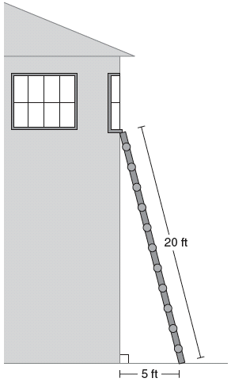
Application Problem
The ladder is leaning on the ground at a 75º angle. At what angle is the top of the ladder touching the building?
180º = 75º + 90º + x
180º = 165º + x
15˚ = x

Slide 6
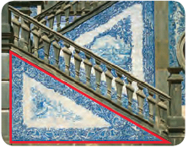
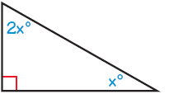
Application Problem: WINTER IS COMING! (Any Game of Thrones fans?)
The tile on your porch staircase forms a right triangle. The measure of one frosted acute angle in the triangle is twice the measure of the other angle. Find the measure of each acute angle.
180º = 90º + xº + 2xº
2(30º) = 60˚
180º = 90º + 3xº
90˚ = 3x˚
30˚ = x
Angles = 30 ˚ & 60˚

Slide 7
Equilateral Triangles
Find the missing angle.
60º
180º – 120º = 60˚
?
60º
?
+
180º
60º
60º
What do you notice about the angle measures in this triangle?

Slide 8
Isosceles Triangles
Find the missing angle.
70º
180º – 140º = 40˚
70º
?
?
+
180º
What do you notice about the angle measures in this triangle?
70º
70º

Slide 9
Think-Pair-Share How can you use the Triangle Sum Theorem to solve for a missing angle in an equilateral or Isosceles Triangle?
Think: Take 30 seconds to think to yourself a response to the question “How can you use the Triangle Sum theorem to solve for a missing angle in an equilateral or isosceles triangle?”
Pair: Tell your elbow partner how you think you could use the Triangle Sum Theorem to solve for a missing angle in an equilateral or isosceles triangle. You and your partner take 30 seconds to edit your responses to create the best response!
Share: One partner text your agreed upon best response to Ms. Santos! (940)784-3726

Slide 10
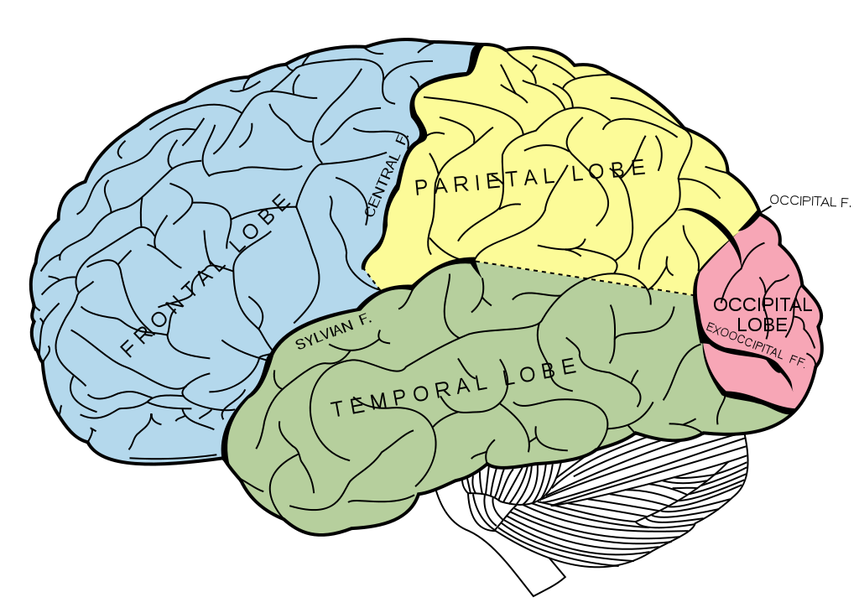
BRAIN BREAK #1

Slide 11
#4 Exterior Angle Theorem

Slide 13
Whiteboard Practice!
Label Homework or Notes at the top of your board.
Write the problem number on your board and draw the figure.
Show all work and box your final answer.
Move on to the next problem if you got a Thumbs Up or fix your current problem if you got a Thumbs Down
1st person done – 5 College Credits
2nd person done – 3 College Credits
3rd person done – 1 College Credit

Slide 15
Homework
#3 Maze in HW Packet (all)

Slide 16
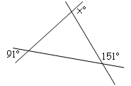
Exit Ticket
What’s the difference between Triangle Sum Theorem and Exterior Angle Theorem?
Find the measure of angle x. (Hint: Recall vertical and supplementary angles from before break!)

Slide 17
BRAIN BREAK #2

