Slide 1
ANNOUNCEMENTS - Check file for your warm up! - Pick up notes -Take out your HW to be stamped
WARM UP
The area of Ms. Santos’s classroom is x² – 9x + 14. She wants to put down a rug to cover the entire floor.
Find the dimensions of the rug. (Hint: Factor!)
Find the perimeter of the rug.
Update TOC.

Slide 2
Homework Questions?

Slide 3
Unit 1: Polynomials & Quadratics
#3 Factoring Quadratics - Special Cases
#4 Solving Quadratics by Factoring

Slide 4
#4 Factoring Quadratics - Special Cases

Slide 5
Launch
Yesterday we learned about factoring quadratic expressions. Look at the expression below:
2X² – 8x + 6
Do you notice anything about the coefficients of the three terms?

Slide 6
SPECIAL CASES CATEGORY: GCF
Why pull out a GCF first?
If there is a GCF, it will make the resulting polynomial much easier to factor, if you pull it out first!
*First pull out the GCF. Then factor like normal!

Slide 7
SPECIAL CASES CATEGORY: GCF
EXAMPLE PROBLEMS:
1. Factor: 2x² -26x + 72
2. Factor: 3x³ - 30x² + 72x

Slide 8
SPECIAL CASES CATEGORY: DIFFERENCE OF SQUARES
What makes it a perfect square?
1. Both terms are ________________ ______________.
2. There is no ___________________ term.
3. There is a _____________________ sign.
FORMULA:
perfect squares
middle (“b”)
minus
a² – b² = (a+b)(a-b)

Slide 9
SPECIAL CASES CATEGORY: DIFFERENCE OF SQUARES
EXAMPLE PROBLEMS:
1. Factor: x² – 16
2. Factor: y² – 64
3.Factor: 4n²- 81

Slide 10
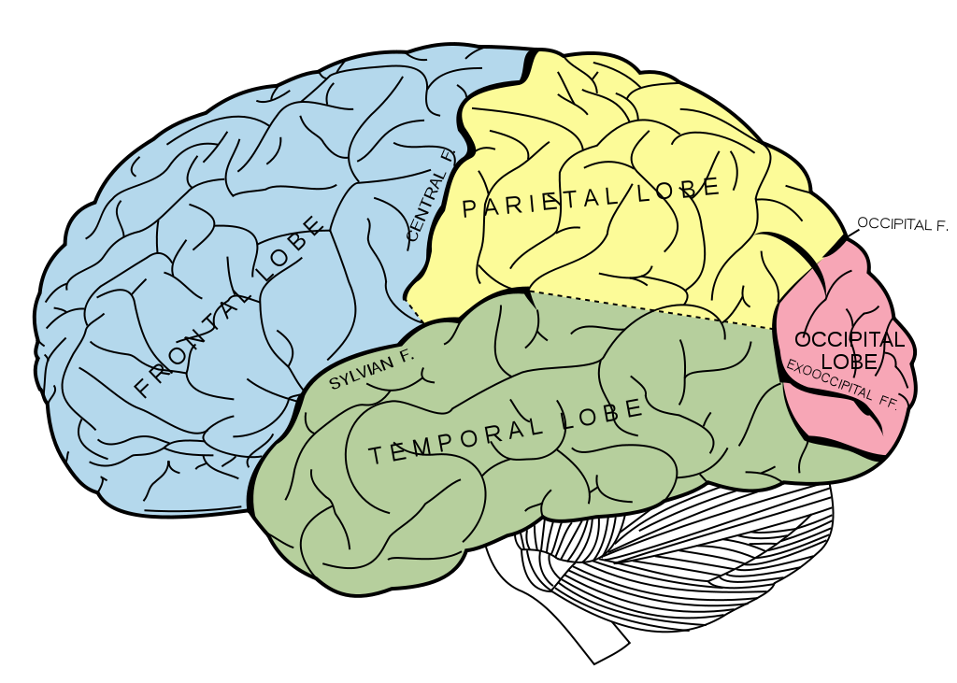
BRAIN BREAK

Slide 11
Partner Practice – Board Game (3rd Period)
Send 1 person from your team to get a board game, dice and questions for your table.
It’s you and your elbow partner vs. the pair across from you in your team. Take turns with the questions. If your team gets it right, roll the dice and move forward that many spaces. If you get it wrong, the other team has to try the same problem.
First team to the finish line wins!
Do NOT write on the questions sheet! Show your work on loose leaf.

Slide 12
#5 Solving Quadratics by Factoring

Slide 13
Launch:
So we’ve been learning to factor quadratics…Why?
What purpose does factoring solve?
Look at the following problem: Bill throws a ball up in the air. The path of the ball can be represented by the quadratic function h = -16t² + 80t + 96, where h represents height and t represents time.
What time does the ball hit the ground?

Slide 14
Solving Quadratic Functions by Factoring
We can use factoring to solve quadratic equations (find when the equation = 0)

Slide 15
Vocabulary!
Roots: the solutions of a function, the x-intercepts of a function, also called zeros
Roots = Zeros = X-Intercepts = Solutions

Slide 16
Solving Quadratic Equations by Factoring
STEPS TO SOLVING QUADRATICS BY FACTORING:
Set the equation equal to zero.
1.) Find the roots: x² + 4x – 12
Factor the equation.
Set each factor equal to zero (Set up two equations!)
Solve each equation.
List both your answers.
BOX your final answer!

Slide 17
Partner Practice
1.) Find the zeroes: x² + 4x + 3 = 0
2.) Solve: c² + 5c = 6
3.) Solve: x² – 3x = 28

Slide 18
BRAIN BREAK

Slide 19
Individual Practice – Let’s Color!
Find the x-intercepts of each of the 8 problems
When you find the answer(s), find that number in the answer grid above and color it in!
When you’ve colored in all answers, a bonus problem will be revealed. First 3 people to reveal the bonus problem AND solve it correctly, get 5 College Credits!

Slide 20
Team Practice Math Baseball – Santos University Students v.s. Ms. Santos
Supplies Manager will help pass out whiteboards and dry erase markers.
I will ask a question and everyone should work it out on their whiteboard. When I say so, everyone show your board.
If most of you get it right (no more than 4 people get it wrong), you get a run. If 4 or more people get it wrong, you get a strike. Try to get 10 runs without striking out!

Slide 21
Homework
HOMEWORK PACKET
#3 Factoring Quadratics (Choose 8)
#4 Solving Quadratics by Factoring (Choose 4)

Slide 22
Exit Ticket
Ms. Santos solved the quadratic equation 4g² – 4g – 8 = 0 and got g = 4, -2 and 1. Find her error and explain to her how to arrive at the correct answer.
Jerika factored 4x² – 49 and got 2x – 7. Find her error and explain how she can arrive at the correct answer.
Without graphing, find the x-intercepts of x² – 14x = -40.

