Slide 1
ANNOUNCEMENTS -NO CALCULATORS! -Take out HW to stamp -Media Center Today!
WARM UP
Copy the following into your Vocab Section (Purple tab!)
Conditional Probability – contains a condition that may limit the sample space for an event
Update your TOC.

Slide 2
Has anyone ever heard of the Monty Hall Game Show?
The idea is that there are 3 doors. Behind 1 door is a brand new car, and behind the other 2 doors are goats. The contestant gets to choose a door and if the door has the car, the contestant gets to keep it!
Let’s play this game now! But instead of cars and goats, we’ll use College Credits. I’ll randomly choose a student to play using a random number generator.
Inside 1 envelope is 5 College Credits. Inside the other 2 envelopes is zilch! If you pick the CC envelope, you win it!

Slide 3
#4 Conditional Probability
https://www.youtube.com/watch?v=mhlc7peGlGg

Slide 4
Media Center Computers!
TAKE A PICTURE OF THIS SLIDE FOR YOUR REFERENCE!
This is a self-guided lesson. You will go through the rest of my slides on your own in the computer lab.
Bring your notes sheet, a writing utensil, and your HW Packet. NO CALCULATORS You can use the calculator on the computer or your phone if you need one.
When you get to the lab, log on to a computer using your student log on information. If there is not enough computers, some of you will have to partner up.
When your computer is up and running, open up Mozilla Firefox and go to my website: wmhsmath2santos.weebly.com
Hover over “Quick Links” and click on “PowerPoints and Notes”
Scroll down to Unit 8 and download the file “#4 Conditional Probability PPT”
Follow along and fill out the notes!
If you finish early, work on #5 Conditional Probability (top of pg. 4) in HW Packet!
We will pack up and come back to the classroom when there is 10 minutes left to glue in our notes and to do the Exit Ticket!

Slide 5
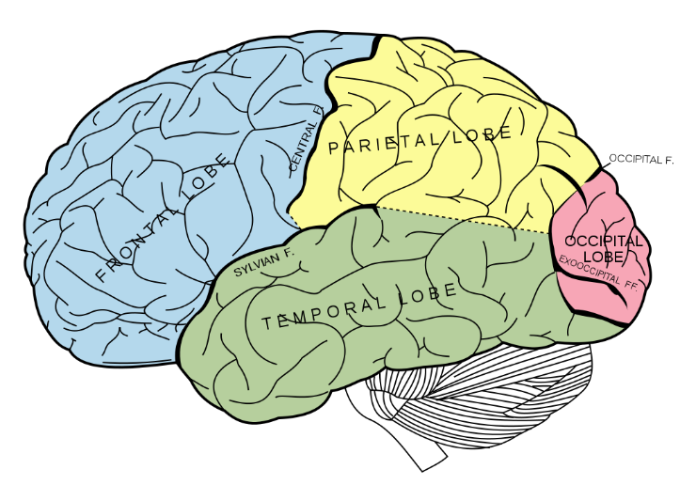
BRAIN BREAK #1

Slide 6
Conditional Probability
Conditional Probability contains a condition that may limit the sample space for an event.
You can write a conditional probability using the notation
- This reads “the probability of event B, given event A”

Slide 7
Example 1: The table shows the results of a class survey. Find P(own a pet|female).
Do you own a pet?
This reads as “probability of owning a pet, given you are female”
First, let’s find the totals for all the categories.
There are how many total females? 8 + 6 = 14
There are how many total males? 5 + 7 = 12
There are how many total “yes’s”? 8 + 5 = 13
There are how many total “no’s”? 6 + 7 = 13
The condition “female” limits the sample space to the total # of females or 14 possible outcomes
So, of the 14 females, how many said “yes” to owning a pet? 8 own a pet
yes no
female 8 6
male 5 7
14 females
12 males
13 yes’s 13 no’s
Therefore, P(own a pet|female) is: $\frac{8}{14}$
which reduces to $\frac{4}{7}$

Slide 8
Conditional Probability
The probability that event A will occur given that another event B has already occurred.
FORMULA: P(A|B) = $\frac{P(AandB)}{P(B)}$

Slide 9


Example 2: Education - The table shows students by gender at two-and four-year colleges, and graduate schools in 2005. You pick a student at random.
 | Males | Females
Two-year colleges | 1866 | 2462
Four-year colleges | 4324 | 5517
Graduate schools | 1349 | 1954
First, let’s calculate all the totals!
Total Grad Schools: 1349 + 1954 =
4328
9841
3303
Total Females: 2462 + 5517 + 1954 =
Total Four-Year Colleges: 4324 + 5517 =
Total Males: 1866 + 4324 + 1349 =
Total Two-Year Colleges: 1866 + 2462 =
What is P(female | graduate school)?
What is P(four-year | male)?
$$\frac{female and grad school}{total grad school}$$
$$\frac{1954}{3303}$$
= .59 = 59%
7539 9933
$$\frac{four year and male}{total male}$$
$$\frac{4324}{7539}$$
= .57 = 57%

Slide 10


Example 3: Statistics - Americans recycle increasing amounts through municipal waste collection. The table shows the collection data for 2007.
Material | Recycled | Not Recycled
Paper | 45.2 | 37.8
Metal | 7.2 | 13.6
Glass | 3.2 | 10.4
Plastic | 2.1 | 28.6
Other | 21.7 | 46.3
Add these up!
First, calculate the totals!
Add these up!
Add these up!
Now, add these up!
83
What is the probability that a sample of recycled waste is paper?
What is the probability that a sample of non-recycled waste is plastic?
Add these up!
20.8
Add these up!
P(Paper | Rec. Waste) =
$$\frac{paper and recycled}{total recycled}$$
13.6
Add these up!
$$\frac{45.2}{79.4}$$
30.7
= .57 = 57%
68
79.4
136.7
$$\frac{plastice and not recycled}{not recycled}$$
P(Plastic | Not Rec. Waste) =
$$\frac{28.6}{136.7}$$
= .209 = 20.9%

Slide 11
BRAIN BREAK #2

Slide 12
Practice Problem #1: Market Research. A utility company asked 50 of its customers whether they pay their bills online or by mail. What is the probability that a customer pays the bill online, given the customer is male?
 | Online | By Mail
Male | 12 | 8
Female | 24 | 6
First, calculate the totals!
Second, fill in the formula!
P(online|male) = $\frac{male and online}{total male}$
=
Last, simplify!
Divide the fraction to convert it into a decimal.
Multiply the decimal by 100 to convert it to a percent.
Answer in decimal form = _________
Answer in percent form = _________

Slide 13
Practice Problem #2: Market Research. Researchers asked shampoo users whether they apply shampoo directly to the head, or indirectly using a hand. What is the probability that a respondent applies shampoo directly to the head, given the respondent is female?
First, calculate the totals!
Second, fill in the formula!
P(directly on head|female) = $\frac{directly on head}{total female}$
=
Last, simplify!
Divide the fraction to convert it into a decimal.
Multiply the decimal by 100 to convert it to a percent.
Answer in decimal form = _________
Answer in percent form = _________

Slide 14
Challenge Problems
39% have a pet now and have had a pet
61% do not have a pet now
86% have had a pet
14% do not have a pet now and have never had a pet
Find the probability that a respondent has a pet, given that the respondent has had a pet.
Find the probability that a respondent has never had a pet, given that the respondent does not have a pet now.
*You may ask Ms. Santos for help after you’ve attempted this problem.

Slide 15
Homework
#5 in HW Packet (top of page 4 – all)
HW Packets due Tuesday, 5/26!

Slide 16
Exit Ticket – DO ON THE BACK OF YOUR NOTES!
Characteristics of Job Applicants
Has High School Diploma | Has Experience
 |  | YES | NO
 | YES | 54 | 27
 | NO | 5 | 4
P(has diploma)
P(has diploma and experience)
P(has experience | has diploma)
P(has no diploma | has experience)
*When you finish this problem, raise your hand to let Ms. Santos know. Then you can begin working on the HW until it is time to go back to the classroom.

