Slide 1
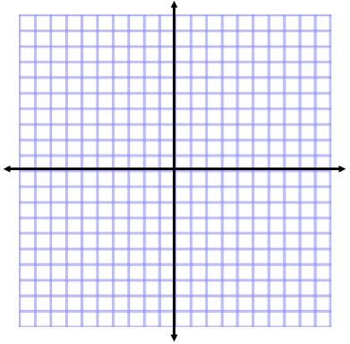
ANNOUNCEMENTS
-NO CALCULATORS
-Take out HW to stamp
WARM UP
Try to sketch a rough graph of the following on your WHITE BOARD.
Your favorite dog groomer charges according to your dog’s weight. If your dog is 15 pounds and under, the groomer charges $35. If your dog is between 15 and 40 pounds, she charges $40. If your dog is over 40 pounds, she charges $40 plus an additional $2 for each pound.
(THE FUNCTION IS ON PG. 22 OF YOUR NOTES FROM YESTERDAY!!)
Update TOC and WAIT to glue notes!

Slide 2

This Friday….
Π Digit Recitation Competition
Line the walls with Π!
Find out how 3.14 got named Π and what the knight Sir Cumference and his son Radius has to do with it.
PIE Project!

Slide 3
HOMEWORK QUESTIONS?

Slide 4
#4 Graphing Piecewise & Step Functions

Slide 5
Graphing Piecewise Functions
f(x) = x² + 1, x ≥ -1 ________________ -3x – 1, x < -1 _______________
STEPS:
1. Determine the shapes of the graphs.
2. Draw the boundaries of each graph (Draw the fences.)
3. Draw each graph. (Draw each neighbor on his side of the fence.)
4. Draw or open or closed circles. (Who owns the fence?)
Continuous or Discontinuous?
Parabola
Line
Because…

Slide 6
Graphing Piecewise Functions
2. f(x) = 3x + 2, x < -2 ________________ -x, -2 < x < 1______________
x² – 2, x >1 ________________
1. Determine the shapes of the graphs.
2. Draw the boundaries of each graph (Draw the fences.)
3. Draw each graph. (Draw each neighbor on his side of the fence.)
4. Draw open or closed circles. (Who owns the fence?)
Continuous or Discontinuous?
Line
Line
Parabola
Because…

Slide 7
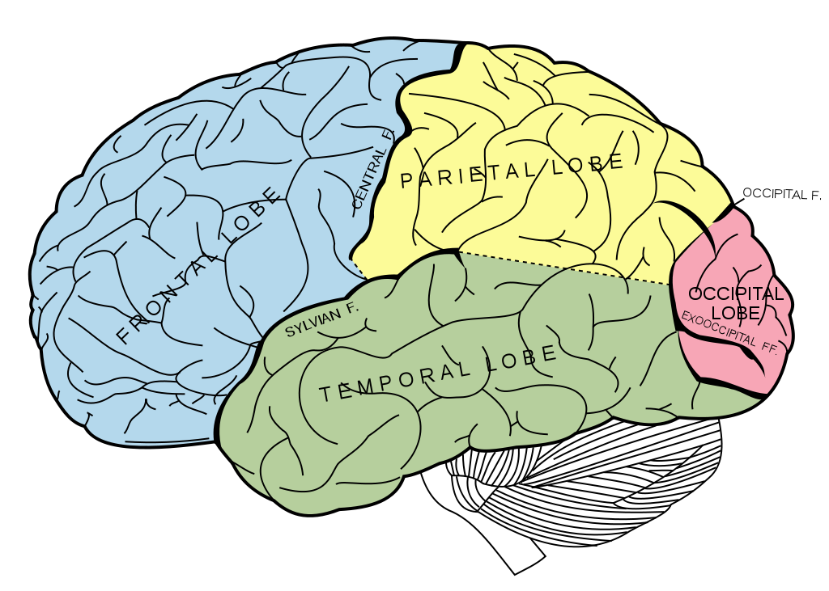

BRAIN BREAK

Slide 8
What was the last movie you saw in theaters?
TICKET PRICES
$5 | Under 13 years old
$9 | Adults 13 years old and up
$6.50 | Senior Citizens 55 years old and up

Slide 9
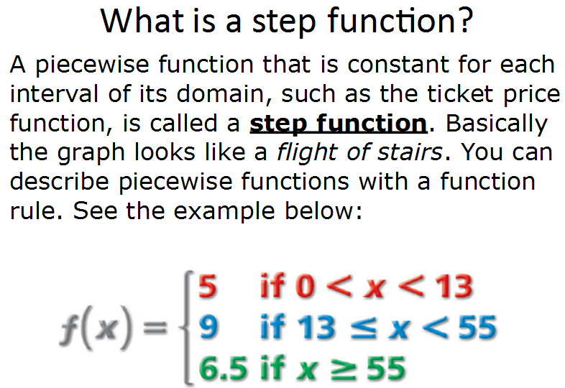

Slide 10
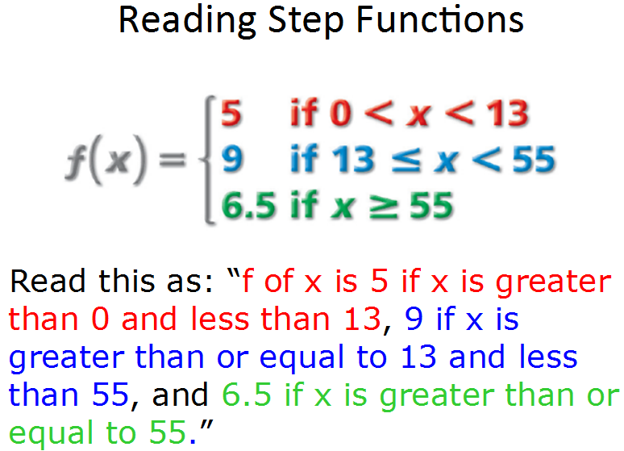

Slide 11
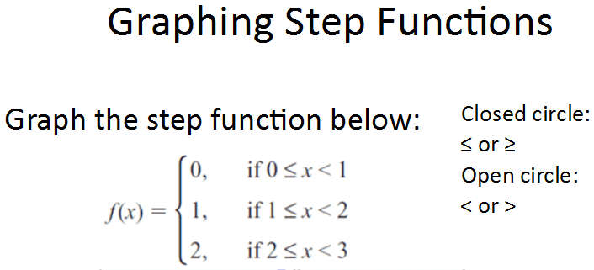
-6
if x < -2
-1
if -2 ≤ x < 4
7
if x ≥ 4
Closed circle: < or >
Open circle: < or >

Slide 12
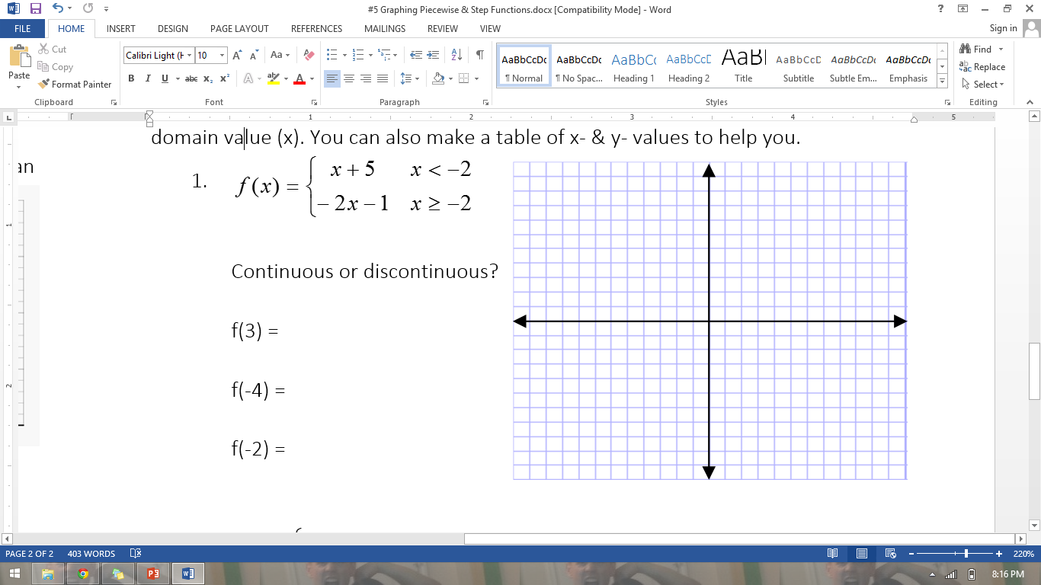
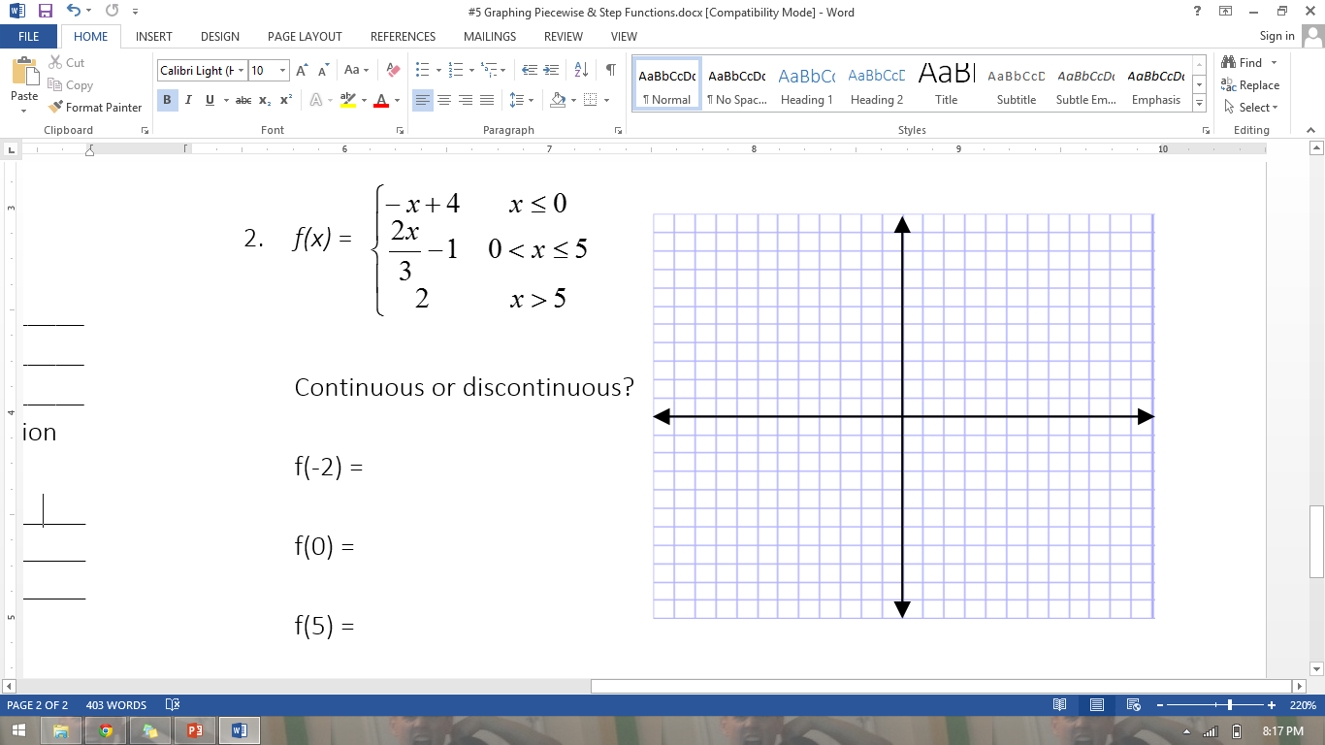
PRACTICE PROBLEMS Carefully graph each of the following. Identify whether each function is continuous or discontinues. Then evaluate the function at each specified domain value (x). You can also make a table of x- & y- values to help you.

Slide 13
BRAIN BREAK

Slide 14
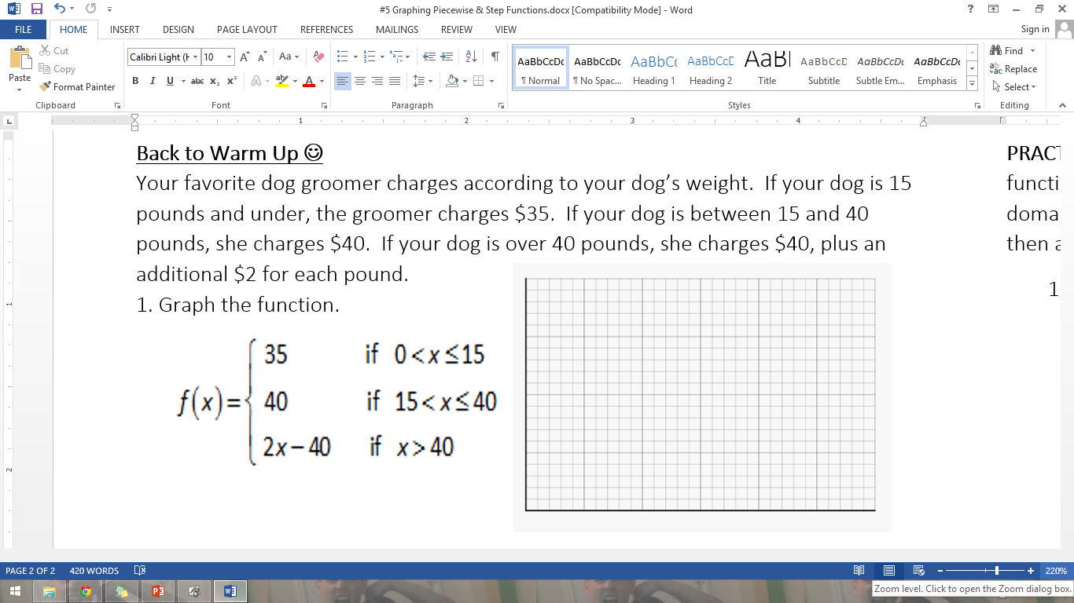
Back to the Warm Up
300
225
150
75
0 10 20 30 40 50 60

Slide 15
Go back to your original graph and compare your answer to the answer we just did together.
Were there any similarities in your first graph and the piecewise function graph? What were they?
Were there any differences in your first graph and the piecewise function graph? What were they?

Slide 16
Homework
#4 in HW Packet (all)
Bring PIE tomorrow for Pi Day!!
Memorize as many digits as you can for the Pi digits competition!

Slide 17
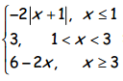
Exit Ticket
Graph the following for f(x) =

