Slide 1
ANNOUNCEMENTS
-NO CALCULATORS
-Take out your HW to stamp
-Extra Credit on my website!
WARM UP
Use the triangles to the right to find the coordinates needed to solve the following:
Give the new coordinates after translating ΔQRS using the rule (x–4, y–2)
Give the new coordinates after a dilation of ΔDEF by a scale factor of 2
Update TOC.

Slide 2
HOMEWORK QUESTIONS?

Slide 3
#4 Reflections

Slide 4
Vocabulary!
Reflection: a transformation representing a flip of a figure; an isometry

Slide 5
Reflections Discovery
Before we take the notes, let’s see if you can come up with the rules yourselves!
20 min to work independently on this discovery.
Pages 3 & 4 in Homework Packet

Slide 6
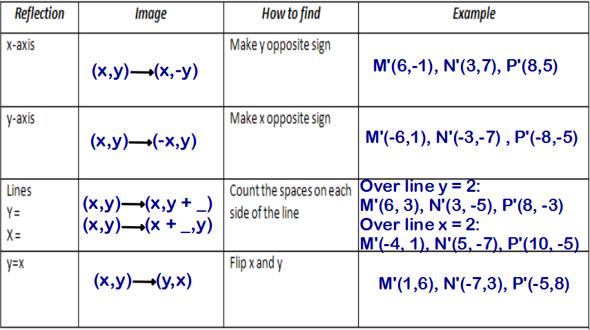
Rules for reflections: Use ΔMNP: M(6,1), N(3, -7), P(8, -5) as an example
Count on graph!

Slide 7
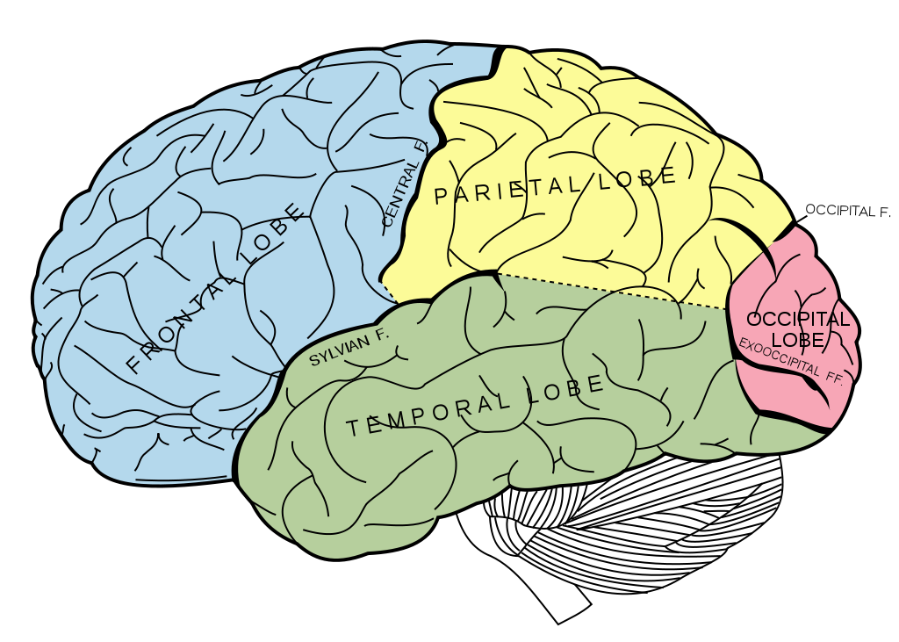

BRAIN BREAK

Slide 8
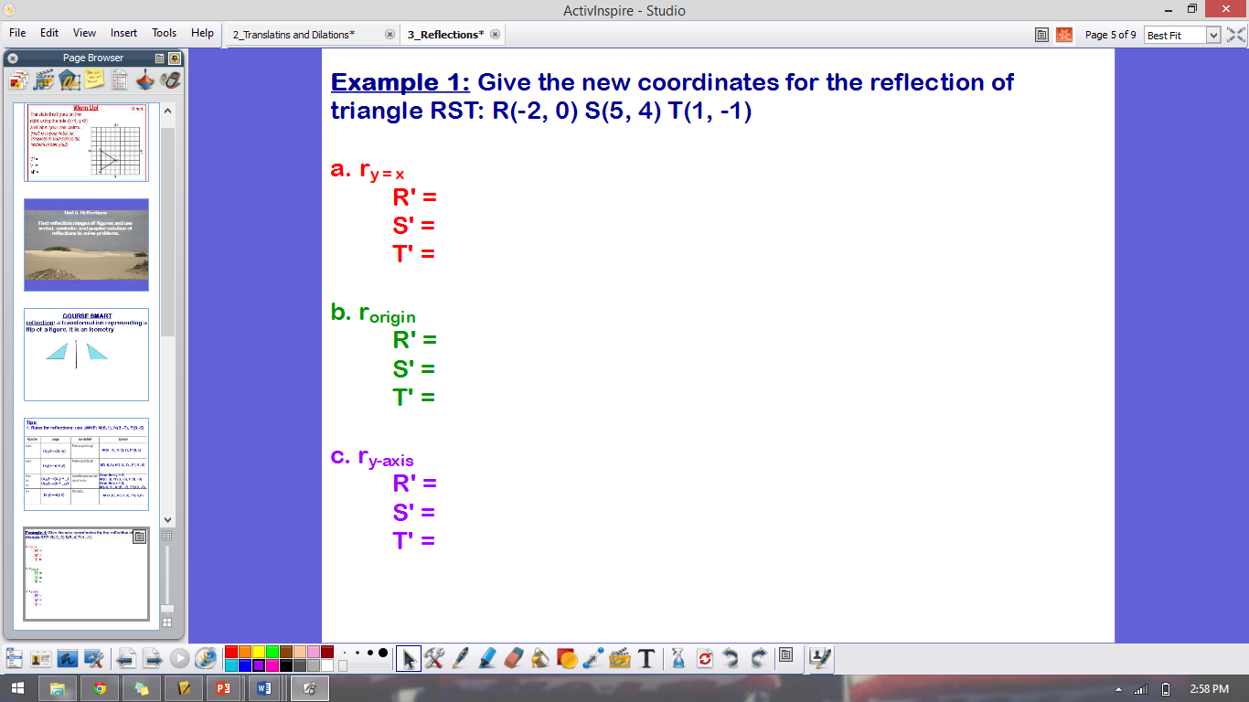
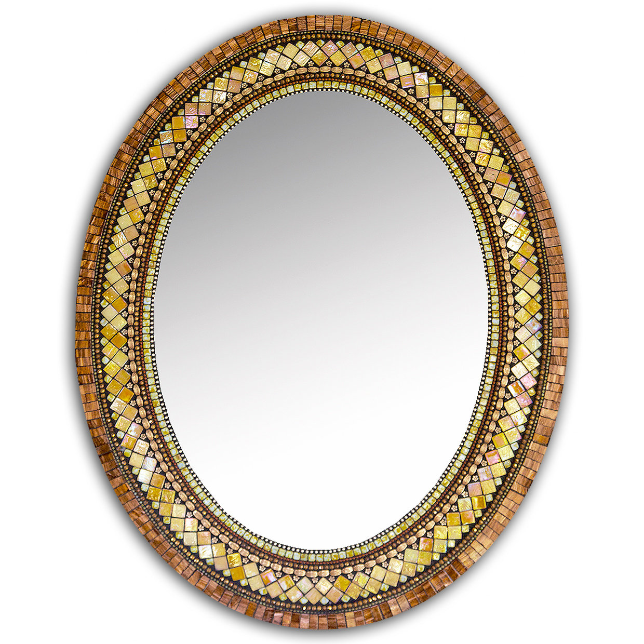
(0, -2)
(4, 5)
(-1, 1)
(x,y) → (-x,-y)
(2, 0)
(-5, -4)
(-1, 1)
(2, 0)
(-5, 4)
(-1, -1)

Slide 9
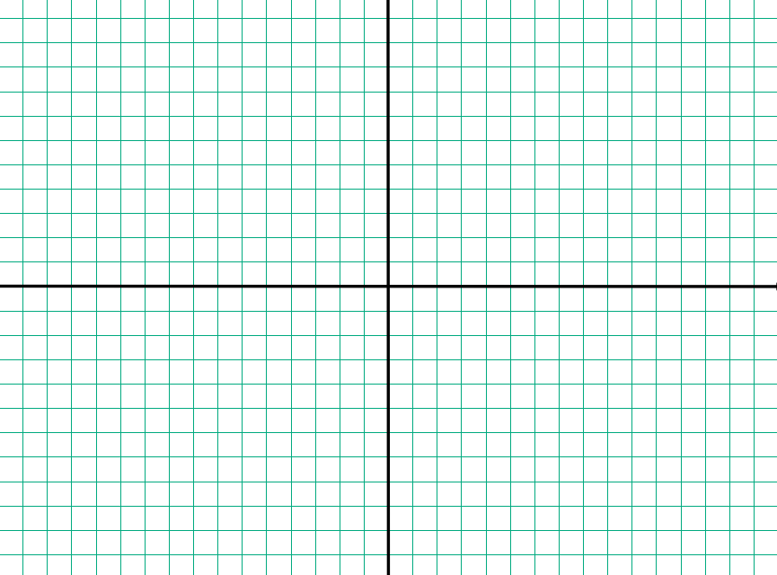
Example 2: r_{x-axis} ΔABC given A(-2, -3), B(5, -3), C(1, -2)

Slide 10
Example 3: Reflect ΔABC over the line y = -2. A(-2, -3), B(5, -3), C(1, -2)

Slide 11
Homework
#4 Reflections (whatever you did not finish)

Slide 12
Exit Ticket
Write a letter to an absent student explaining the difference between a translation and a reflection. Give one example of each. Show graphical representations.
Dear absent student,
The difference between a translation and a reflection is…
Sincerely,
Your Name

Slide 13
Exit Ticket
Use the triangles to the right to find the coordinates needed to solve the following:
What are the coordinates of ΔL’M’N’ after a reflection of ΔLMN over the y-axis.
Find the coordinates of ΔA’B’C’ after a reflection of ΔABC over the line y=x.

Slide 14
BRAIN BREAK

