Slide 1
ANNOUNCEMENTS -Pick up your assigned calculator -Take out homework to stamp
WARM UP
Draw the following diagrams and fill in all the missing angles.
Update your TOC and glue #5 notes onto page 36

Slide 2
Homework
#5 Isosceles Triangle Theorem (whatever you didn’t finish)
NOTES SUMMARY: On PAGE 38, summarize today’s lesson in your own words. This is new for us! Last week, we made flashcards to help us with our understanding. Notes Summaries are another excellent study skill tool to help with retention and understanding of the material. Since writing proofs is new for everyone, it might be trickier to master. Homework tonight is to write a ½ page summary in your own words, explaining the day’s lesson. The goal of your notes summary is for any absent student to be able to read it and have a complete understanding of what he/she missed. Tomorrow, 1-3 of you will be randomly called on to read your notes summary.

Slide 3
#5 Isosceles Triangle Theorem

Slide 4
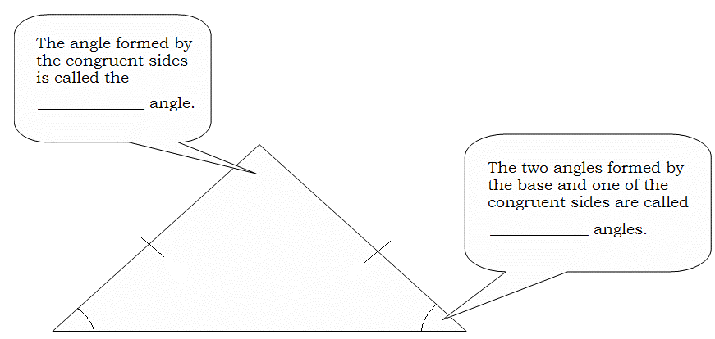
Isosceles Triangle: A triangle with at least ___ sides and angles congruent.
2
vertex
base

Slide 5
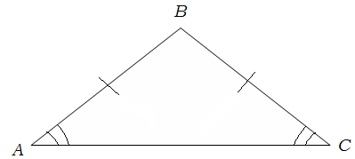
Isosceles Triangle Theorem: If two sides of a triangle are _______________, then the angles opposite those sides are _______________.
congruent
congruent
Example:
___________________________
Given $\overline{AB}$ ≅ $\overline{CB}$,
∠A ≅ ∠C

Slide 6
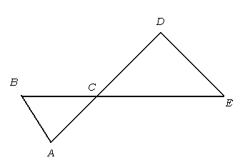
Example 1: If $\overline{DE}≅\overline{CD}$, $\overline{BC}≅\overline{AC}$,and m∠CDE = 120º, what is the measure of ∠BAC?

Slide 7
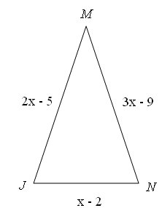
Example 2: Find x, $\overline{JM}$, $\overline{MN}$, and JN if ∆JMN is an isosceles triangle with ∠J ≅ ∠N.

Slide 8
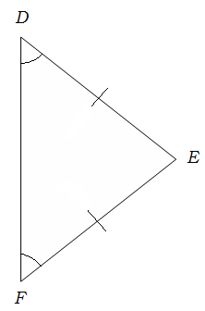
Converse to Isosceles Triangle Theorem: If two angles of a _______________ are congruent, then the sides opposite those angles are ___________________.
triangle
congruent
Example:
___________________________
Given ∠D ≅ ∠F,
$$\overline{DE}≅\overline{FE}$$

Slide 9
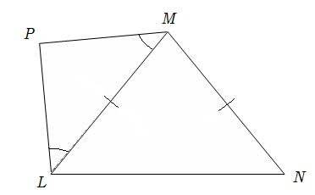
Example 3:
a.) Name all of the congruent angles.
_______________________
_______________________
b.) Name all of the congruent segments.
_______________________
_______________________
∠PLM ≅ ∠PML
∠MLN ≅ ∠MNL
$\overline{PM }$ ≅ $\overline{PL}$
$\overline{ML }$ ≅ $\overline{MN}$

Slide 10
Example 4: Find the measures of angles 1, 2, 3, and 4.

Slide 11
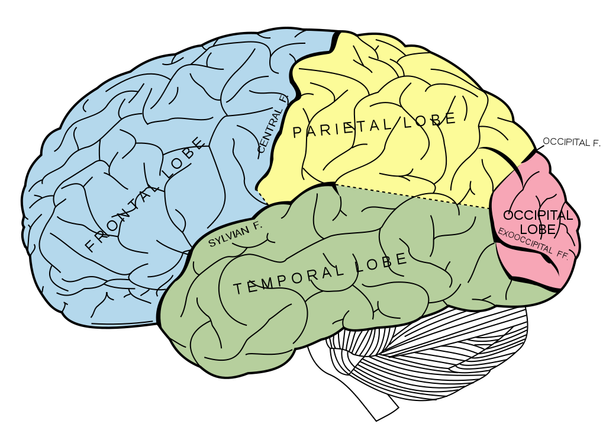
BRAIN BREAK #1

Slide 12
Individual Practice – HW Packet #5
Since there will be two lessons for homework tonight, I’m giving you extra class time to work on #5 (first half of the first page) of your HW Packet.
Take 15 minutes to complete these 6 problems.
You may talk your teammates or ask me for help, but everyone should be working on their own packet.

Slide 13
#6 CPCTC

Slide 14
VOCABULARY!
Congruent Triangles: triangles that are the same size and shape

Slide 15
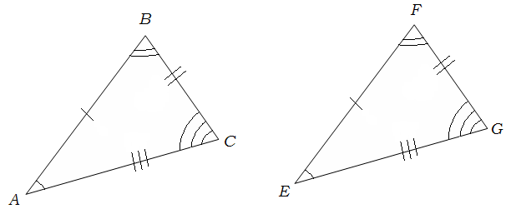
DEFINITION OF CONGRUENT TRIANGLES (CPCTC): *Two triangles are congruent if and only if their corresponding parts are _____________. *CPCTC: ________________ parts of ________________ triangles are _____________.
congruent
corresponding
congruent
congruent
Example:
Name all corresponding angles.
________ ________ ________
Name all corresponding sides. ________ ________ ________
Write a congruence statement.
__________________
∠A ≅ ∠E
∠B ≅ ∠F
∠C ≅ ∠G
$\overline{AB}$ ≅ $\overline{EF}$
$\overline{BC}$ ≅ $\overline{FG}$
$\overline{AC}$ ≅ $\overline{GE}$
ΔABC ≅ ΔEFG

Slide 16
Example 2: In the diagram, DEFG ≅ KLMN.
a.) Find the value of x.
b.) Find the value of y.

Slide 17
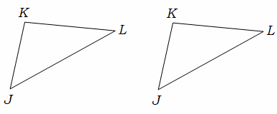
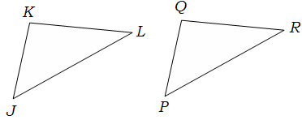
PROPERTIES OF TRIANGLE CONGRUENCE
Reflexive | Symmetric | Transitive
Definition: any quantity is congruent to itself Example: ΔJKL ≅ ΔJKL | Definition: If a = b, then b = a. Example: ΔJKL ≅ ΔPQR. Therefore, ΔPQR ≅ ΔJKL | Definition: If a = b and b = c, then a = c. Example: ΔJKL ≅ ΔPQR and ΔPQR ≅ ΔXYZ. Therefore ΔJKL ≅ ΔXYZ

Slide 18
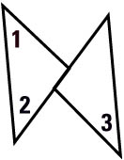
Example 3: This two-column proof uses the Transitive Property.
GIVEN
m 3 = 40°, 1 2, 2 3
PROVE
m 1 = 40°
Statements
Reasons
1
m 3 = 40°, 1 2,
Given
2 3
2
1 3 Transitive property of Congruence
3
m 1 = m 3 Definition of congruent angles
4
m 1 = 40° Substitution property of equality

Slide 19
BRAIN BREAK #2

Slide 20
Homework
#5 Isosceles Triangle Theorem (whatever you didn’t finish)
NOTES SUMMARY: On PAGE 38, summarize today’s lesson in your own words. This is new for us! Last week, we made flashcards to help us with our understanding. Notes Summaries are another excellent study skill tool to help with retention and understanding of the material. Since writing proofs is new for everyone, it might be trickier to master. Homework tonight is to write a ½ page summary in your own words, explaining the day’s lesson. The goal of your notes summary is for any absent student to be able to read it and have a complete understanding of what he/she missed. Tomorrow, 1-3 of you will be randomly called on to read your notes summary.

Slide 21
Exit Ticket
Write a Two-Column Proof (Hint: Refer to example 1 from pg. 36):
GIVEN → If $\overline{DE}≅\overline{CD}$, $\overline{BC}≅\overline{AC}$,and m∠CDE = 120º
PROVE → ∠BAC = 75^{O}
Statements | Reasons
1.
2.
3.
4.

