Slide 1
ANNOUNCEMENTS -Pick up your assigned calculator -Take out your HW to be stamped
WARM UP
∆ABC is an isosceles triangle with leg $\overline{AB}$ = 10 feet. Find the length of $\overline{AC}$. Hint: How many angles are the same in an isosceles triangle? Label those angles!
Update your TOC. Glue #5 notes onto pg. 48.

Slide 2
Homework Questions?

Slide 3
Pop Quiz!
Turn your desks forward.
Open-note → Your own notes only!
You have 40 minutes to complete the quiz.
Material Covered:
Pythagorean Theorem
Trigonometric Ratios – Finding a Side
Trigonometric Ratios – Finding an Angle
Special Right Triangles

Slide 4
ANNOUNCEMENTS -Pick up your assigned calculator
WARM UP
Use the Pythagorean Theorem to prove whether or not the figure shown is a right triangle.
Update your TOC. Glue #5 notes onto pg. 48.

Slide 5
ANNOUNCEMENTS -Pick up your assigned calculator -Take out HW to stamp
WARM UP
Update your TOC.
Take 5 minutes to study Special Right Triangles (pg. 55-56) & get ready for the Celebration Questions (CQs).
Once I pass out the CQs, you will have 15 minutes to complete them. No notes!

Slide 6
Unit 6 Celebration of Knowledge – Special Right Triangles
15 minutes to complete – no extensions!
Complete individually!
No use of notes!
Yes calculators! No phones!
No need to turn your desks! – You all have a different form!

Slide 7
Extra Credit!
For one extra credit point each, answer on the back of your CQs.
By how many points did da Bulls slaughter the Bucks in Game 6 of the series last night? ☺
What was the biggest point differential in Bulls history (by how many points did they win)?
In what year did the Bulls have biggest point differential win?
Who did the Bulls beat when they had their biggest point differential?

Slide 8
#5 Law of Cosines

Slide 9
LAW OF COSINES
a² = b² + c² – 2bc▪cos(A)
*Usually used when you have SSS or SAS.

Slide 10
USE LAW OF COSINES WHEN…
You know the length of all three __________ of a triangle and are trying to find an ______________.
You know two ___________ and an included ____________ and are trying to find the side __________________ the angle.
sides
angle
sides
angle
opposite

Slide 11
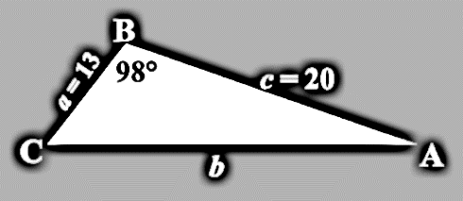
Example 1: Given SAS: Find the length of $\overline{AC}$, given that angle B = 98º, side a= 13 and side c= 20.
a² = b² + c² – 2bc▪cos(A)
b² = a² + c² – 2ac▪cos(B)
b² = 13² + 20² – 2(13)(20)▪cos(98º)
b² = 169 + 400 – 520▪(-0.14)
b² = 569 + 72.8
b² = 641.8
$\sqrt{b^{2}}$ = $\sqrt{641.8}$
b = 25.33

Slide 12
Practice Problems: Find the value of x.
1.
x = 53.61
x = 5.09
2.

Slide 13
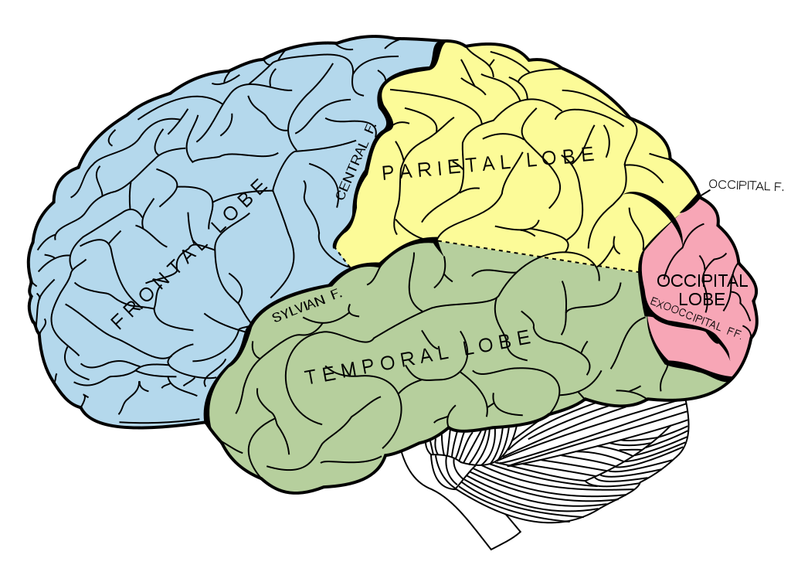
BRAIN BREAK #1

Slide 14
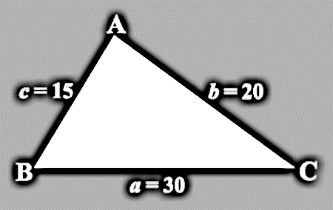
Example 2: Given SSS: Find m∠B, given that side a = 30, side b = 20, and side c = 15.
a² = b² + c² – 2bc▪cos(A)
b² = a² + c² – 2ac▪cos(B)
20² = 30² + 15² – 2(30)(15)▪cos(B)
400 = 900 + 225 – 900▪cos(B)
400 = 1125 – 900▪cos(B)
-1125 = -1125
-725 = -900▪cos(B)
B = 36.29º
-900
-900
.806 = cos(B)
cos⁻¹(.806) = B

Slide 15
Practice Problems: Find the values of x and y. Hint: You will have to use the Law of Cosines twice!
3.
4.
x = 36.87º
x = 21.57º
y = 34.92º
y = 53.13º

Slide 16
ANNOUNCEMENTS -Pick up your assigned calculator -Take out your HW to be stamped
WARM UP
∆ABC is an isosceles triangle with leg $\overline{AB}$ = 10 feet. Find the length of $\overline{AC}$. Hint: How many angles are the same in an isosceles triangle? Label those angles!
Update your TOC. Glue #5 notes onto pg. 48.
DO ON WHITEBOARD!!

Slide 17
HOMEWORK QUESTIONS?

Slide 18
#6 Law of Sines

Slide 19
Homework
#5 & #6 in HW Packet (#1-7 use Law of Cosines; #8-15 use Law of Sines)

Slide 20
LAW OF SINES
$\frac{\sin{(A)}}{a}$ = $\frac{\sin{(B)}}{b}$ = $\frac{\sin{(C)}}{c}$
*Usually used when you have ASA or AAS.

Slide 21
USE LAW OF SINES WHEN…
You know two __________ and an ____________ side and are trying to find the angle ________________ the side.
You know two ____________ and a non-included _________ and are trying to find a missing _____________.
angles
included
opposite
angles
side
side(s)

Slide 22
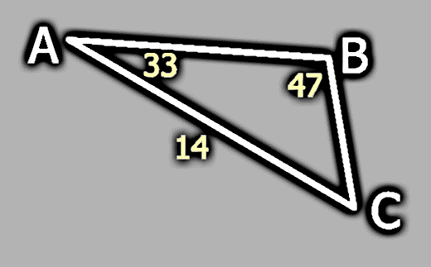
Example 1: Find the missing angle. In the triangle below, m∠A = 33º, m∠B = 47º and b = 14. Find the length of $\overline{BC}$.
c
$$\frac{sinA}{a}= \frac{sinB}{b}$$
a
$$\frac{sin{33}^{o}}{a}= \frac{sin{47}^{o}}{14}$$
b
14($\sin{{33}^{o})=a(\sin{{47}^{o})}}$
$$\sin{{47}^{o}}$$
$$\sin{{47}^{o}}$$
10 = a
10 = BC

Slide 23
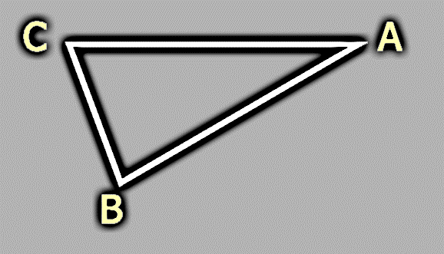
Practice Problems: Find all missing angles and sides in the triangle below: m∠A = 28º, a = 12, and b = 24.
180º = 70º + 28º + C
b
24
$$\frac{sin{28}^{o}}{12}= \frac{sinB}{24}$$
28º
180º = 98º + C
82º
-98º -98º
a
12
70º
c
24($\sin{{28}^{o})=12(\operatorname{sinB}{)}}$
82º = C
12 12
2($\sin{{28}^{o})=sinB}$
.939 = sinB
70º = B

Slide 24
Example 2: A civil engineer wants to determine the distances from points A and B to an inaccessible point C. From direct measurement, the engineer knows that AB = 25 meters, m∠A = 110º, and m∠B = 20º. Find AC and BC.
A
180º = 110º + 20º + C
$\frac{sinA}{a}= \frac{sinB}{b}$ = $\frac{sinC}{c}$
11m
180º = 130º + C
25m
110º
b
-130º -130º
c
$$\frac{sin110o}{a}= \frac{sin50o}{25}$$
50º = C
20º
50º
$$\frac{sin20o}{b}= \frac{sin50o}{25}$$
$$25(sin110o)=a(sin⁡50o)$$
B
a
C
$sin⁡50o$ $sin⁡50o$
$3$1m
$$25(sin20o)=b(sin⁡50o)$$
$$31=a$$
$sin⁡50o$ $sin⁡50o$
1$1=$b
AC = 11m
BC = 31m

Slide 25
On your whiteboard, write down this sentence:
The Bulls will beat the Cavaliers tonight.

Slide 26
BRAIN BREAK #2

Slide 27
Homework
#5 & #6 in HW Packet (#1-7 use Law of Cosines; #8-15 use Law of Sines)

Slide 28
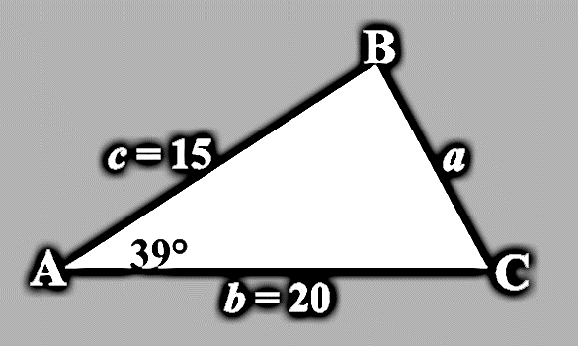
Exit Ticket
Find a, given that angle A = 39º, side b = 20, and side c = 15.
Find the measure of angle B, using the information provided and the information you found in #1.

