Slide 1
ANNOUNCEMENTS -Pick up your assigned calculator -Take out your HW to be stamped
WARM UP
Copy the following into your Vocab Section (Purple tab!)
Ratio – a comparison of two quantities
Directed Line Segment – a segment between two points A & B with a --- directions, from A to B or from B to A
Update your TOC.

Slide 2
Cross Sections Review

Slide 3
Inverse Variation Review
The length of a violin string varies inversely as the frequency of its vibrations. A violin string 14 inches long vibrates at a frequency of 450 cycles per second. Find the frequency of a 12-inch violin string.

Slide 4
HOMEWORK QUESTIONS?

Slide 5
#5 Partitioning Directed Line Segments

Slide 6
What is a directed line segment?
A directed line segment is a segment between two points A and B with a specified direction, from A to B or from B to A. To PARTITION a directed line segment is to divide it into two segments with a given ratio.

Slide 7
How to find the Coordinates of a Point in a Directed Line Segment
Identify the _______ from start point to end point.
Find the change in ______ and the change in ______.
___________ the change in x’s and the change in y’s by the _______ from start point to end point.
_________ or __________________ these values from your ___________ point.
ratio
X’s
Y’s
Multiply
ratio
Add
Subtract
START

Slide 8
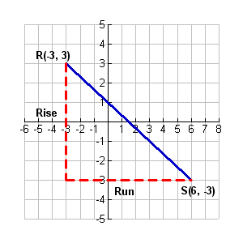

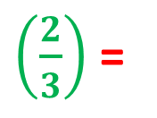
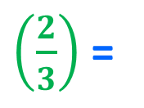
Example 1: Finding the Coordinates of a Point in a Directed Line Segment Find the point Q along the directed line segment from point R(–3, 3) to point S(6, –3) that divides the segment into the ratio 2 to 1.
Step 4: Add or Subtract these values from your START point.
Step 1: Identify the ratio from start point to end point
Step 2: Find the change in X’s and Y’s.
Step 3: Multiply the change in x’s and the change in y’s by the ratio from start point to end point.
$$\frac{first \#}{total}$$
=
$$\frac{2}{3}$$
Step 1
 | X’s | Y’s
Step 2
Step 3
Step 4
6 – –3 =
6 + 3 =
9
–3 – 3 =
–6
9
$\left(\frac{2}{3}\right)$ =
6
–6
$\left(\frac{2}{3}\right)$ =
–4
Q(3, –1)
–3
+
6
=
3
3
– 4
=
–1

Slide 9
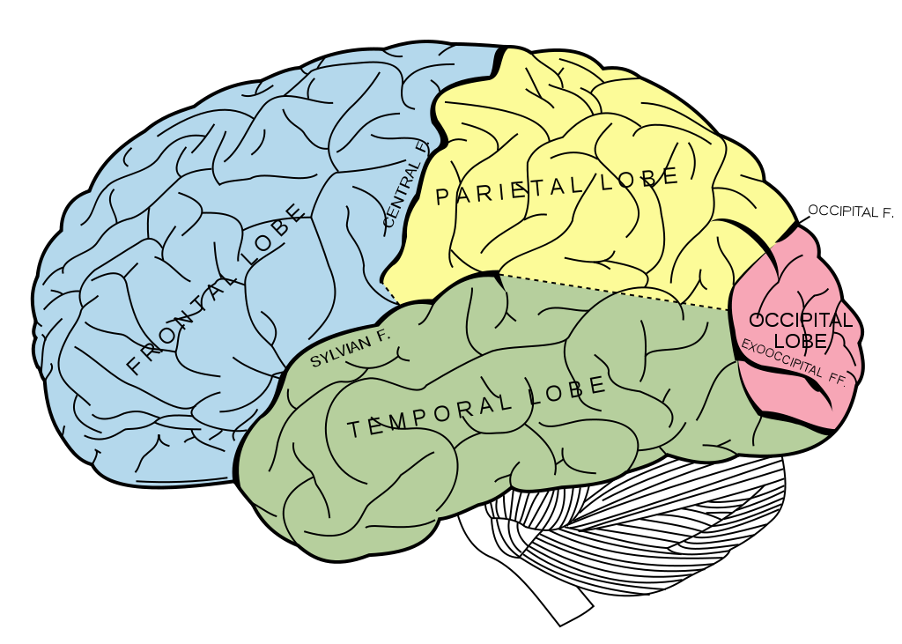
BRAIN BREAK

Slide 10
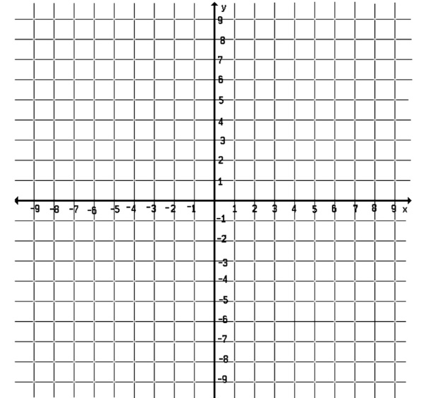
Example 2: Find the coordinates of the point P that lies along the directed segment from A(1, 1) to B(7, 3) and partitions the segment in the ratio of 1 to 4.

Slide 11
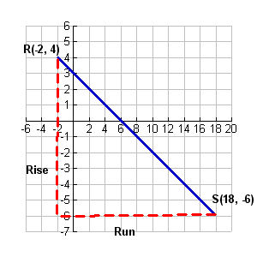
Practice Problem: Find the point Q along the directed line segment from point R(–2, 4) to point S(18, –6) that divides the segment in the ratio 3 to 7.

Slide 12
Midpoint Review
M = $\left(\frac{−2+−6}{2},\frac{−5+6}{2}\right)$
M = $\left(\frac{−8}{2},\frac{1}{2}\right)$
M = $\left(−4,.5\right)$

Slide 13
BRAIN BREAK

Slide 14
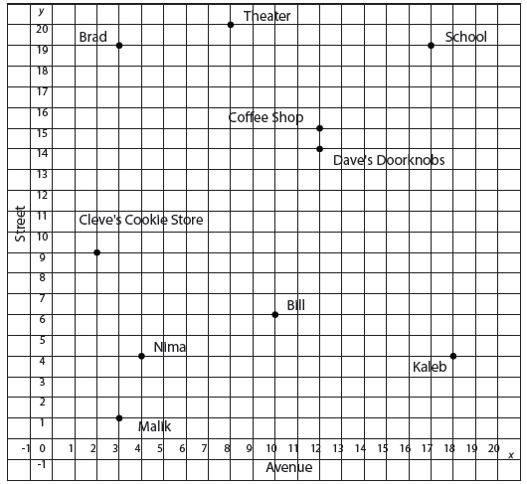
Practice! – HW Packet pg. 4
Luis works at a theater on 8th Avenue and 20th Street. Kaleb lives at the corner of 18th Avenue and 4th Street. What is a possible location that is midway between them?
Nima lives at the corner of 4th Avenue and 4th Street. Bill lives at the corner of 10th Avenue and 6th Street. Their favorite bakery is located midway between them. What is one possible of the bakery?
Cleve’s Cookie Store is located at the corner of 2nd Avenue and 9th Street. Dave’s Doorknobs is located at the corner of 12th Avenue and 14th Street. Located 1/5 of the distance from Cleve’s Cookie Store is the post office. Where is the post office?
Malik and Brad both live on 3rd Avenue. Malik lives at the corner of 1st Street, and Brad lives at the corner of 19th Street. 2/3 the distance from Malik’s apartment to Brad’s apartment is a market. Where is the market?
The main entrance to the high school is located at the corner of 17th Avenue and 19th Street. On his way from school to the bank, Luis stops at the coffee shop located at 12th Avenue and 15th Street. The coffee shop is the midpoint of this trip. What is the location of the bank?

Slide 15
Homework
#5 in HW Packet (pg. 4 – all)
HW Packets due Friday!
Continue working on your Unit 7 Celebration Partner Poster!

Slide 16
Exit Ticket
How does finding the midpoint of a segment and partitioning a directed line segment in a 1:1 ratio relate to each other? Answer in complete sentences, and refer to specific notes or homework examples.

