Slide 1
ANNOUNCEMENTS -Pick up your assigned calculator -Take your HW Packet out to stamp.
WARM UP
Solve for a: $\frac{1}{a+1}+\frac{1}{a−1}$ = $\frac{2}{a^{2}−1}$ (#4 from HW)
Update your TOC.

Slide 2
Homework Questions

Slide 3
#5 Radical Expressions & Equations

Slide 5
Steps to Simplifying Radicals
Example $\sqrt{18}$
Factor the radicand.
Make sure one of the factors is a perfect square.
Take the square root of the BIGGEST perfect square factor and pull it outside of the radical.
Simplify what's left in the radicand.
18 $\sqrt{2▪9}$
18
9 $3\sqrt{2}$
6

Slide 6
Practice Problems
1. $\sqrt{24}$ 2. $\sqrt{108}$ 3. $\sqrt{27}$ 4. $\sqrt{72}$ 5. $\sqrt{96}$
$2\sqrt{6}$ $6\sqrt{3}$ $3\sqrt{3}$ $6\sqrt{2}$ $4\sqrt{6}$

Slide 7
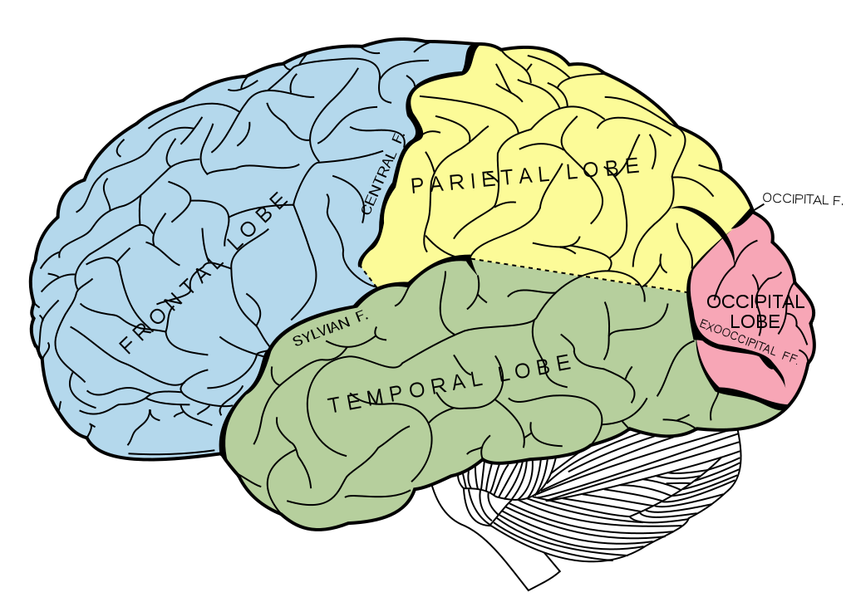
BRAIN BREAK

Slide 8
https://www.youtube.com/watch?v=ukY6pQk3d2k Until 1:45

Slide 9
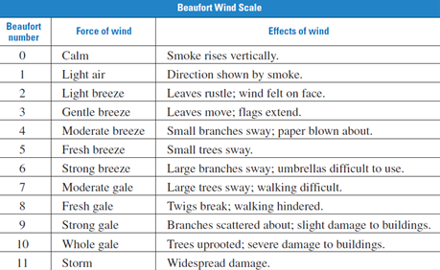
The Beaufort Wind Scale was devised to measure wind speed. The Beaufort number, B, which range from 0-12, can be modeled by B = 1.69$\sqrt{s+4.45}$ – 3.49 where s is the speed (in miles per hour) of the wind.
If the sailors have the best and safest wing when the Beaufort number is 6, how fast is the wind moving?
6 = 1.69$\sqrt{s+4.45} −3.49$
+3.49 +3.49
9.49 = 1.69$\sqrt{s+4.45}$
1.69 1.69
5.62 = $\sqrt{s+4.45}$
31.58 = s + 4.45
-4.45 -4.45
27.13 mph = s
Check:
6 = 1.69$\sqrt{(27.13)+4.45}−3.49$
6 = 1.69$\sqrt{31.58}−3.49$
6 = 1.69(5.62) – 3.49
6 = 9.5 – 3.49
6 ≈ 6.01
2 2

Slide 10
So who won America’s Cup last year? (36:50)
https://www.youtube.com/watch?v=JLX1XPCQodk

Slide 11
Solving Radical Equations is just like finding the wind speed for the sailboats! There you solved for speed “s” and here you’ll want to solve for the variable still.
Principle for Solving Radical Equations
To Solve a Radical Equation Containing One Square Root
Isolate the radical on one side of the equation.
Square both sides of the equation.
Solve for the variable.
Check the solutions.

Slide 12
Example Problems
1. $\sqrt{x+3}$ – 5 = 0
2. 10 = $\sqrt[3]{6x−2}$
( )³ ( )³
+5 +5
$$\sqrt{x+3}=5$$
x + 3 = 25
-3 -3
x = 22
Check:
$$\sqrt{\left(22\right)+3}−5=0$$
$\sqrt{25}−5=0$
5 – 5 = 0
0 = 0
1000 = 6x – 2
+2 +2
1002 = 6x
6 6
167 = x
2 2
Check:
10 = $\sqrt[3]{6(167)−2}$
10 = $\sqrt[3]{1002−2}$
10 = $\sqrt[3]{1000}$
10 = 10

Slide 13
BRAIN BREAK

Slide 14
Team Practice – Color Match Up #5 in HW Packet
Solve the radical equations on the left and match them to their solutions on the right.
When you find a match, color those boxes in using the same color.
You should use 10 different colors.

Slide 15
Example Problems
3. A ten-foot board leans against an 8-foot wall so that the top end of the board is at the top of the wall. How far must the bottom of the board be from the wall? Let x be the distance from the bottom of the board to the wall. Use the Pythagorean Theorem.
a² + b² = c²
x² + 8² = 10²
x² + 64 = 100
-64 -64
x² = 36
x = 6 ft.
Check:
(6)² + 8² = 10²
36 + 64 = 100
100 = 100
$$√$$
$$√$$

Slide 16
Homework
#5 Radical Equations (all 10) – whatever you did not finish

Slide 17
Exit Ticket
Simplify $\sqrt{86}$
Solve $\sqrt{17m−15}=4m$

