Slide 1
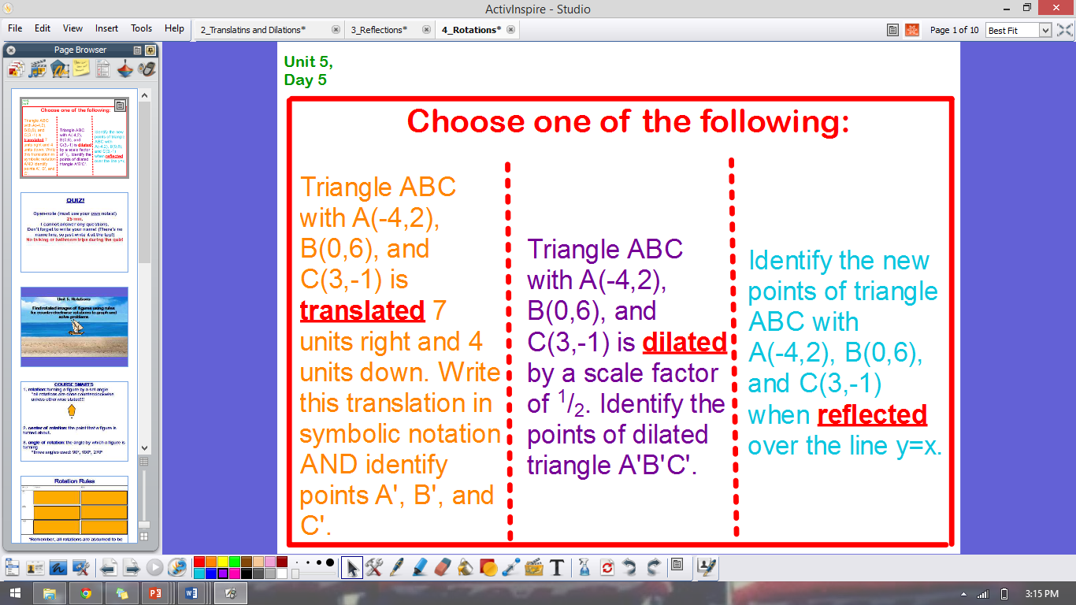
ANNOUNCEMENTS
-Pick up your assigned calculator
-Take out your HW to stamp
WARM UP

Slide 2
HOMEWORK QUESTIONS?

Slide 3
#5 Rotations

Slide 4
Vocabulary!
Rotation: turning a figure by a set angle
Center of Rotation: the point that a figure is turned about

Slide 5
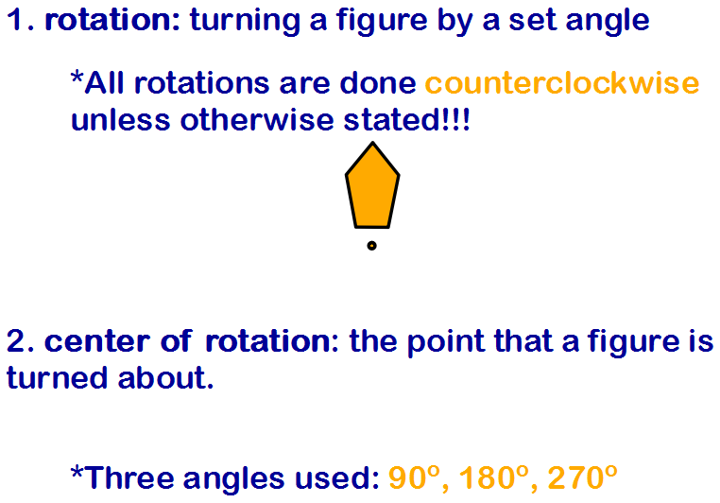

Slide 6
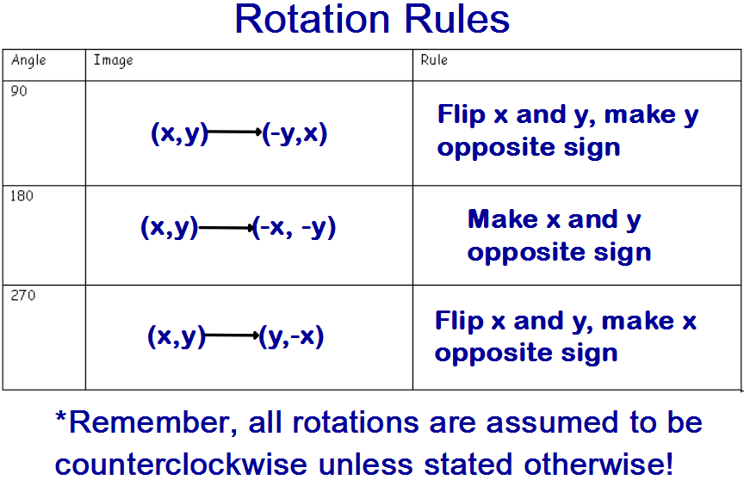

Slide 7
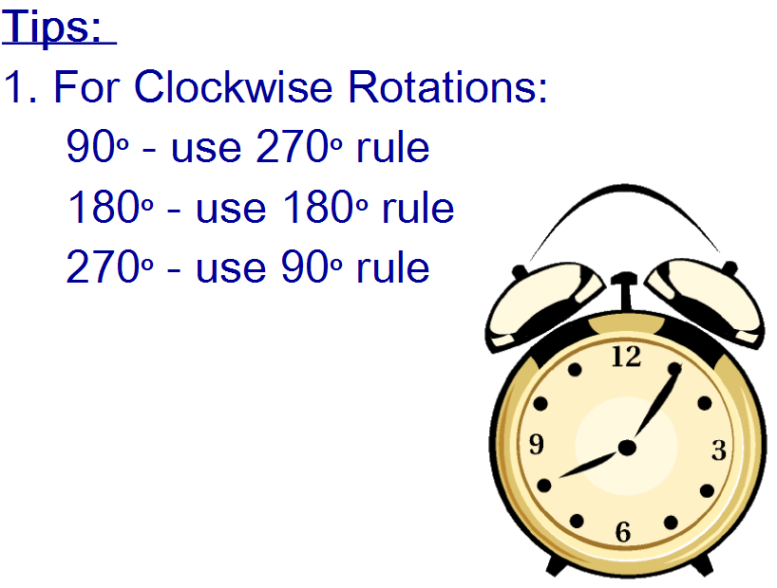

Slide 8
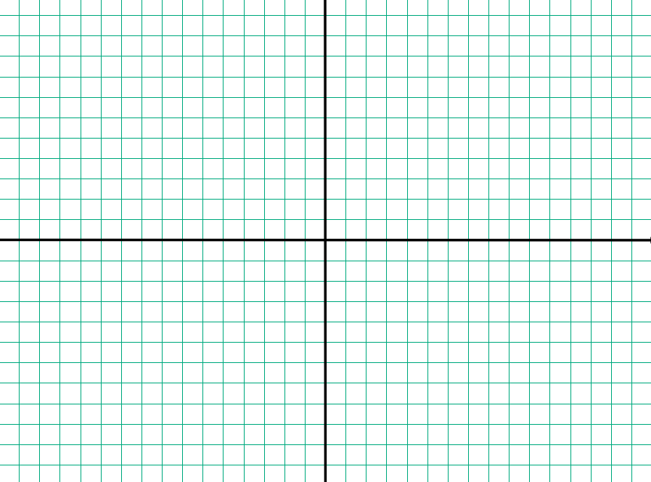
EXAMPLE 1: R₂₇₀º: ΔABC: A(6,2) B(-3,4) C(8,5)

Slide 9
EXAMPLE 2. R₉₀º: ΔXYZ: X(3,-4) Y(7,2) Z(-6,5)

Slide 10
EXAMPLE 3. R₁₈₀º: ABCD: A(5,9) B(8,9) C(8,4) D(5,4)

Slide 11
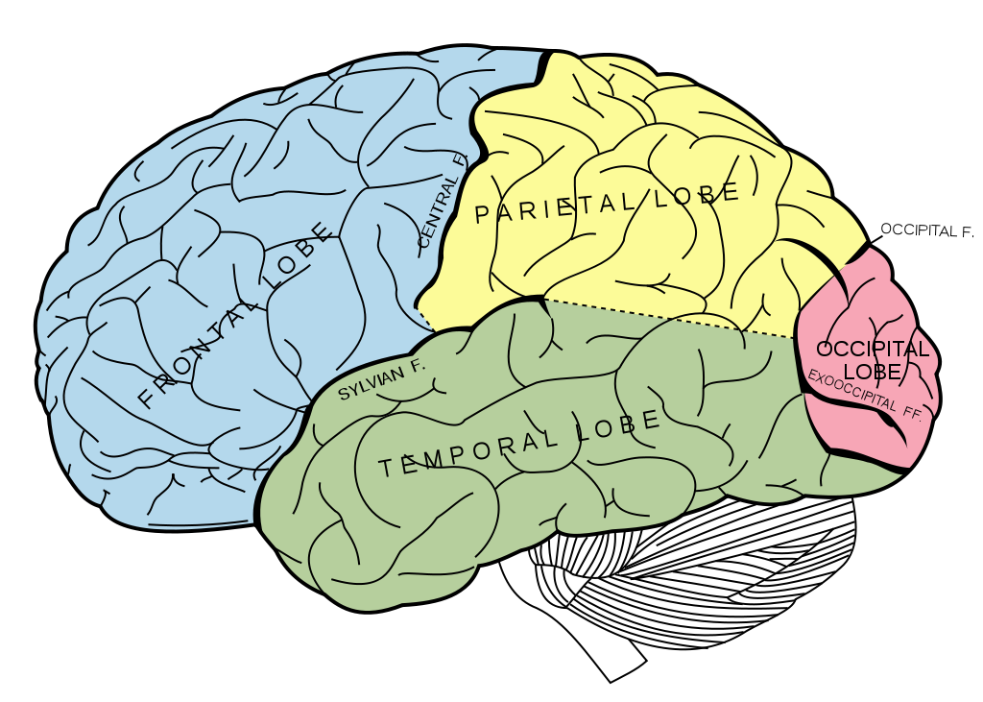

BRAIN BREAK

Slide 12
Homework
#5 Rotations

Slide 13
“POP” QUIZ!
Individual quizzes
Name & Number
Show ALL work
Open-note: can only use your own ISN
Use back of page & graph sheet if you need more room
No bathroom trips during quiz time
Flip over when done

Slide 14
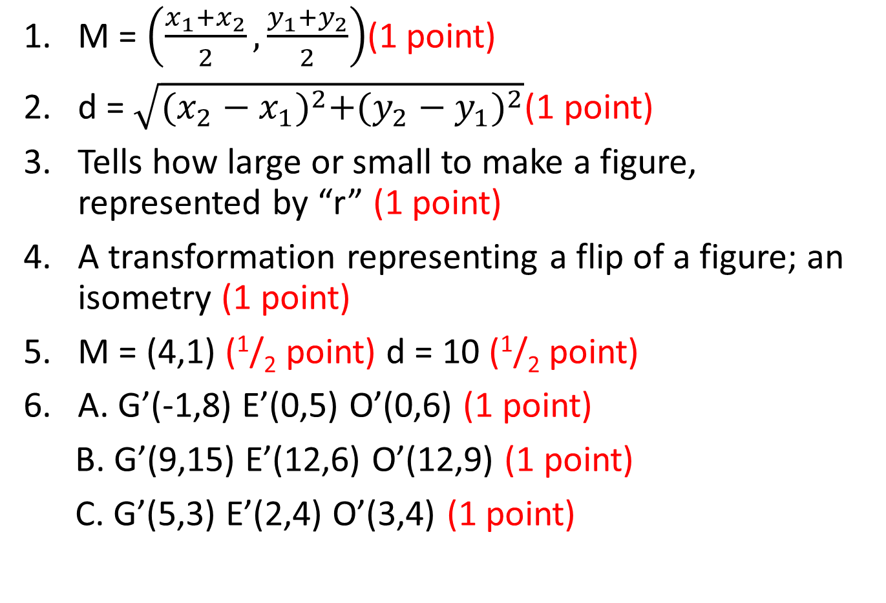
Quiz Answers
M = $\left(\frac{x_{1}+x_{2}}{2},\frac{y_{1}+y_{2}}{2}\right)$(1 point)
d = $\sqrt{{(x_{2}−x_{1})}^{2}+{(y_{2}−y_{1})}^{2}}$(1 point)
Tells how large or small to make a figure, represented by “r” (1 point)
A transformation representing a flip of a figure; an isometry (1 point)
M = (4,1) (¹/₂ point) d = 10 (¹/₂ point)
A. G’(-1,8) E’(0,5) O’(0,6) (1 point)
B. G’(9,15) E’(12,6) O’(12,9) (1 point)
C. G’(5,3) E’(2,4) O’(3,4) (1 point)

Slide 15
WORK TIME
Unit 3 Test Corrections – Friday 3/27
Unit 4 Homework Packet – Tuesday 3/31
Midterm Notebook Check – Wed. 3/25 (1st Period), Fri. 3/27 (3rd Period), Mon. 3/30 (4th Period)
    TOC updated (Yellow Tab)
    All notes glued/taped in AND filled out (even from when you were absent)
    Page numbers
    Vocabulary & Formulas (Purple Tab)
    Data Trackers (Green Tab)
Midterm – Next week! Wed. 3/25 (1st Period), Fri. 3/27 (3rd Period), Mon. 3/30 (4th Period)
Late or Missing Work – Friday 3/27
    Late – anything from Unit 3 will be accepted until Friday 10/17 for 70%
    Anything else missing – will be accepted for 50%
Check yellow bin for extra copies or print a new copy from my website.

Slide 16
Exit Ticket
Use the triangles to the right to find the coordinates needed to solve the following:
Rotate ΔQRS 270º.
CHALLENGE! Rotate ΔQRS 270º, then translate it by the rule (x+1, y+4).

Slide 17
BRAIN BREAK

