Slide 1
ANNOUNCEMENTS -Pick up your assigned calculator -Take out HW to stamp
1st Period - WARM UP – on whiteboard!
There are 10 students total who are running for office in our class elections. Ty’She, Trevor, & Trayvon are running for Secretary. Jesse, Jaylon, Juan, & Jamya are running for Treasurer. Rell, Bree, & Nigel are running for President. Write answers in percent form!
What is the probability that a girl will be elected Secretary?
What is the probability that a boy will be elected Secretary and Rell will beat out his opponents for the Treasurer position?
What is the probability that someone with at least 2 vowels in their name will be elected President?
Challenge: What is the probability that a someone with an “i” in their name or whose name ends in a consonant will be elected for Treasurer and two girls will be elected for the other positions?
Update your TOC.

Slide 2
ANNOUNCEMENTS -Pick up your assigned calculator -Take out HW to stamp
3rd Period - WARM UP – on whiteboard!
There are 10 students total who are running for office in our class elections. Hope, Dre, & Lexi are running for Secretary. Tikwan, Philip, Paola, & Ozzy are running for Treasurer. Kaliyah, Sha-Myia, & William are running for President. Write answers in percent form!
What is the probability that a girl will be elected Secretary?
What is the probability that a boy will be elected Secretary and Tikwan will beat out his opponents for the Treasurer position?
What is the probability that someone with at least 2 vowels in their name will be elected President?
Challenge: What is the probability that a someone with an “i” in their name or whose name ends in a consonant will be elected for Treasurer and two girls will be elected for the other positions?
Update your TOC.

Slide 3
ANNOUNCEMENTS -Pick up your assigned calculator -Take out HW to stamp
4th Period - WARM UP – on whiteboard!
There are 10 students total who are running for office in our class elections. Armaan, Antonio, & Abbey are running for Secretary. Zarriah, Tyra, Nigel, & Tay are running for Treasurer. Justin, Madeline, & Shannon are running for President. Write answers in percent form!
What is the probability that a girl will be elected Secretary?
What is the probability that a boy will be elected Secretary and Nigel will beat out his opponents for the Treasurer position?
What is the probability that someone with at least 2 vowels in their name will be elected President?
Challenge: What is the probability that a someone with an “i” in their name or whose name ends in a consonant will be elected for Treasurer and two girls will be elected for the other positions?
Update your TOC.

Slide 4
Homework Questions?

Slide 5
Vocab! (Purple Tab)
Set – a collection of things
Intersection – everything in common; symbolic notation: ∩
Union – everything included; symbolic notation: ∪

Slide 6
#5 Venn Diagrams & Two-Way Frequency Tables

Slide 7
Sets
A set is a collection of things
For example, the items you wear are in a set: these would include shoes, socks, hat, shirt, pants, and so on.
You write sets inside curly brackets like this:
{shoes, socks, hat, shirt, pants}
You can also have sets of numbers
The set of numbers between 1 and 5 would be: {1, 2, 3, 4, 5}

Slide 8
Two Way Tables – Conditional Probability Review
Two way tables compare one thing with another. For example, the number of students taking Spanish lessons, and which of those students are girls or boys.
These tables can be used to work out the probability that a student selected at random would be a boy taking Spanish, for example.

Slide 9
Let’s start with an example right from our class!

Slide 10
Example – Data Collection
Who in the room has been to Atlanta, GA? Who in the room currently owns an iPod? |  | Has an iPod |  | TOTALS
 |  | Yes | No
Has been to Atlanta, GA | Yes
 | No
TOTALS
What is the Probability of someone in the room not currently owning an Ipod, but who has been to Atlanta, GA? ___________

Slide 11
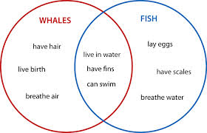
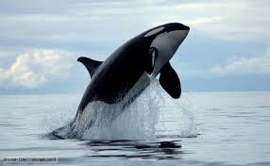
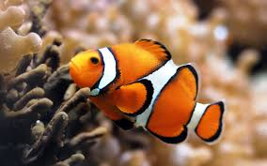
Venn Diagrams
Venn diagrams were invented by a guy named John Venn (no kidding; that was really his name) as a way of picturing relationships between different groups of things.
We can use Venn Diagrams to hold the same information presented in Two-Way Tables.

Slide 12
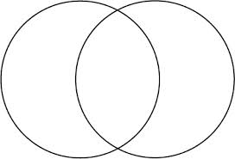
Example 1: Students who have been to Atlanta and students who own an iPod
Been to Own an Atlanta Both iPod

Slide 13
Unions Vs. Intersections
The union of a set is everything that is included. The symbolic representation is ∪.
So the union of students who have been to Atlanta or own an iPod is :
The intersection of a set is everything they have in common. The symbolic representation is ∩.
The intersection of students who have been to Atlanta and students who have an iPod is:

Slide 14
Unions
Example 2: A bouquet of flowers contain roses, carnations, and baby’s breath. A second bouquet has roses, lilies, and daisies. Both bouquets are put in the same vase. Write a set for union of flowers in the vase.
{roses, carnations, baby’s breath, lilies, daisies}
Example 3: P = {5, 10, 15, 20} and Q = {8, 10, 18, 20}. Find P ∪ Q.
{5, 8, 10, 15, 18, 20}

Slide 15
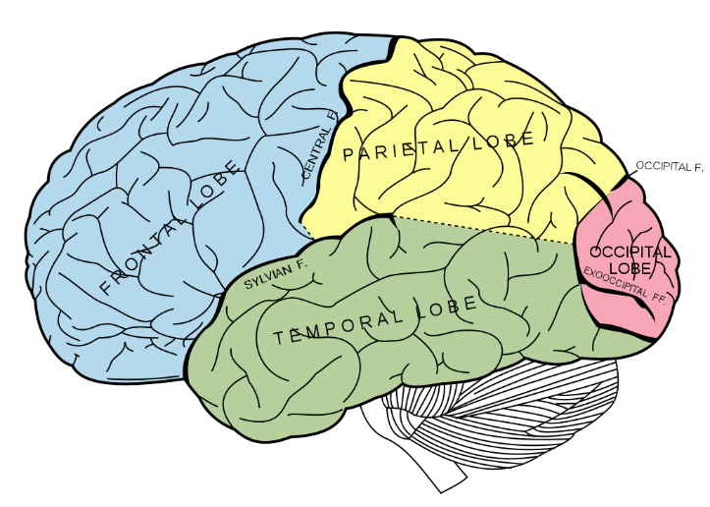
BRAIN BREAK #1

Slide 16
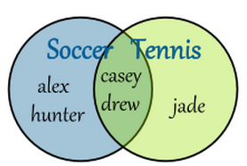
Intersections
Example 4: What would the intersection of the following Venn diagram be?.
{Casey, Drew}
Example 5: What would the intersection of the following sets be?
A { 1,3,5,7,9,11,13} and B {1,2,3,4,5,6,7}
{1,3,5,7}

Slide 17
Example 6: In a school of 320 students, 85 students are in the band, 200 students are on sports teams, and 60 students participate in both activities. How many students are involved in either band or sports?
“or” means add!
Band Both Sports Team
85
-60
25
200
-60
140
320
-25
-60
-140
95
60
25 band students + 140 sports students = 165 in band or sports

Slide 18
State Final Example! Twenty-one students at a school have an allergy to peanuts, shellfish, or both. □Fourteen students at the school are allergic to peanuts. □Twelve students at the school are allergic to shellfish. How many of the students are allergic to both peanuts and shellfish?
Total = 21
Peanuts Both Shellfish
A. 12
B. 7
C. 5
D. 2
14 + 12 = 26
14
- 5
9
26
-21
5
12
- 5
7
9 + 5 + 7 = 21

Slide 19
Venn Diagram Team Project
You will now work within your teams to develop your own two-way table and Venn Diagram on a mini-poster. You will also create 5 questions based off your table/diagram and an answer key.
Follow along with the steps as we go through the activity (DO NOT MOVE ONTO THE NEXT STEP UNTIL I SAY SO)
Each step will be assigned a time limit to complete the step in
Be Creative and HAVE FUN doing the activity!
The best mini poster (with a grade of 95% or higher) will be included in your upcoming test!

Slide 20
TITLES FOR VENN DIAGRAMS
RED: Students who have at least one brother/have at least one sister
ORANGE: Students who have seen The Notebook/have seen The Fast and Furious
YELLOW: Students who are from NC/out-of-state
GREEN: Students who are 5’5” or shorter/taller than 5’5”
BLUE: Students who are in an after school club/taking driver’s ed
PURPLE: Students wearing black/red
PINK: Students who take the bus/car
TEAL: Students who are on a sports team/have been to another country

Slide 21
Create a Two-Way Table on your poster that looks like this
Question 1
Question 2
Both
 |  |  |  | TOTALS
TOTALS
Question 2
Yes
No
Create a Venn Diagram on your poster that looks like this
Question 1
Yes
No

Slide 22
STEP #1 (10 minutes)
Each group will get a chance to conduct their survey to the rest of the class (do not forget to survey your own group members)
A member of your group will go to another groups table with a pencil/pen and something to write on and will conduct the survey
When the survey is completed, return to your desk and allow the next group to get started

Slide 23
Step #2 (3 minutes)
Get all of the information you retrieved from the class and add all of the results of the survey together

Slide 24
Step #3 (10 minutes)
Each group will be given a poster. Use the material in your Team Boxes for creativity (rulers, markers, etc.)!
Using the poster, make a presentation for the results of your survey in the form of a two-way table and a Venn Diagram
On the back, create 5 test questions based off your diagram and table.
Each poster needs to include
The completely written out survey questions
A two-way table with the results of your survey
The Venn Diagram with students’ names
Your group members names

Slide 25
Create a Two-Way Table on your poster that looks like this
Question 1
Question 2
Both
 |  |  |  | TOTALS
TOTALS
Question 2
Yes
No
Create a Venn Diagram on your poster that looks like this
Question 1
Yes
No

Slide 26
Homework
#4 in HW Packet (bottom of pg. 2 and pg. 3 – all)
HW Packets due Friday, 12/19!
Copy down the table for #5!

