Slide 1
ANNOUNCEMENTS -Pick up your assigned calculator -Take out HW to stamp
WARM UP
Work on #4 LITERAL EQUATIONS from HW Packet. Choose any 5 problems to complete. You can write directly on your HW Packet (You don’t need to write on the Warm Up sheet.)

Slide 2
#6 Exponential Growth & Decay

Slide 3
Vocabulary!
Exponential Growth: any quantity that grows by a fixed percent or regular intervals
Exponential Decay: any quantity that decays by a fixed percent or regular intervals

Slide 4
Quantitative Comparison
The ACT will ask you more rigorous questions that require you to conceptualize answers without actually solving a problem.
These types of problems will give you to quantities and determine whether A) Quantity A is bigger, B) Quantity B is bigger, C) They are equal, or D) Not enough information to decide
To prepare for this, we are going to practice one now to introduce the last topic in our Trig Unit.
Let’s do a quick practice round before the real thing!

Slide 5
A: Quantity A is bigger B: Quantity B is bigger C: They are the equal D: Not enough information to decide
QUANTITY A
2
QUANTITY B
4
Take 10 seconds to decide on your answer and write the letter on your whiteboard.

Slide 6
Which is bigger – Quantity A or Quantity B? A: Quantity A is bigger B: Quantity B is bigger C: They are the equal D: Not enough information to decide
QUANTITY A
The value of a car after t years as given by the equation: V₁ = 24,000(0.55)^{2t}
The value of a car that initially costs $24,000, after t years, that depreciates in value at a rate of 45% every 2 years.
QUANTITY B
The value of a car after t years as given by the equation: V₂ = 24,000(0.42)^{t}
The value of a car that initially costs $24,000, after t years, that depreciates in value at a rate of 58% every year.
Notes:
Quick Poll 1: before solving
Quick Poll 2: individually work out on whiteboards and formalize ideas (3 min) – discuss with partner (3 min)
Quick Poll 3: after whole class discussion

Slide 7
EXPONENTIAL GRAPHS
growth
decay
Now graph Quantity A: V₁ = 24,000(0.55)^{2t} or Quantity B: V₁ = 24,000(0.42)^{t} in your calculator! Use Y for V and X for t.
After you put it in Y=, hit ZOOM 0 (ZoomFit) so you can see the whole thing!
Are the values of the cars increasing or decreasing? Exponential growth or decay?

Slide 8
EXPONENTIAL FORMULAS
EXPONENTIAL GROWTH
EXPONENTIAL DECAY
Y = a(1 + r)^{t}
Y = a(1 – r)^{t}
y = new value
a = start value
r = growth rate
t = time
What is the growth rate of the value of Quantity A: V₁ = 24,000(0.55)^{2t} or the value of Quantity B: V₁ = 24,000(0.42)^{t}?

Slide 9
Which is bigger – Quantity A or Quantity B? A: Quantity A is bigger B: Quantity B is bigger C: They are the equal D: Not enough information to decide
QUANTITY A
The value of a car after t years as given by the equation: V₁ = 24,000(0.55)^{2t}
The value of a car that initially costs $24,000, after t years, that depreciates in value at a rate of 45% every 2 years.
QUANTITY B
The value of a car after t years as given by the equation: V₂ = 24,000(0.42)^{t}
The value of a car that initially costs $24,000, after t years, that depreciates in value at a rate of 58% every year.
Notes:
Quick Poll 1: before solving
Quick Poll 2: individually work out on whiteboards and formalize ideas (3 min) – discuss with partner (3 min)
Quick Poll 3: after whole class discussion

Slide 10
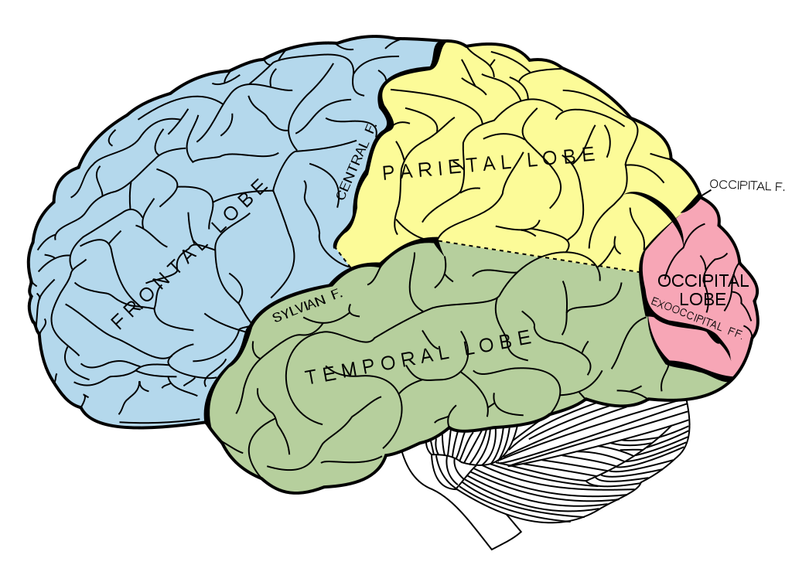
BRAIN BREAK

Slide 11
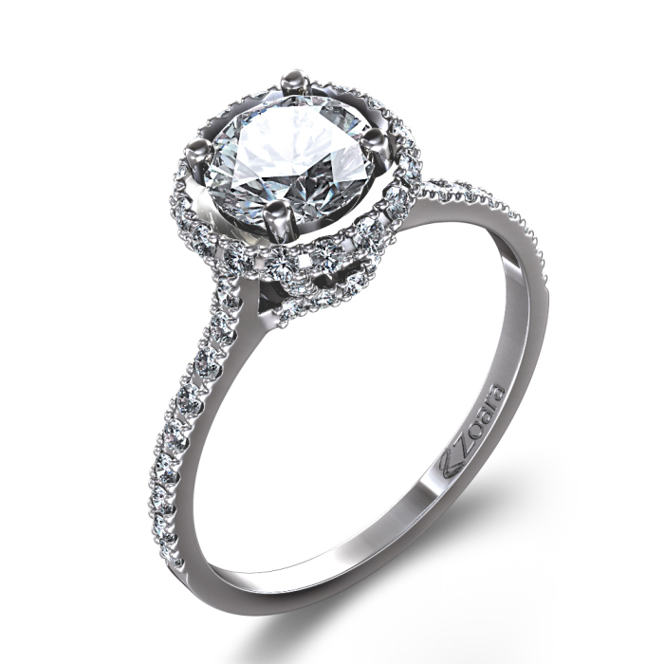
Example 1: A diamond ring was purchased in 1994 for $500. The value of the ring increased by 8% each year. What is the value of the ring today?
2015 8% = .08 y = a(1+r)^{t}
-1994 y = 500(1+.08)²¹
21 y = 500(1.08)²¹
y = $2,516.92
Notes:
Exponent first, then multiply by initial value

Slide 12
Example 2: This month, Kim deposits $1000 into her Hawk Metro Credit Union account at a rate of 6% interest compounded continuously. Find the amount in her account when she graduates.
t = 2 years 6% = .06 y = a(1+r)^{t}
y = 1000(1+.06)²
y = 1000(1.06)²
y = $1,123.60

Slide 13
Example 3: This month, Bree also deposits $1000 into her bank account. Her bank has an interest rate of 6% compounded quarterly. Find the amount in her account when she graduates. Who has more money, Kim or Bree?
t = 2 years 6% = .06 y = a(1+r)^{t}
y = 1000(1+$\frac{.06}{4}$)²⁽⁴⁾
y = 1000(1.015)⁸
y = $1,126.49
Bree has more money!

Slide 14
Example 2: This month, Sha’Myia deposits $1000 into her Hawk Metro Credit Union account at a rate of 6% interest compounded continuously. Find the amount in her account when she graduates.
t = 2 years 6% = .06 y = a(1+r)^{t}
y = 1000(1+.06)²
y = 1000(1.06)²
y = $1,123.60

Slide 15
Example 3: This month, Dari also deposits $1000 into her bank account. Her bank has an interest rate of 6% compounded quarterly. Find the amount in her account when she graduates. Who has more money, Sha’Myia or Dari?
t = 2 years 6% = .06 y = a(1+r)^{t}
y = 1000(1+$\frac{.06}{4}$)²⁽⁴⁾
y = 1000(1.015)⁸
y = $1,126.49
Dari has more money!

Slide 16
Example 2: This month, Evelin deposits $1000 into her Hawk Metro Credit Union account at a rate of 6% interest compounded continuously. Find the amount in her account when she graduates.
t = 2 years 6% = .06 y = a(1+r)^{t}
y = 1000(1+.06)²
y = 1000(1.06)²
y = $1,123.60

Slide 17
Example 3: This month, Minnie also deposits $1000 into her bank account. Her bank has an interest rate of 6% compounded quarterly. Find the amount in her account when she graduates. Who has more money, Evelin or Minnie?
t = 2 years 6% = .06 y = a(1+r)^{t}
y = 1000(1+$\frac{.06}{4}$)²⁽⁴⁾
y = 1000(1.015)⁸
y = $1,126.49
Minnie has more money!

Slide 18
PULSE CHECK
“I’m good with this, Ms. Santos. Let me work on my own!”
“I’ll be good, but can I get one more example please?”
“No no no! Ms. Santos don’t leave me! Come help!”

Slide 19
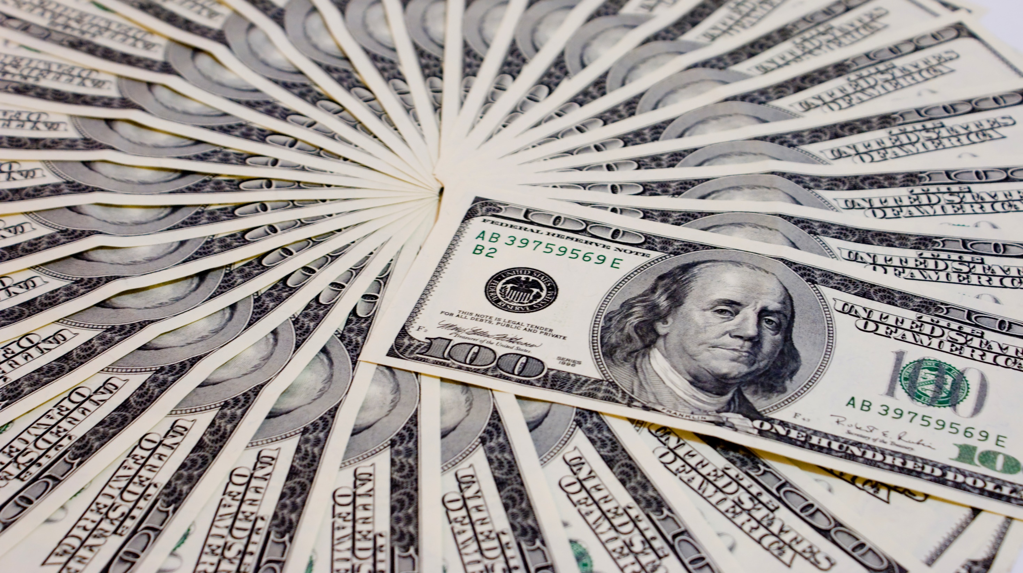
Example 4: When Coach Lawing was a freshman at West Meck in 1975, he deposited $2,340.00 into his Hawk Metro Credit Union account. The account pays interest at a rate of 3% compounded continuously. How much money is in his account today?
2015 3% = .03 y = a(1+r)^{t}
-1975 y = 1000(1+$\frac{.03}{12}$)⁴⁰⁽¹²⁾
40 y = 1000(1.0025)⁴⁸⁰
y = $7,757.45

Slide 20
Example 5: A man purchased a brand new Outlander 800 ATV for $13,000. It depreciates at a rate of 15% per year. What is the value of the Outlander after 5 years?
15% = .15 y = a(1 – r)^{t}
y = 13,000(1 – .15)⁵
y = 13,000(1.015)⁸
y = $5,768.17

Slide 21
BRAIN BREAK

Slide 22
Homework
#6 in HW Packet (all)

Slide 23
Exit Ticket
A man purchased a brand new Outlander 800 ATV for $13,000. It depreciates at a rate of 11% per year. What is the value of the Outlander after 6 years?

Slide 24
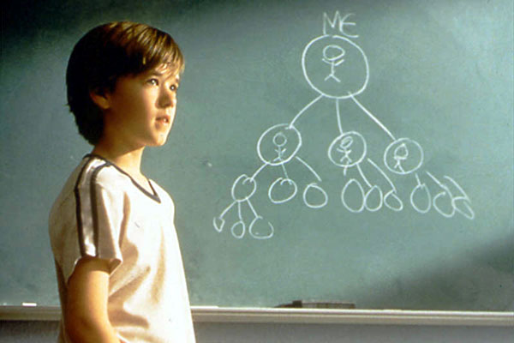
Exponential Growth in Real Life
Pay It Forward
Can one idea change the world?

Slide 25
Exit Ticket
Is it possible for one idea to change the world? Use your mathematical findings from investigating Trevor’s idea in Pay It Forward to support your answer.

