Slide 1
ANNOUNCEMENTS -Pick up your assigned calculators! -Take out HW to stamp
WARM UP
According to the diagram, what is the probability that a student will take the bus to school?
Which students are in the following set {bus ∩ car}?
Update your TOC.

Slide 2
Homework Questions?

Slide 3
Finish Your Team Project from yesterday!
20 minutes right now to finish your projects!
Suggestion: Divide up the remaining work so that you can finish on time!
Each poster needs to include
The 2 completely written out survey questions
A two-way table with the results of your survey
The Venn Diagram with students’ names
5 test questions about your table/diagram (on the back) with work written out
Your group members names

Slide 4
Create a Two-Way Table on your poster that looks like this
Question 1
Question 2
Both
 |  |  |  | TOTALS
TOTALS
Question 2
Yes
No
Create a Venn Diagram on your poster that looks like this
Question 1
Yes
No

Slide 5
#6 Permutations & Combinations

Slide 6
Permutations
A Permutation is an arrangement of items in a particular order.
Notice, ORDER MATTERS!
To find the number of Permutations of n items, we can use the Fundamental Counting Principle or factorial notation.

Slide 7
Permutations
The number of ways to arrange the letters ABC:
____ ____ ____
Number of choices for first blank?
3 ____ ____
Number of choices for second blank?
3 2 ___
Number of choices for third blank?
3 2 1
3*2*1 = 6 3! = 3*2*1 = 6
ABC ACB BAC BCA CAB CBA

Slide 8
Permutations
To find the number of Permutations of n items chosen r at a time, you can use the formula:
*In your calculators:
n
Math → PRB → nPr
r
*2*1
= 5*4*3 = 60
$$\overline{ 2∗1 }$$

Slide 9
Example 1: A combination lock will open when the right choice of three numbers (from 1 to 30, inclusive) is selected. How many different lock combinations are possible assuming no number is repeated?
How many to choose from? (n) _______
How many are being picked? (r) _______
30
3

Slide 10
Example 2: From a club of 24 members, a President, Vice President, Secretary, Treasurer and Historian are to be elected. In how many ways can the offices be filled?
How many to choose from? (n) _______
How many are being picked? (r) _______
24
5

Slide 11
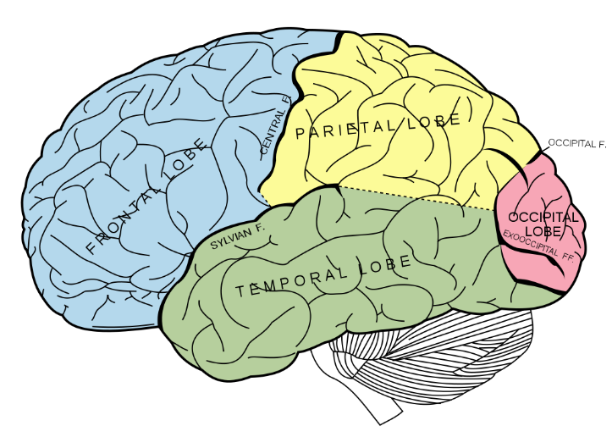
BRAIN BREAK #1

Slide 12
Combinations
A Combination is an arrangement of items in which order does not matter.
ORDER DOES NOT MATTER!
Since the order does not matter in combinations, there are fewer combinations than permutations. The combinations are a "subset" of the permutations.

Slide 13
Combinations
*In your calculators:
n
Math → PRB → nCr
r
To find the number of Combinations of n items chosen r at a time, you can use the formula

Slide 14
Example 3: To play a particular card game, each player is dealt five cards from a standard deck of 52 cards. How many different hands are possible?
How many to choose from? (n) _______
How many are being picked? (r) _______
52
5

Slide 15
Example 4: A student must answer 3 out of 5 essay questions on a test. In how many different ways can the student select the questions?
How many to choose from? (n) _______
How many are being picked? (r) _______
5
3

Slide 16
Practice Problem 1: How many ways can we pick a first and second favorite from a collection of 23 CD's?
Step 1: Does order matter? Yes / No Permutation / Combination
Step 2: How many to choose from? _______ How many are being picked? _______
Step 3: Fill in correct formula and solve.

Slide 17
Practice Problem 2: A coach must choose five starters from a team of 12 players. How many different ways can the coach choose the starters?
Step 1: Does order matter? Yes / No Permutation / Combination
Step 2: How many to choose from? _______ How many are being picked? _______
Step 3: Fill in correct formula and solve.

Slide 18
Practice Problem 3: In how many ways can the 4 infield positions of a baseball team be filled, if there are 13 possible players for the positions?

Slide 19
BRAIN BREAK #2

Slide 20
Exit Ticket
A basketball team consists of two centers, five forwards, and four guards. In how many ways can the coach select a starting line up of one center, two forwards, and two guards?

Slide 21
Homework
#6 in HW Packet (bottom of page 4 – page 5, all)
HW Packets due Tuesday, 5/26!

Slide 22
Little Slips!
Team’s write all work on one sheet of paper to be turned in. Write all teammates’ names at the top.
Each team needs to select a “Messenger.” The messenger will get one “Little Slip” at a time and bring it back to the table.
There are a total of 4 Little Slips with 2-4 problems on each.
Each member of the team will work on the problem, taking turns as the “scribe.” Write your initials next to the problem you write on the team sheet.
Once the team has all answers for the Little Slip, a new messenger will bring the Little Slip with the answer for me to check.
Once the correct answer is given, the messenger will trade for the next Little Slip and the process is repeated.
First team done, receives 10 College Credits! Any team that finishes in the allotted time frame receives 5 College Credits!

