Slide 1
ANNOUNCEMENTS -Pick up your assigned calculator -Take out your HW to be stamped (pgs. 4-5)
WARM UP (on whiteboard)
A surveyor recorded the measurements shown in the figure below. Use the Law of Cosines to find the length of the pond.
Update your TOC.

Slide 2
Homework Questions?

Slide 3
Trig. Graphs – VOCAB SECTION!
Amplitude: the height of the graph
Period: how long it takes for the function to make one complete cycle

Slide 4
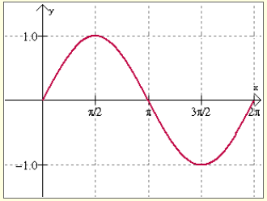
Sine Graph (page 57)
Parent graph: f(x) = sin(x)
Amplitude: 1
Period: 2π

Slide 5
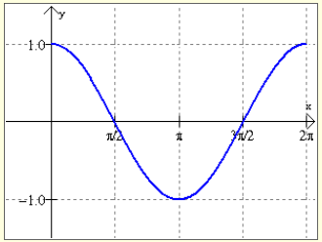
Cosine Graph (page 58)
Parent graph: f(x) = cos(x)
Amplitude: 1
Period: 2π

Slide 6
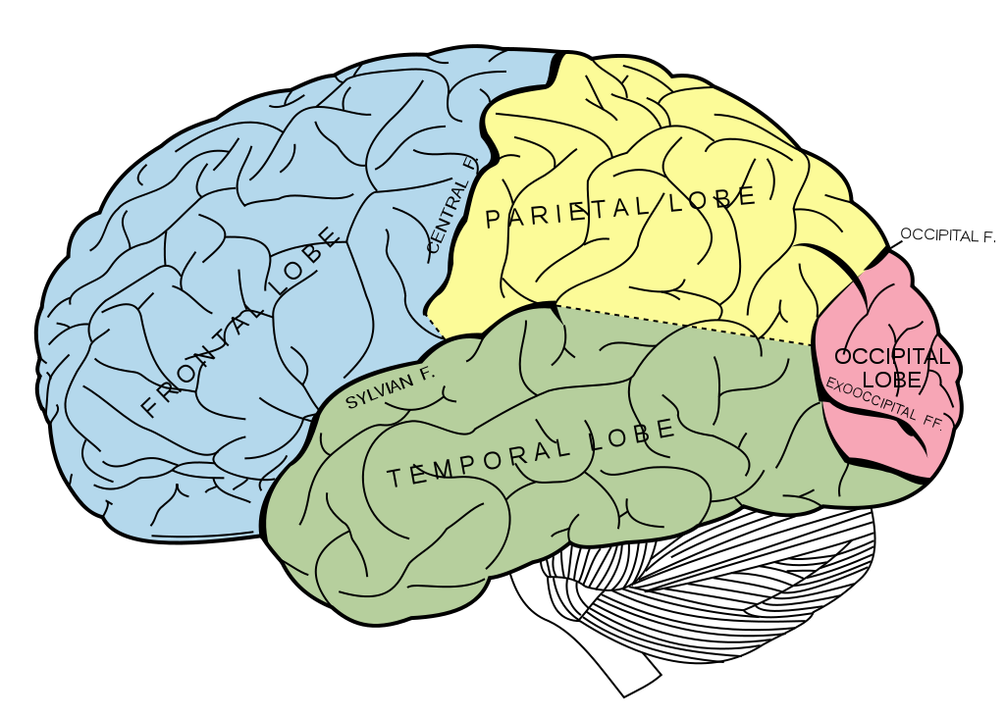
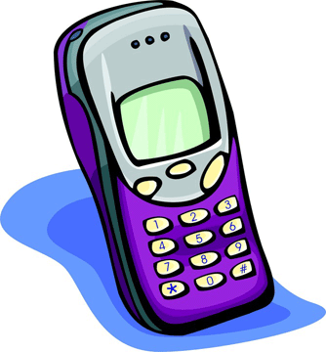
BRAIN BREAK

Slide 7
A: Quantity A is bigger B: Quantity B is bigger C: They are the equal D: Not enough information to decide
QUANTITY A
6
QUANTITY B
9
Take 10 seconds to decide on your answer and write the letter on your whiteboard.

Slide 8
Which is bigger – the area of Quantity A or the area of Quantity B? A: Quantity A is bigger B: Quantity B is bigger C: They are the equal D: Not enough information to decide
QUANTITY A
QUANTITY B
x > 90º
2
x
Notes:
Quick Poll 1: before solving
Quick Poll 2: individually work out on whiteboards and formalize ideas (3 min) – discuss with partner (3 min)
Quick Poll 3: after whole class discussion

Slide 9
Which is bigger – the area of Quantity A or the area of Quantity B? A: Quantity A is bigger B: Quantity B is bigger C: They are the equal D: Not enough information to decide
QUANTITY A
QUANTITY B
x > 90º
2
xº
Notes:
Quick Poll 1: before solving
Quick Poll 2: individually work out on whiteboards and formalize ideas (3 min) – discuss with partner (3 min)
Quick Poll 3: after whole class discussion

Slide 10
#7 Area of a Triangle

Slide 11
What is the area of a triangle?
Area = $\frac{1}{2}(base)(height$)

Slide 12
What if we don’t know the base or the height? What if we only know an angle instead?
Area = $\frac{1}{2}(base)(height$)
HYP
We can use trig to come up with a new formula and values for the base and height!
OPP
Let a = base
Let’s use ∠C. Use a trig ratio to solve for the height.
ADJ
$$\sin{C}= \frac{h}{b}$$
b∙
∙b
Solve for h! (Literal Equations from Unit 2!)
$$b\sin{C}=h$$
Replace the values in our normal area formula.
Area = $\frac{1}{2}(side)(side$)sin(angle)
Area = $\frac{1}{2}$
$$a$$
$$bsinC$$

Slide 13
Example 1: Find the area of ∆DEF, if d = 3cm, e = 8cm, and ∠F = 35º. Round to the nearest whole number.
E
Area = $\frac{1}{2}(side)(side)sin⁡(angle)$
3cm
d
f
Area = $\frac{1}{2}(3cm)(8cm)sin⁡(35o)$
35º
D
F
e
8cm
Area = $\frac{1}{2}(3)(8)sin⁡(35o)$
= $7cm2$
Area = $6.88cm2$

Slide 14
BRAIN BREAK

Slide 15
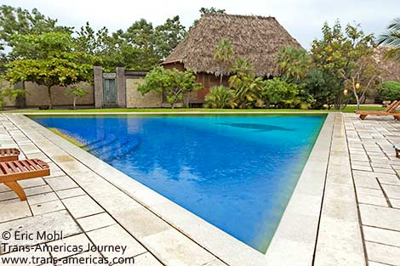
Example 2: West Meck is finally getting a pool in the gym for the swim team! In order to cut down on costs, the pool is going to be triangular shaped instead of rectangular. Two of the sides of the pool are 80 yards and 150 yards. The angle between the two sides is 67º. What is the surface area of the pool going to be?

Slide 16
Practice Problems: Find the area of each triangle using the given information. Round to the nearest whole number
1. ∆ABC, a = 3, b = 2, ∠C = 24º 2. ∆CFV, c = 31, ∠F = 27º, v = 26
A = $\frac{1}{2}$(31)(26)sin27º
A = $\frac{1}{2}$(3)(2)sin24º
A = $1.22$
A = $182.$96

Slide 17
Homework
#7 in HW Packet (all)

Slide 18
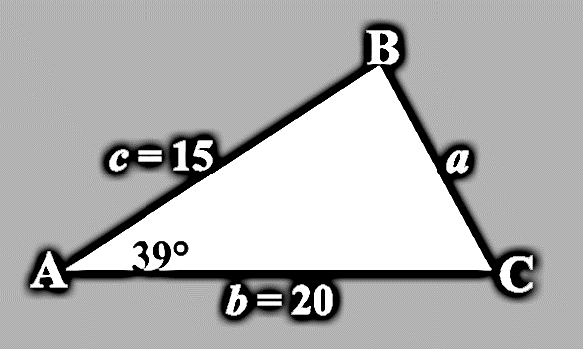
Exit Ticket
Use the formula learned in the lesson to find the area of this triangle.

