Slide 1
ANNOUNCEMENTS -Pick up your assigned calculator -Take a picture of the Unit 2 answer key for corrections Today’s lesson is long and challenging. Stay in a positive mindset and work efficiently through the example problems to help your understanding for the homework and tomorrow’s project. If you focus and take good notes, you will do well!
WARM UP
Update TOC.
Update Data Tracker (Green Tab) – Find your # in the chart below and fill in the bar graph for your Unit 1 and Unit 2 mastery.
File # | Unit 1 % | Unit 2 %
1 | - | -
2 | 26 | 41
3 | 43 | 32
4 | - | -
5 | 57 | 51.5
6 | 78 | 89
7 | 28 | 44
8 | 0 | 3
9 | 63 | 29
10 | 89 | 105.5
11 | 72 | 44
12 | 28 | 41
13 | 30 | 47
14 | 35 | -
15 | 28 | 41
16 | 20 | 12
17 | 37 | 56
File # | Unit 1 % | Unit 2 %
18 | 70 | 71
19 | 28 | 71
20 | 59 | 47
21 | - | -
22 | 7 | 0
23 | 57 | 64.2
24 | - | 15
25 | 95 | 68
26 | 76 | 107
27 | - | -
28 | 57 | 77
29 | 36 | 55
30 | 98 | 104
31 | 35 | -
32 | - | 24
33 | - | -
34 | - | -

Slide 2
ANNOUNCEMENTS -Pick up your assigned calculator -Take a picture of the Unit 2 answer key for corrections Today’s lesson is long and challenging. Stay in a positive mindset and work efficiently through the example problems to help your understanding for the homework and tomorrow’s project. If you focus and take good notes, you will do well!
WARM UP
Update TOC.
Update Data Tracker (Green Tab) – Find your # in the chart below and fill in the bar graph for your Unit 1 and Unit 2 mastery.
File # | Unit 1 % | Unit 2 %
1 | 57 | 71.8
2 | 50 | 29
3 | 63 | 90
4 | 41 | 81.5
5 | 9 | -
6 | 65 | 71
7 | 35 | -
8 | 91 | 95.2
9 | 54 | 76
10 | 100 | 103
11 | 50 | -
12 | 28 | 47
13 | 109.5 | 106.5
14 | 17 | -
15 | 81 | 60.8
16 | 74 | 95.7
17 | 57 | 73.5
File # | Unit 1 % | Unit 2 %
18 | 101.3 | 118
19 | 70 | 57.5
20 | - | 74
21 | 67 | 95
22 | 59 | 83.5
23 | 22 | 38
24 | 67 | 26
25 | 72 | 41
26 | 30 | 59
27 | 77 | 74
28 | 93.5 | 76
29 | 22 | 62
30 | 9 | 56
31 | 37 | 71
32 | 2 | 81
33 | 9 | 38
34 | 95 | 63

Slide 3
Tomorrow, you will be work with a team of 4-5 on a School Beautification Project.
ON THE NOTECARD…
On one side: Write your name
On the back:
Write the names of 3 students you would like to be on a team with.
Write the name of 1 student you would not like to be on a team with.
The teams you write down are not guaranteed, but I will take your preferences into consideration when assigning your teams.

Slide 4
#7 Linear Programming

Slide 5
Michael wants to be a singer. Jordan wants to own his own record label. To get closer to their dream jobs, Michael and Jordan decide to open a music shop and sell guitars and keyboards. They want to find out the maximum amount of money they may have to borrow to purchase new instruments. Each guitar will cost them $150 and each keyboard will cost $350.
c) Michael and Jordan have certain restrictions on the number of instruments they can purchase.
They can only purchase a maximum of 75 instruments.
Because guitars are more popular than keyboards, they want to purchase at least twice the number of guitars than keyboards.
To get started, they need at least 10 guitars and 7 keyboards.
Write the constraints.
a) Define the variables
b) Write the objective function for the amount of money they have to borrow to pay for the instruments.
x = guitars
y = keyboards
x + y ≥ 75
x ≥ 2y
C = 150x + 350y
x ≥ 10
y ≥ 7

Slide 6
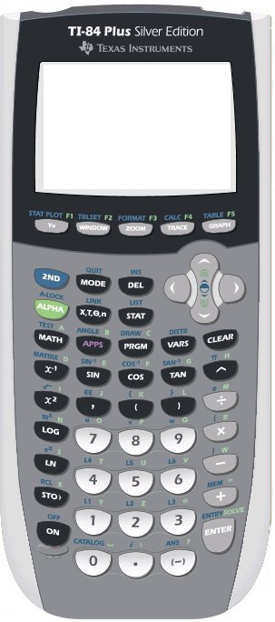
Application Problem: Michael wants to be a singer. Jordan wants to own his own record label. To get closer to their dream jobs, Michael and Jordan decide to open a music shop and sell guitars and keyboards. They want to find out the maximum amount of money they may have to borrow to purchase new instruments. Each guitar will cost them $150 and each keyboard will cost $350.
x = guitars, y = keyboards B = 150x + 350y
y < -x + 75 y < ½ x x > 10 y > 7
d) Graph the feasible region
e) Determine the vertices of the feasible region.
Graph each constraint as a new Y=
Shade above or below depending on ≤ or ≥
To find the vertices (intersection points)
2nd Calc → Intersect
Right Bound → close to first vertex
Left Bound → close to first vertex
Repeat for each vertex
x + y ≥ 75 x ≥ 2y x ≥ 10 y ≥ 7
100
95
90
85
80
75
70
65
60
55
50
45
40
35
30
25
20
15
10
5
0 5 10 15 20 25 30 35 40 45 50 55 60 65 70 75 80 85 90 95 100 105 110 115

Slide 7
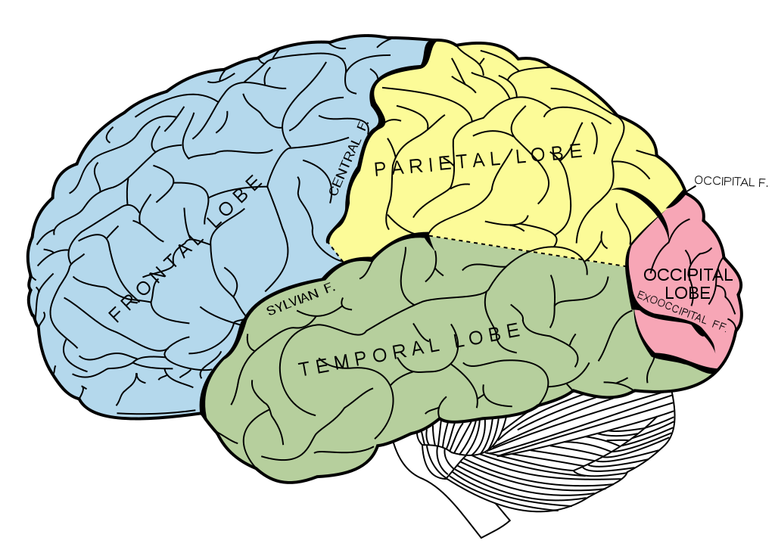
BRAIN BREAK

Slide 8
Application Problem: Michael wants to be a singer. Jordan wants to own his own record label. To get closer to their dream jobs, Michael and Jordan decide to open a music shop and sell guitars and keyboards. They want to find out the maximum amount of money they may have to borrow to purchase new instruments. Each guitar will cost them $150 and each keyboard will cost $350.
x = guitars, y = keyboards B = 150x + 350y
y < -x + 75 y < ½ x x > 10 y > 7
e) Determine the vertices of the feasible region.
f) Determine the amount they need to borrow (check each vertex)
g) What is the maximum amount of money they need to borrow? What is the minimum amount of money they can borrow?
(14,7), (50,25), (68,7)
100
95
90
85
80
75
70
65
60
55
50
45
40
35
30
25
20
15
10
5
Vertex | B = 150x + 350y
(14,7) | 150(14) + 350(7) =
(50,25) | 150(50) + 350(25) =
(68,7) | 150(68) + 350(7) =
100
95
90
85
80
75
70
65
60
55
50
45
40
35
30
25
20
15
10
5
$4,550
$16,250
$12,650
$16,250
$4,550
0 5 10 15 20 25 30 35 40 45 50 55 60 65 70 75 80 85 90 95 100 105 110 115
0 5 10 15 20 25 30 35 40 45 50 55 60 65 70 75 80 85 90 95 100 105 110 115

Slide 9
BRAIN BREAK

Slide 10
Homework
Start Unit 2 Celebration Corrections

Slide 11
Exit Ticket
Cut out the Vocabulary Chart from the bottom of the notes. Fill in the definitions from the chart below. Then glue into your Vocab Section (Purple Tab).
Unit 2 #7 Linear Programming VOCABULARY
OPTIMIZATION | The process of finding the maximum or minimum value of some varying quantity
OBJECTIVE FUNCTION | The function which is optimized to find the maximum or minimum values
CONSTRAINTS | Linear inequalities which form the feasible region
FEASIBLE REGION | The graph of the system of constraints (bounded by the linear inequalities)
VERTICES OF THE FEASIBLE REGION | Points of intersection of the constraint lines
MAXIMUM VALUE OF OBJECTIVE FUNCTION | Largest value of a vertex of the feasible region
MINIMUM VALUE OF OBJECTIVE FUNCITON | Smallest value of a vertex of the feasible region
LINEAR PROGRAMMING | The process of using an objective function and constraints to determine the feasible region

Slide 12
ANNOUNCEMENTS -Pick up your assigned calculator -Turn in any Unit 2 Corrections
WARM UP
Finish copying down any vocab you missed yesterday.
Sit with your new team!
Unit 2 #7 Linear Programming VOCABULARY
OPTIMIZATION | The process of finding the maximum or minimum value of some varying quantity
OBJECTIVE FUNCTION | The function which is optimized to find the maximum or minimum values
CONSTRAINTS | Linear inequalities which form the feasible region
FEASIBLE REGION | The graph of the system of constraints (bounded by the linear inequalities)
VERTICES OF THE FEASIBLE REGION | Points of intersection of the constraint lines
MAXIMUM VALUE OF OBJECTIVE FUNCTION | Largest value of a vertex of the feasible region
MINIMUM VALUE OF OBJECTIVE FUNCITON | Smallest value of a vertex of the feasible region
LINEAR PROGRAMMING | The process of using an objective function and constraints to determine the feasible region

Slide 13
A - School Beautification Project
Your team has decided to volunteer to clean up West Mecklenburg school grounds and plant some bushes and trees. You determine that the bushes you want to plan average $15 each and each tree costs $25. You will definitely buy both bushes and trees. You realize that you cannot plant more than 18 trees. Mr. Jones says that you should plant at least 12 plants total but no more than 30. The number of trees must be at least ½ the number of bushes.
On a poster, solve the above problem by completing the following:
Define the variables.
Determine the objective function.
Write out the constraints.
Show the graph and shade in the feasible region.
Determine the vertices of the feasible region.
Determine the cost for each vertex.
Under the given conditions, what is the minimum amount of money your team could spend on the plants?
Write at least 4 sentences describing all the combinations of the number of bushes and the number of trees you can purchase.
On the printout provided, sketch your team’s new planting design for both trees and bushes around West Meck. Be sure to distinguish your trees from bushes through use of color! Glue this on to your poster.
On the green sheet, describe how your team will obtain funding ($$) for this project. (creative component!)
Be sure to include all 5 of the above on your poster for full credit!

Slide 14
B - School Beautification Project
Your team has decided to volunteer to clean up West Mecklenburg school grounds and plant some bushes and trees. You determine that the bushes you want to plan average $15 each and each tree costs $10. You will definitely buy at least 1 bush and at least 1 tree. You realize that you cannot plant more than 4 trees. Mr. Jones says that you should plant at least 6 plants.
On a poster, solve the above problem by completing the following:
Define the variables.
Determine the objective function.
Write out the constraints.
Show the graph and shade in the feasible region.
Determine the vertices of the feasible region.
Determine the cost for each vertex.
Under the given conditions, what is the maximum amount of money your team could spend on the plants?
Write at least 4 sentences describing all the combinations of the number of bushes and the number of trees you can purchase.
On the printout provided, sketch your team’s new planting design for both trees and bushes around West Meck. Be sure to distinguish your trees from bushes through use of color! Glue this on to your poster.
On the green sheet, describe how your team will obtain funding ($$) for this project. (creative component!)
Be sure to include all 5 of the above on your poster for full credit!

Slide 15
C - School Beautification Project
Your team has decided to volunteer to clean up West Mecklenburg school grounds and plant some bushes and trees. You determine that the bushes you want to plan average $15 each and each tree costs $20. You will definitely buy both bushes and trees. You realize that you can’t plant more than 11 more trees than bushes. Mr. Jones says that you should plant no more than 27 plants altogether.
On a poster, solve the above problem by completing the following:
Define the variables.
Determine the objective function.
Write out the constraints.
Show the graph and shade in the feasible region.
Determine the vertices of the feasible region.
Determine the cost for each vertex.
Under the given conditions, what is the maximum amount of money your team could spend on the plants?
Write at least 4 sentences describing all the combinations of the number of bushes and the number of trees you can purchase.
On the printout provided, sketch your team’s new planting design for both trees and bushes around West Meck. Be sure to distinguish your trees from bushes through use of color! Glue this on to your poster.
On the green sheet, describe how your team will obtain funding ($$) for this project. (creative component!)
Be sure to include all 5 of the above on your poster for full credit!

Slide 16
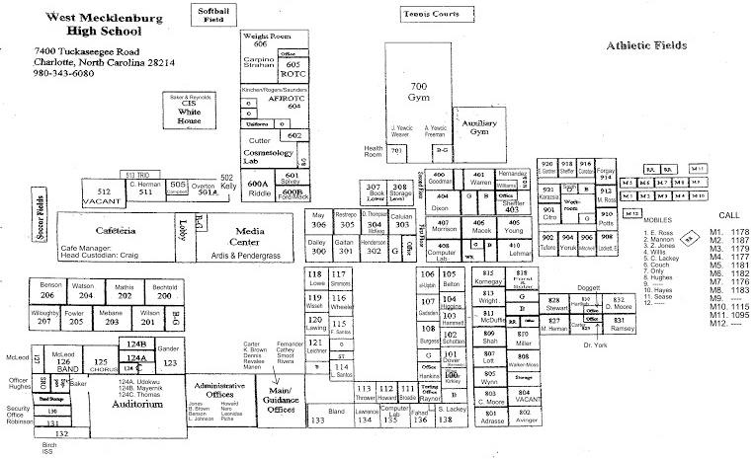
Grading Rubric (2x Quiz Grade!)
Activity | Points Possible
Define variables | 5
Objective Function | 10
Constraints | 15
Graph | 15
Vertices | 10
Cost for Each Vertex | 10
2. Minimum Amount of $ | 5
3. Sentences Describing Possible Combinations | 15
4. Plantings Design | 10
5. Funding | 5
Total | 100

Slide 17
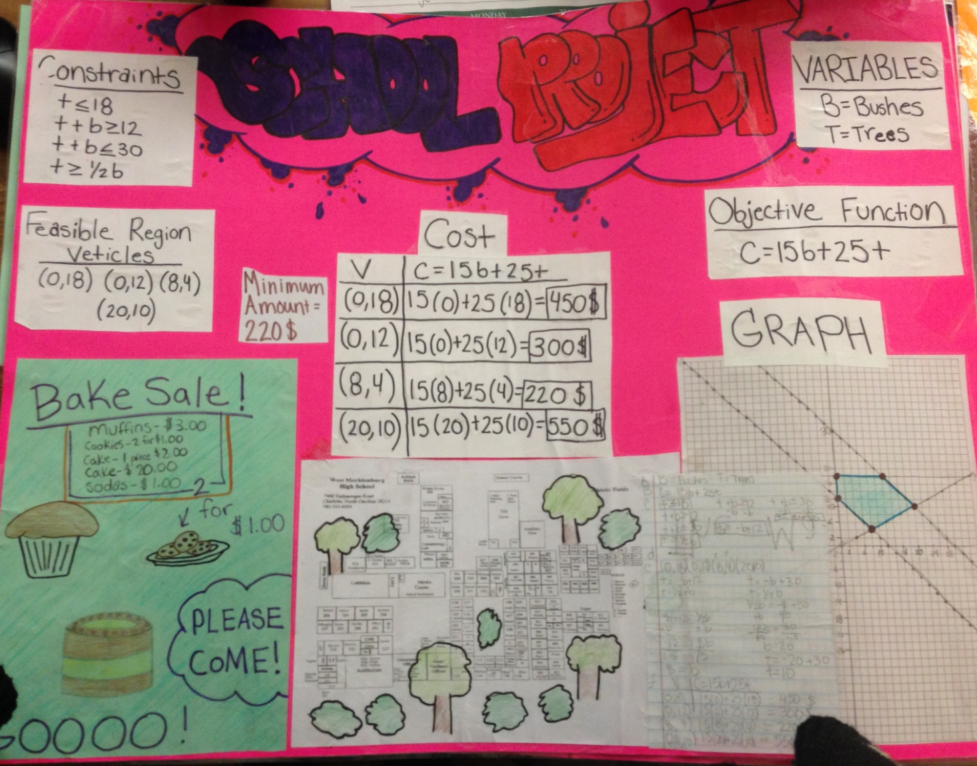
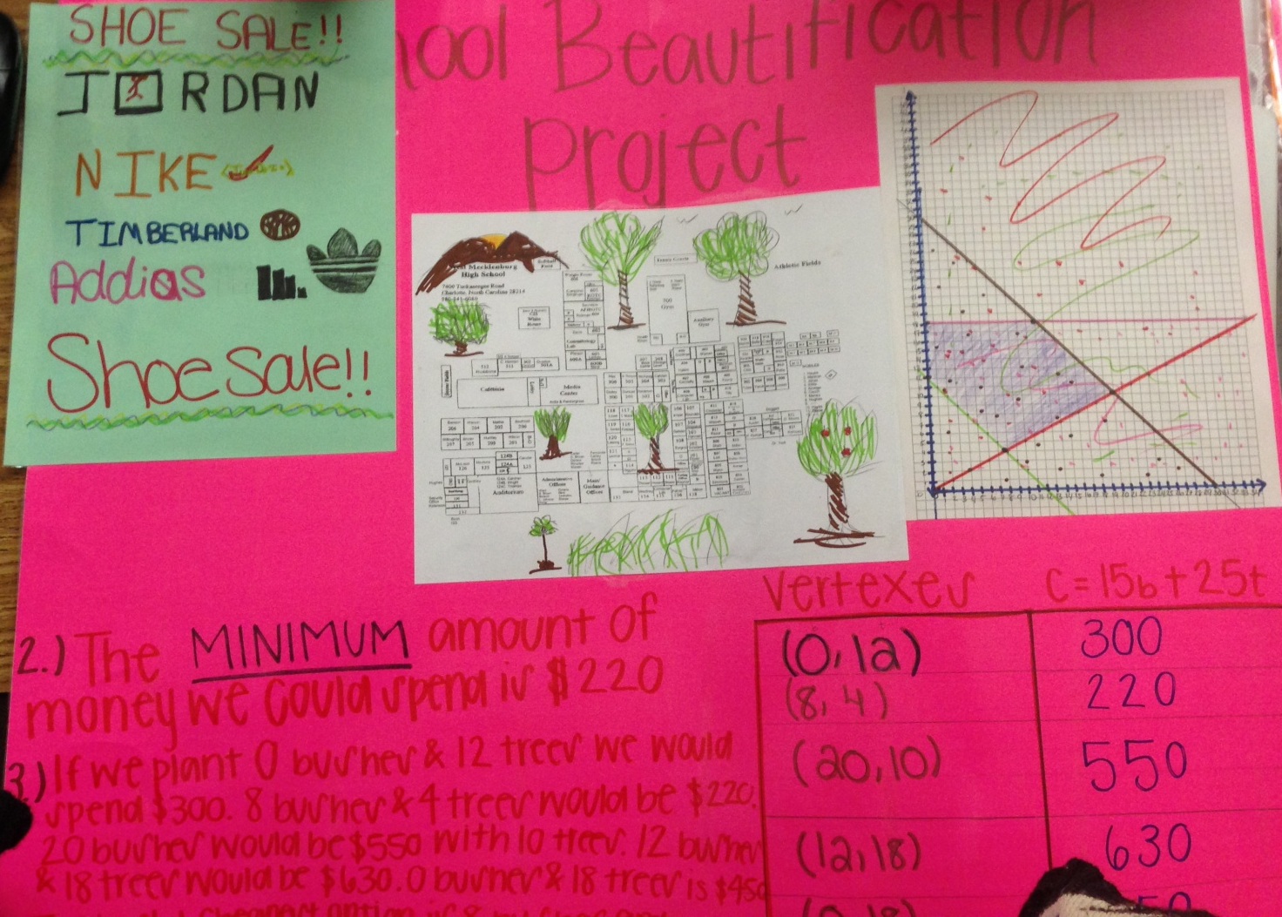
Exemplar Student Work from the past

Slide 18
ANNOUNCEMENTS -Pick up your assigned calculator -Turn in any Unit 2 Corrections
WARM UP – 20 min
Finish your School Beautification Project!

Slide 19
Team Presentations
Each Team will be called up at random to present part of their poster.
You will be graded by Ms. Santos based on your understanding and presentation of the content you are asked to present.
You will be graded by your classmates based on their understanding of your presentation.
CLASSMATE GRADERS:
If the team presenting were the teachers, would you be able to understand the concept well enough to do at home for homework?
What are some things the presenting team did well explain?
What are some things the presenting team did not explain very well?
What is the overall % grade you would give the presenting team?

Slide 20
Exit Ticket
In the chart, I passed out….
Teammate Grader
Your name & Team color at the top
Names of each of your teammates
What was their contribution(s) to the project (What did they do)?
What % grade do you think they deserve?

