Slide 1
Notes Summary Presentation
If your number is called, you will read your notes summary out loud to the class.
This practice will prove how smart you are for having an amazing summary completed, and it will help any absent students really grasp the concept we learned yesterday!

Slide 2
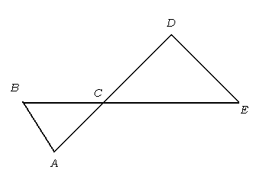
ANNOUNCEMENTS -NO calculators! -Check your file for your quiz!
WARM UP - Do on page 41!! Set it up like the notes from yesterday!
Write a Two-Column Proof (Hint: Refer to example 1 from pg. 37):
GIVEN → If $\overline{DE}≅\overline{CD}$, $\overline{BC}≅\overline{AC}$,and m∠CDE = 120º
PROVE → ∠BAC = 75^{O}
Update your TOC.
Statements | Reasons
1. | 1.
2. | 2.
3. | 3.
4. | 4.
5. | 5.
6. | 6.

Slide 3
ANNOUNCEMENTS -NO calculators! -Check your file for your quiz!
WARM UP
Update your TOC.
Write down the following key terms on page 41.
Complementary Angles Exterior Angle Theorem
Supplementary Angles CPCTC
Vertical Angles Reflexive Property of Triangle Congruence
Adjacent Angles Symmetric Property of Triangle Congruence
Congruent Transitive Property of Triangle Congruence
Corresponding Angles Isosceles Triangle Theorem
Alternate Interior Angles
Alternate Exterior Angles
Same Side Interior Angles
Angle Addition Postulate
Triangle Sum Theorem

Slide 4
ANNOUNCEMENTS -NO calculators! -Check your file for your quiz!
WARM UP
Do you prefer to take notes “College-style” like we did yesterday or guided notes with handouts like we normally do? Write down your favorite!
Update your TOC.
Write down the following key terms on page 41.
Complementary Angles Same Side Interior Angles
Supplementary Angles Angle Addition Postulate
Vertical Angles Triangle Sum Theorem
Adjacent Angles Exterior Angle Theorem
Congruent CPCTC
Corresponding Angles Reflexive Property of Triangle Congruence
Alternate Interior Angles Symmetric Property of Triangle Congruence
Alternate Exterior Angles Transitive Property of Triangle Congruence

Slide 5
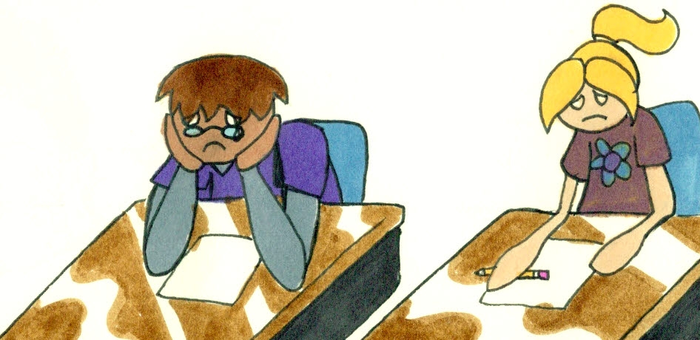
I won’t be here tomorrow…
While I’m gone, you are going to make UNIT 5 FLASH CARDS!
For each of the 17 key terms you wrote down on page 41 for your warm up, you will make one flash card.
On the front, write the key word and draw a picture representing it.
On the back, write the definition in your own words.
Like notes summaries, flash cards are a great tool to help you study and retain information!
Keep your flash cards in the pocket we will make on page 42!
I will check these on Monday!
This is an (easy) quiz grade!

Slide 6
Homework
1. #6 CPCTC DAY 1 in HW Packet (2nd half of page 5 – no proofs)
2. NOTES SUMMARY:
On page 44
½ page summary in your own words, explaining the day’s lesson.
Be sure to discuss PROOFS, SSS, & SAS in your summary.
The goal of your notes summary is for any absent student to be able to read it and have a complete understanding of what he/she missed.
Monday, 1-3 of you will be randomly called on to read your notes summary.

Slide 7
#7 Triangle Congruence – SSS & SAS

Slide 8
Goal 2
REVIEW: Proving Triangles are Congruent
You have learned to prove that two triangles are congruent by the definition of congruence – that is, by showing that all pairs of corresponding angles and corresponding sides are congruent.
THEOREM
Properties of Congruent Triangles
B
Reflexive Property of Congruent Triangles
A
C
Every triangle is congruent to itself.
E
Symmetric Property of Congruent Triangles
If ≅ , then ≅ .
D
F
ABC
DEF
DEF
ABC
L
Transitive Property of Congruent Triangles
If ≅ and ≅ , then ≅ .
ABC
DEF
DEF
JKL
ABC
JKL
J
K

Slide 9
SSS AND SAS CONGRUENCE POSTULATES
If all six pairs of corresponding parts (sides and angles) are
congruent, then the triangles are congruent.
Sides are
congruent
Angles are
congruent
Triangles are
congruent
If
and
then
1. AB DE
4. A D
2. BC EF
5. B E
Δ ABC Δ DEF
3. AC DF
6. C F

Slide 10
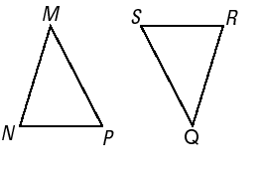
SSS CONGRUENCE POSTULATES
POSTULATE
Side - Side - Side (SSS) Congruence Postulate
If three sides of one triangle are congruent to three sides of a second triangle, then the two triangles are congruent.
If
Side MN QR
S
Side NP RS
then Δ MNP Δ QRS
S
Side PM SQ
S

Slide 11
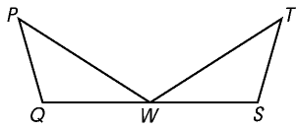
1. Using the SSS Congruence Postulate
Prove that
Δ PQW Δ TSW.
SOLUTION
Two-Column Proof
STATEMENT REASON__________
1) PQ ≅ TS, PW ≅ TW, and QW ≅ SW. 1) Given
2) Δ PQW ≅ ΔTSW 2) SSS Congruence Postulate

Slide 12
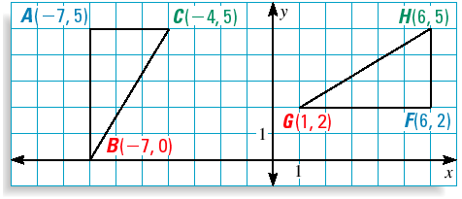
2. Congruent Triangles in a Coordinate Plane
Use the SSS Congruence Postulate to show that Δ ABC ≅ Δ FGH.
SOLUTION
AC = 3 and FH = 3
AC ≅ FH
AB = 5 and FG = 5
AB ≅ FG

Slide 13
2. Congruent Triangles in a Coordinate Plane
Use the distance formula to find lengths BC and GH.
d = (x ₂ – x₁ ) ² + ( y₂ – y₁ ) ²
d = (x ₂ – x₁ ) ² + ( y₂ – y₁ ) ²
BC = (– 4 – (– 7)) ² + (5 – 0 ) ²
GH = (6 – 1) ² + (5 – 2 ) ²
= 3 ² + 5 ²
= 5 ² + 3 ²
= 34
= 34

Slide 14
2. Congruent Triangles in a Coordinate Plane
BC = $\sqrt{34}$ and GH = $\sqrt{34}$
BC ≅ GH
All three pairs of corresponding sides are congruent,
Δ ABC ≅ Δ FGH by the SSS Congruence Postulate.

Slide 15
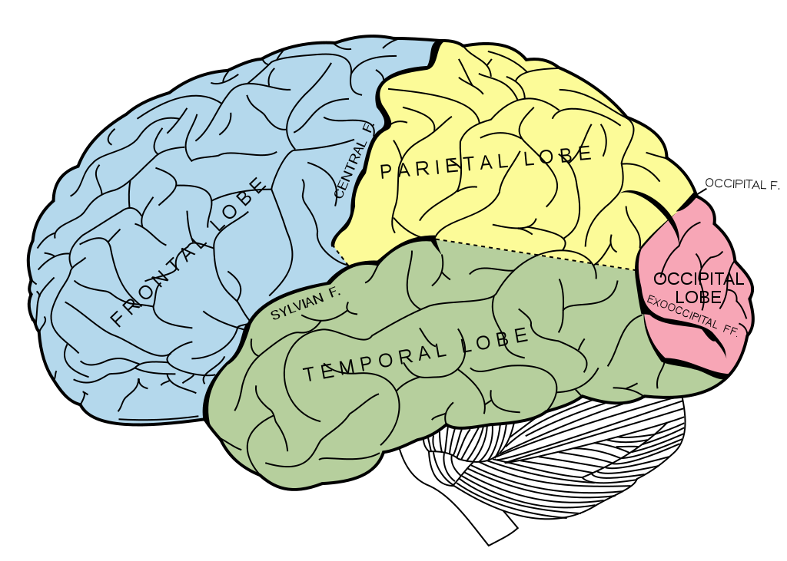
BRAIN BREAK #1

Slide 16
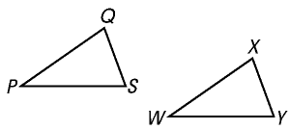
SAS CONGRUENCE POSTULATES
POSTULATE
Side-Angle-Side (SAS) Congruence Postulate
If two sides and the included angle of one triangle are
congruent to two sides and the included angle of a
second triangle, then the two triangles are congruent.
If
Side PQ WX
S
A
then Δ PQS ΔWXY
Angle Q X
S
Side QS XY

Slide 17
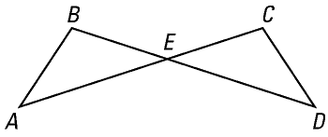
3. Using the SAS Congruence Postulate
Prove that
Δ AEB Δ DEC.
1
2
Statements
Reasons
AE ≅ DE, BE ≅ CE Given
1
1 ≅ 2 Vertical Angles Theorem
2
3
Δ AEB ≅ Δ DEC SAS Congruence Postulate

Slide 18
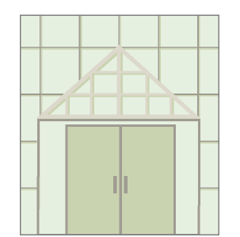
MODELING A REAL-LIFE SITUATION
4. Applying Triangle Congruence Using Proofs
ARCHITECTURE You are designing the window shown in the drawing. You
want to make Δ DRA congruent to Δ DRG. You design the window so that
DR AG and RA ≅ RG.
Can you conclude that ΔDRA ≅ ΔDRG ?
D
SOLUTION
DR AG
A
R
G
GIVEN
RA RG
PROVE
Δ DRA Δ DRG

Slide 19
4. Proving Triangles Congruent
D
GIVEN
DR AG
RA RG
PROVE
Δ DRA Δ DRG
A
R
G
Statements
Reasons
1
DR AG
Given
2
DRA and DRG
are right angles.
If 2 lines are , then they form
4 right angles.
3
DRA ≅ DRG
Right Angle Congruence Theorem
4
RA ≅ RG
Given
5
DR ≅ DR
Reflexive Property of Congruence
6
Δ DRA ≅ Δ DRG
SAS Congruence Postulate

Slide 20
Notes Summary on page 44
On page 44
½ page summary in your own words, explaining the day’s lesson.
Be sure to discuss PROOFS, SSS, & SAS in your summary.
The goal of your notes summary is for any absent student to be able to read it and have a complete understanding of what he/she missed.
Monday, 1-3 of you will be randomly called on to read your notes summary.

Slide 21
BRAIN BREAK #2

Slide 22
Homework
1. #6 CPCTC DAY 1 in HW Packet (2nd half of page 5 – no proofs)
2. NOTES SUMMARY:
On page 44
½ page summary in your own words, explaining the day’s lesson.
Be sure to discuss PROOFS, SSS, & SAS in your summary.
The goal of your notes summary is for any absent student to be able to read it and have a complete understanding of what he/she missed.
Monday, 1-3 of you will be randomly called on to read your notes summary.

Slide 23
BRAIN BUSTER
Use all 5 numbers to come up with the magic number!
Can use any operation! (add, subtract, multiply, divide, raise to a power, etc.)
Must use ALL numbers ONCE and only ONCE!
First 3 students to come up with a way that works gets 5 CCs!
If you beat Ms. Santos, double the CCs!

Slide 24
Exit Ticket
Write a two-column proof given the following diagram.
PROVE → ΔADC ≅ Δ CBA

