Slide 1
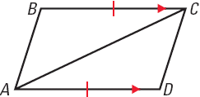
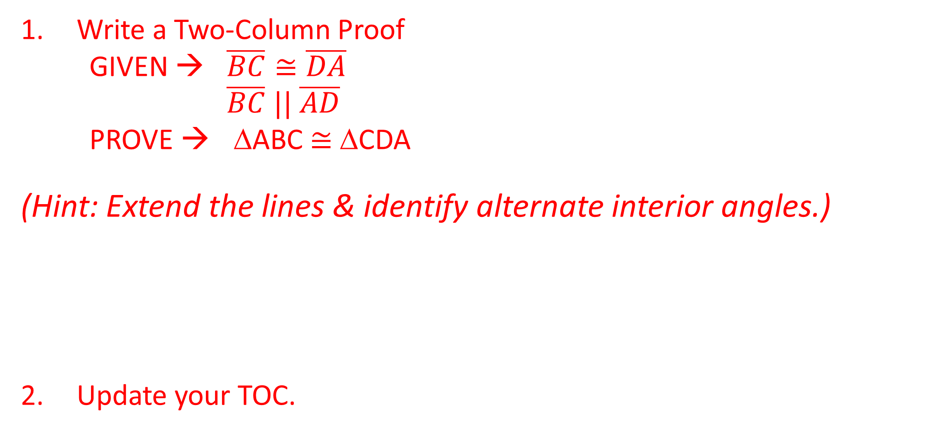
ANNOUNCEMENTS
-NO calculators!
-Take out HW to stamp
-Open notebook to notes summary
WARM UP
Write a Two-Column Proof
GIVEN → $\overline{BC}≅\overline{DA}$
$\overline{BC} || \overline{AD}$
PROVE → ΔABC $≅$ ΔCDA
(Hint: Extend the lines & identify alternate interior angles.)
Update your TOC.

Slide 2
Write a proof.
GIVEN
BC DA, BC AD
PROVE
ABC CDA
STATEMENTS
REASONS
S
BC DA
Given
BC AD
Given
A
BCA DAC
Alternate Interior Angles
S
AC CA
Reflexive Property
5. ΔABC ΔCDA
5. SSS

Slide 3
Notes Summary Presentation
If your number is called, you will read your notes summary out loud to the class.
This practice will prove how smart you are for having an amazing summary completed, and it will help any absent students really grasp the concept we learned yesterday!

Slide 4
#7 Triangle Congruence (Continued) – ASA, AAS, & HL

Slide 5
Homework
1. #6 CPCTC DAY 2 in HW Packet (Page 6 – no proofs)
2. NOTES SUMMARY:
  On page 46 of your ISN
  ½ page summary in your own words, explaining the day’s lesson.
  Be sure to discuss PROOFS, HL, ASA & AAS in your summary.
  The goal of your notes summary is for any absent student to be able to read it and have a complete understanding of what he/she missed.
  Tomorrow, 3 of you will be randomly called on to read your notes summary.

Slide 6

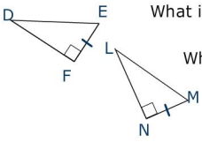
Hypotenuse – Leg (HL) Congruence Postulate
If the hypotenuse and a leg of a right Δ are ≅ to the hypotenuse and a leg of a right second Δ, then the 2 Δs are congruent.
If
H
Hyp DE LM
Leg FE NM
then ΔDEF Δ LMN
L

Slide 7
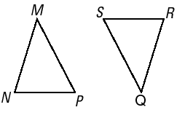
Angle – Side – Angle (ASA) Congruence Postulate
If two angles and the included side of one triangle are congruent to two angles and the included side of a second triangle, then the triangles are congruent.
If
Angle ∠N ∠ R
A
Side NP RS
then Δ MNP Δ QRS
S
Angle ∠ P ∠ S
A

Slide 8
Angle – Angle – Side (AAS) Congruence Postulate
If two angles and a non-included side of one triangle are congruent to two angles and the corresponding non-included side of a second triangle, then the triangles are congruent.
If
Angle ∠N ∠ R
A
Angle ∠ M ∠ Q
then Δ MNP Δ QRS
A
Side MP QS
S

Slide 9
Example 1: Is it possible to prove these triangles are congruent? If so, state the postulate or theorem you would use. Explain your reasoning.
YES!
ΔFEG ≅ ΔHJG by AAS Theorem

Slide 10
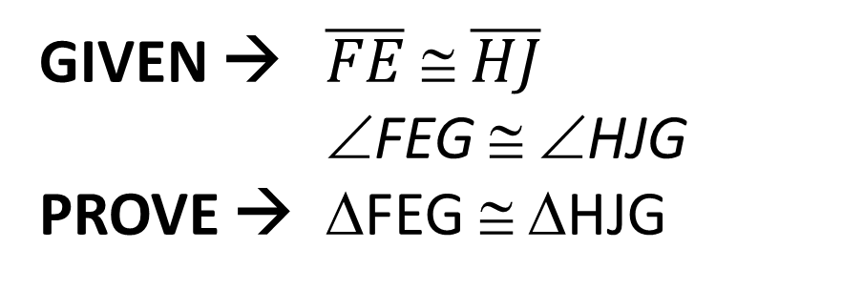
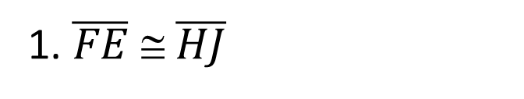
GIVEN → $\overline{FE}$ ≅ $\overline{HJ}$
∠FEG ≅ ∠HJG
PROVE → ΔFEG ≅ ΔHJG
STATEMENT | REASON
1. $\overline{FE}$ ≅ $\overline{HJ}$
1. Given
2. ∠FEG ≅ ∠HJG
2. Given
3. ∠EGF ≅ ∠JGH
3. Vertical Angles Theorem
4. ΔFEG ≅ ΔHJG
4. AAS

Slide 11

Example 2: Is it possible to prove these triangles are congruent? If so, state the postulate or theorem you would use. Explain your reasoning.
We are only given $\overline{FE}$ ≅ $\overline{HJ}$. We can deduce $\overline{NP}$ ≅ $\overline{NP}$ because of the Reflexive Property. But we only have 2 sides congruent. We need ALL 3 SIDES congruent in order for the triangles to be congruent.
NO!
ΔFEG is not ≅ to ΔHJG because there is not enough information.
MP
QN

Slide 12
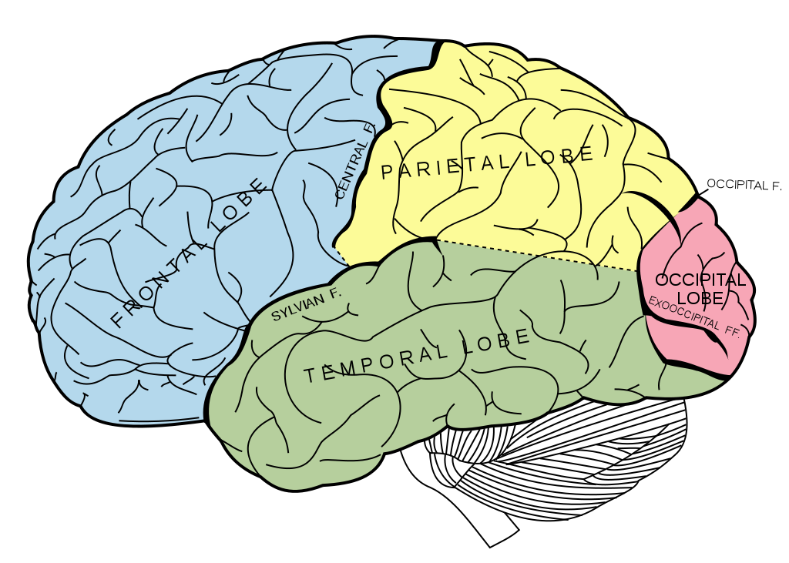

BRAIN BREAK

Slide 13
Example 3: - YOU TRY!
Given: AD║EC, BD ≅ BC
Prove: ∆ABD ≅ ∆EBC
Plan for proof: Notice that ∠ABD and ∠EBC are congruent because they are vertical angles. You are given that BD ≅ BC. Use the fact that AD ║EC to identify a pair of congruent angles.

Slide 14
Given: AD║EC, BD ≅ BC
Prove: ∆ABD ≅ ∆EBC
Statements:
BD ≅ BC, AD ║ EC
∠ABD ≅ ∠EBC
∠D ≅ ∠C
∆ABD ≅ ∆EBC
Reasons:
Given
Vertical Angles
Alternate Interior Angles
ASA

Slide 15
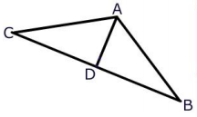
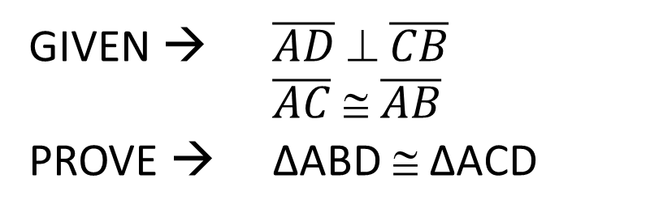
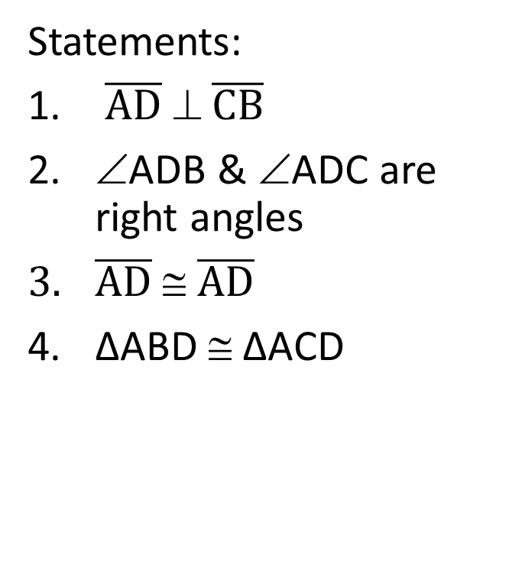
Example 4:
GIVEN → $\overline{AD}$ ⊥ $\overline{CB}$
$\overline{AC}$ ≅ $\overline{AB}$
PROVE → ∆ABD ≅ ∆ACD
Statements:
$\overline{AD}$ ⊥ $\overline{CB}$
∠ADB & ∠ADC are right angles
$\overline{AD}$ ≅ $\overline{AD}$
∆ABD ≅ ∆ACD
Reasons:
Given
2 ⊥ lines forms right angles
Reflexive Property
HL

Slide 16
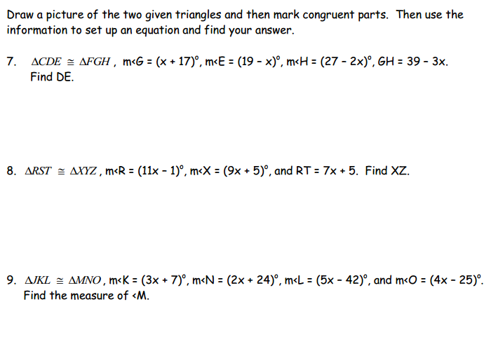
Example 5:
K
M
N
J
L
O

Slide 17
BRAIN BREAK

Slide 18
BRAIN BUSTER
Use all 5 numbers to come up with the magic number!
Can use any operation! (add, subtract, multiply, divide, raise to a power, etc.)
Must use ALL numbers ONCE and only ONCE!
First 3 students to come up with a way that works gets 5 CCs!
If you beat Ms. Santos, double the CCs!

Slide 19
Homework
1. #6 CPCTC DAY 2 in HW Packet (Page 6 – no proofs)
2. NOTES SUMMARY:
  On page 46 of your ISN
  ½ page summary in your own words, explaining the day’s lesson.
  Be sure to discuss PROOFS, HL, ASA & AAS in your summary.
  The goal of your notes summary is for any absent student to be able to read it and have a complete understanding of what he/she missed.
  Tomorrow, 3 of you will be randomly called on to read your notes summary.

Slide 20
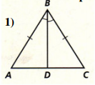
Exit Ticket
Write a two-column proof given the following diagram.
PROVE → ΔABD ≅ ΔCBD

