Slide 1
ANNOUNCEMENTS -Take out HW to stamp (Packet & notes summary on page 46)
WARM UP
Triangle Congruence Color Match Up sheet I handed you at the door
Decide which Theorem or Postulate on the right proves that the triangles on the left are congruent. When you find a match, color in those two boxes (one on the left and one on the right) with the same color. Some of the theorems can fit for more than one. (You should use 5 different colors!)
Update your TOC.

Slide 2
Notes Summary Presentation
If your number is called, bring Ms. Santos your notes summary to be read to the class.
This practice will prove how smart you are for having an amazing summary completed, and it will help any absent students really grasp the concept we learned yesterday!

Slide 3
HOMEWORK QUESTIONS

Slide 4
#8 Midsegment Theorem

Slide 5
Homework
#7 Midsegment Theorem in HW Packet (ENTIRE HW Packet completed and turned in tomorrow!)
Study for your Unit 5 Part 2 Celebration!
Isosceles Triangle Theorem
CPCTC
Triangle Congruence Postulates (SSS, SAS, HL, ASA, AAS)
Midsegment Theorem
Proofs

Slide 6
Vocabulary!
Midsegment: a segment joining the midpoints of two sides of a triangle; also called the midline

Slide 9
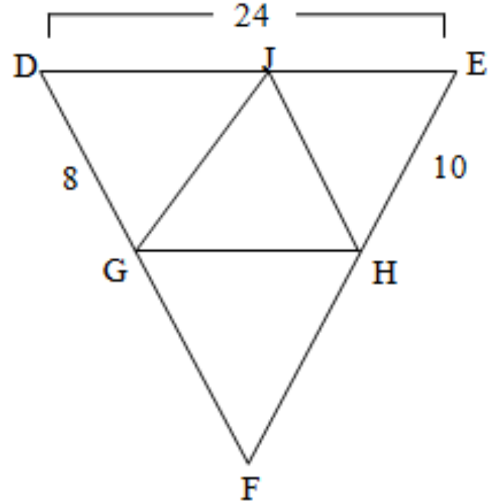
Example 1: Find the length of the midsegment GH.
12

Slide 10
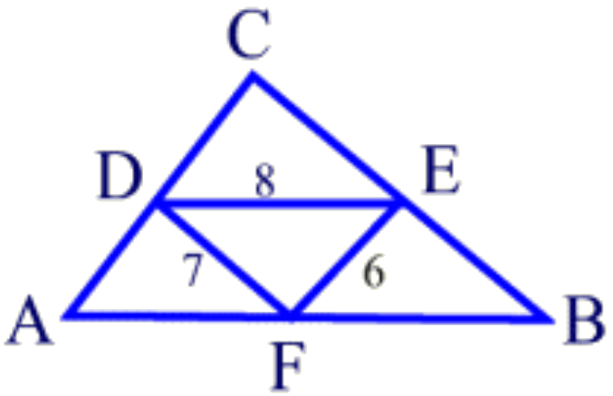
Example 2: Given DE is the midsegments of AB, DF is the midsegments of CB, and EF is the midsegments of AC, Find the perimeter of ΔABC.
2(8) + 2(7) + 2(6) = 42

Slide 11
Examples: Find the value of the variable.
17
7
3.
4.

Slide 12
Example 6. Find the length of the midsegment
Example 5. Find the length of SQ
x + 6 = 2(x – 3)
x + 6 = 2x – 3
9 = x
9 – 3 = 6
3x – 8 = 2(x + 2)
3x – 8 = 2x + 4
x = 12

Slide 13
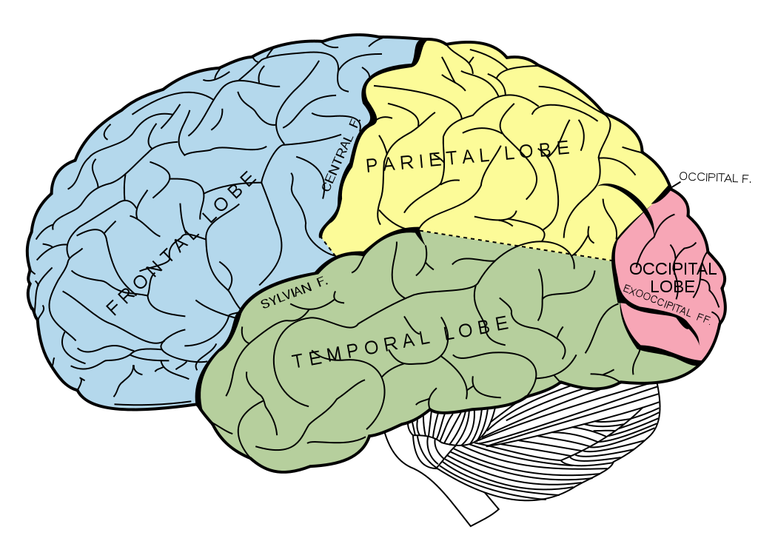
BRAIN BREAK

Slide 14
BRAIN BUSTER
Use all 5 numbers to come up with the magic number!
Can use any operation! (add, subtract, multiply, divide, raise to a power, etc.)
Must use ALL numbers ONCE and only ONCE!
First 3 students to come up with a way that works gets 5 CCs!
If you beat Ms. Santos, double the CCs!
10 minute limit!

Slide 15
Unit 5 Study Guide!
You have the rest of the period to work on the study guide.
Do all your work on loose leaf.
Do the problems in any order.
You do not need to do the whole thing, but the more you do, the more prepared you will be for tomorrow’s celebration!
You will turn in whatever you have completed tomorrow.

Slide 16
BRAIN BREAK

Slide 17
Homework
#7 Midsegment Theorem in HW Packet (ENTIRE HW Packet completed and turned in tomorrow!)
Study for your Unit 5 Part 2 Celebration!
Isosceles Triangle Theorem
CPCTC
Triangle Congruence Postulates (SSS, SAS, HL, ASA, AAS)
Midsegment Theorem
Proofs

Slide 18
Pythagorean Theorem Review!
a² + b² = c²
Find the hypotenuse.
3
3² + 4² = c²
9 + 16 = c²
25 = c²
4
$\sqrt{25}$ = $\sqrt{c^{2}}$
5 = c

Slide 19
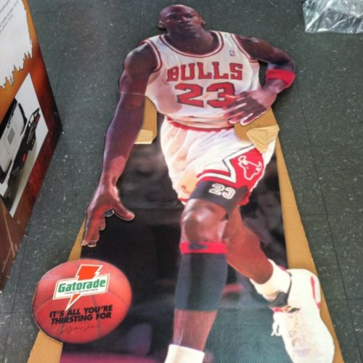
basketball player
Cut out of the greatest basketball player ever!
Work with your teammates to solve this application problem! You have 12 minutes to help Alex find the length of the angled support!

Slide 20
If the cutout measures 66 inches, what is $\frac{2}{3}$ the length of the cutout?
The horizontal support acts as the midsegment connecting the cutout to the angled support. How does the length of the midsegment compare to the side it is parallel to?
If the horizontal support is 15.5 inches, what is the distance from the bottom of the angled support to the base of the cutout?
How can you determine the length of the angled support?
What is the length of the angled support rounded to the nearest inch?

Slide 21
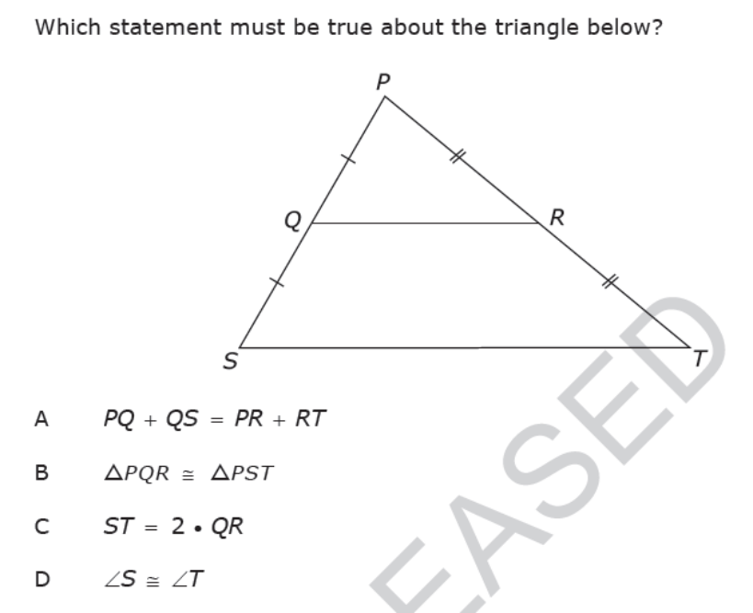
Exit Ticket

