Slide 1
ANNOUNCEMENTS -Turn in Class Jobs application if you still have one! -Pick up your assigned calculator - Tutoring tomorrow 2:45 – 4pm! - UNIT 1 CELEBRATION WEDNESDAY!!
WARM UP
Finish your Team’s poster if you did not finish Friday. Then get tape from Ms. Santos and hang it up along the hallway wall. (15 min)
When you are done, begin working on the Unit 1 Study Guide (picked up from front). Do your work on loose leaf to turn in.

Slide 2
#9 Quadratic Word Problems (Continued)

Slide 3
Example 2: A company’s expenses in millions of dollars, d, can be modeled by the following quadratic equation, d = 2t² – 8t + 9, where t is the time in years after the company started.
a.) How long after the company started did it pay its minimum expense?

Slide 4
Example 2: A company’s expenses in millions of dollars, d, can be modeled by the following quadratic equation, d = 2t² – 8t + 9, where t is the time in years after the company started.
b.) What was the minimum expense of the company?
A = 2
B = -8
C = 9
(x,y)
(t, d)

Slide 5
Example 2: A company’s expenses in millions of dollars, d, can be modeled by the following quadratic equation, d = 2t² – 8t + 9, where t is the time in years after the company started.
c.) What was the expense of the company 5 years after the company started?
A = 2
B = -8
C = 9
(x,y)
(t, d)

Slide 6
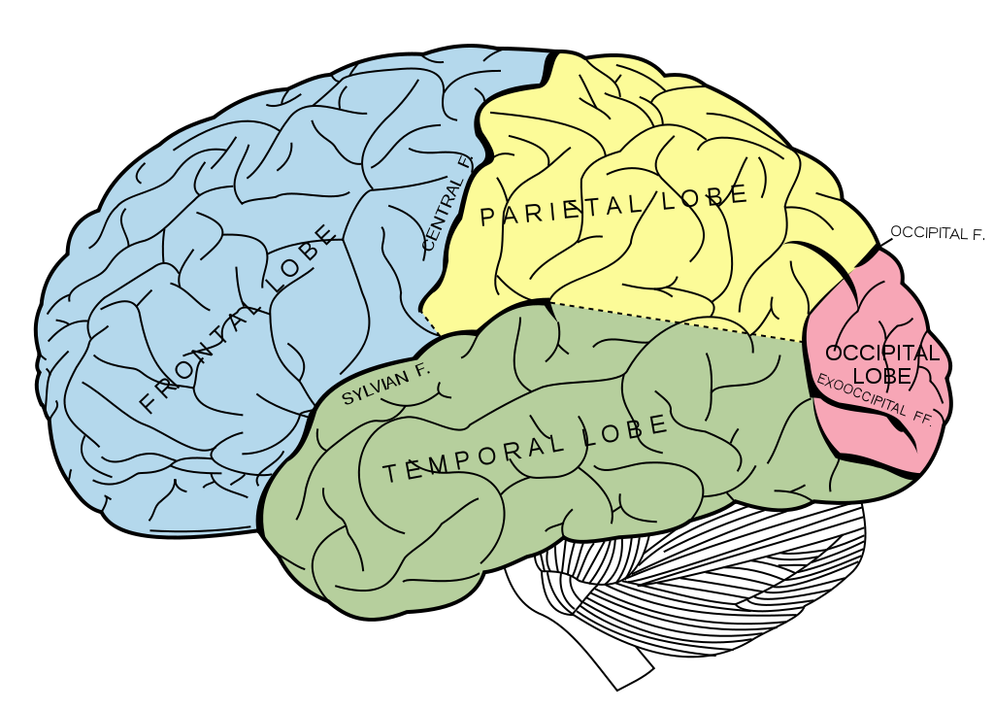
BRAIN BREAK

Slide 7
Unit 1 Celebration of Knowledge
All free response
12 questions; some have multiple parts
You only have your class period to complete. You cannot finish after school.
There are no retests. Study hard tonight and tomorrow so that you do well the first time!
Problems are very similar to Warm Up questions and THE STUDY GUIDE!!

Slide 8
Unit 1 Celebration Study Guide
You have the remainder of the period to work on the study guide.
You may work individually or with your teammates.
If you need help from me and your teammates could not help you out, come right up to the student help desks.
If both desks are full, raise your hand so I know to call you up next.
Do your best to finish as much as you can before the period ends. We will use these in our review game tomorrow, so it is important that you solved the problems ahead of time!
Remember, I wrote the celebration, and I wrote the study guide. They are very similar to one another. If you can do the problems on this study guide, you will do well on the celebration!!

Slide 9
Exit Ticket
Choose one from each column:
Polynomial Operations | Factoring | Discriminant & Quadratic Formula | Graphing
1. Add: (3x² –2x + 7) + (2x + 9) | 4. Factor: x² – 4x + 3 | 7. Find the discriminant of 3x² –21x + 7. | 10. What is the minimum of 2x² – 8x + 6?
2. Subtract: (3x² –2x + 7) – (2x + 9) | 5. Factor: 2x² – 8x + 6 | 8. How many and what type of solutions does 3x² –21x + 7 have? | 11. Identify the y-intercept and the axis of symmetry.
3. Multiply: (3x² – 2x + 7)(2x + 9) | 6. Find the roots by factoring: 49x² – 196 | 9. Use the quadratic formula to find the zeros of 3x² –21x + 7. | 12. Find the roots of 2x² – 8x + 6 by graphing.

Slide 10
HOMEWORK
1st Period | 3rd Period | 4th Period
#1 Adding & Subtracting Polynomials (choose 4) #2 Multiplying Polynomials (all 4) #3 Factoring Quadratics (choose 8) OR Finish your BINGO grid entirely #5 Discriminant & Quadratic Formula (all 4 from bottom of pg. 2 & choose 3 from pg. 3) Extra Credit if you do the whole puzzle Unit 1 Study Guide (Extra Credit) | #1 Adding and Subtracting Polynomials in HW Packet (all 6 problems) #2 Multiplying Polynomials (all 4) #3 Factoring Quadratics (choose 8) #5 Discriminant & Quadratic Formula (all 4 from bottom of pg. 2 & choose 4 from pg. 3) Extra Credit if you do the whole puzzle #6 Graphing Quadratics (choose any 2). Be sure to graph, label the x-intercepts, the y-intercept, and the vertex Unit 1 Study Guide (Extra Credit) | #1 Adding & Subtracting Polynomials (all 6) #2 Multiplying Polynomials (all 4) #3 Factoring Quadratics (choose 8) #5 Discriminant & Quadratic Formula (all 4 from bottom of pg. 2 & choose 10 from pg. 3). Extra Credit if you do the whole puzzle #6 Graphing Quadratics (choose 1). Graph & label the x-intercepts, y-intercepts, and vertex. Dr. Seuss puzzle is extra credit! Unit 1 Study Guide
Make sure all assignments in HW Packet are complete to turn in on Wednesday!
Check my website under your class period to find the complete list of assigned homework for your period.
Study hard for your Unit 1 Celebration on Wednesday!

Slide 11
ANNOUNCEMENTS -Turn in Class Jobs application if you still have one! -Pick up your assigned calculator - Tutoring today from 2:45 – 4pm! - UNIT 1 CELEBRATION tomorrow!!
WARM UP
You are trying to dunk a basketball. You need to jump 2.5 ft. in the air to dunk the ball. The height that your feet are above the ground is given by the function h = -16t² + 12t. What is the maximum height your feet will be above the ground? Will you be able to dunk the basketball?
Take our your homework packet and your study guide.

Slide 12
Ms. Santos went cliff jumping into the ocean at Bygdøy, Norway while studying abroad. Her height as a function of time could be modeled by the function h = -16t² + 16t + 480, where t is the time in seconds and h is the height in feet. How long did it take her to hit the water?

Slide 13
BRAIN BREAK

Slide 14
Review Kahoot!
You and your partner are sharing an iPad and on a team.
If you prefer to work individually you can, but you must have a smart phone.
All questions are taken directly from the Study Guide!
Connect to the Wi-Fi.
Open up a web browser and go to kahoot.it
Enter in Game Pin that is shown on the board.
Enter both partners’ names.
Get pumped to play our first Kahoot!

Slide 15
Other Study Guide Questions?

Slide 16
Homework Questions?

Slide 17
HOMEWORK
Make sure all assignments in HW Packet are complete to turn in tomorrow!
Check my website under your class period to find the complete list of assigned homework for your period.
Study hard for your Unit 1 Celebration! Your notes and study guide will be the best help!
1st Period | 3rd Period | 4th Period
#1 Adding & Subtracting Polynomials (choose 4) #2 Multiplying Polynomials (all 4) #3 Factoring Quadratics (choose 8) OR Finish your BINGO grid entirely #5 Discriminant & Quadratic Formula (all 4 from bottom of pg. 2 & choose 3 from pg. 3) Extra Credit if you do the whole puzzle Unit 1 Study Guide (Extra Credit) | #1 Adding and Subtracting Polynomials in HW Packet (all 6 problems) #2 Multiplying Polynomials (all 4) #3 Factoring Quadratics (choose 8) #5 Discriminant & Quadratic Formula (all 4 from bottom of pg. 2 & choose 4 from pg. 3) Extra Credit if you do the whole puzzle #6 Graphing Quadratics (choose any 2). Be sure to graph, label the x-intercepts, the y-intercept, and the vertex Unit 1 Study Guide (Extra Credit) | #1 Adding & Subtracting Polynomials (all 6) #2 Multiplying Polynomials (all 4) #3 Factoring Quadratics (choose 8) #5 Discriminant & Quadratic Formula (all 4 from bottom of pg. 2 & choose 10 from pg. 3). Extra Credit if you do the whole puzzle #6 Graphing Quadratics (choose 1). Graph & label the x-intercepts, y-intercepts, and vertex. Dr. Seuss puzzle is extra credit! Unit 1 Study Guide

