Slide 1
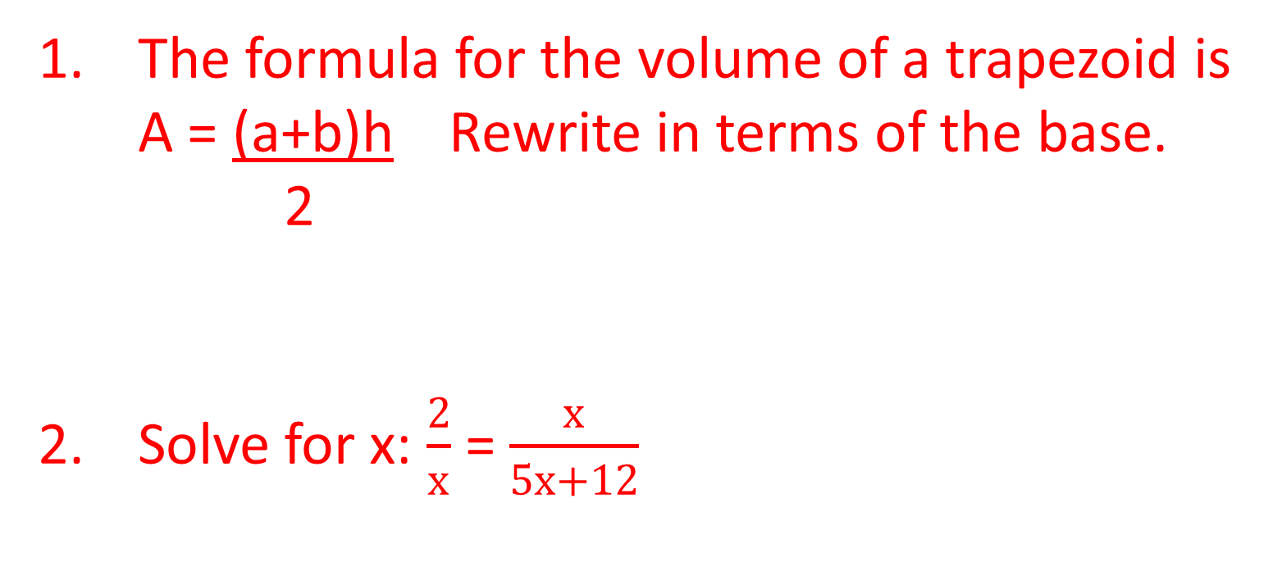
ANNOUNCEMENTS
-Pick up your assigned calculator
-Take your HW out to stamp
WARM UP
Answer each of the following on your WHITEBOARD. Use your notes and talk to your teammates for help.
The formula for the volume of a trapezoid is
A = (a+b)h Rewrite in terms of the base.
2
Solve for x: $\frac{2}{x}$ = $\frac{x}{5x+12}$

Slide 2
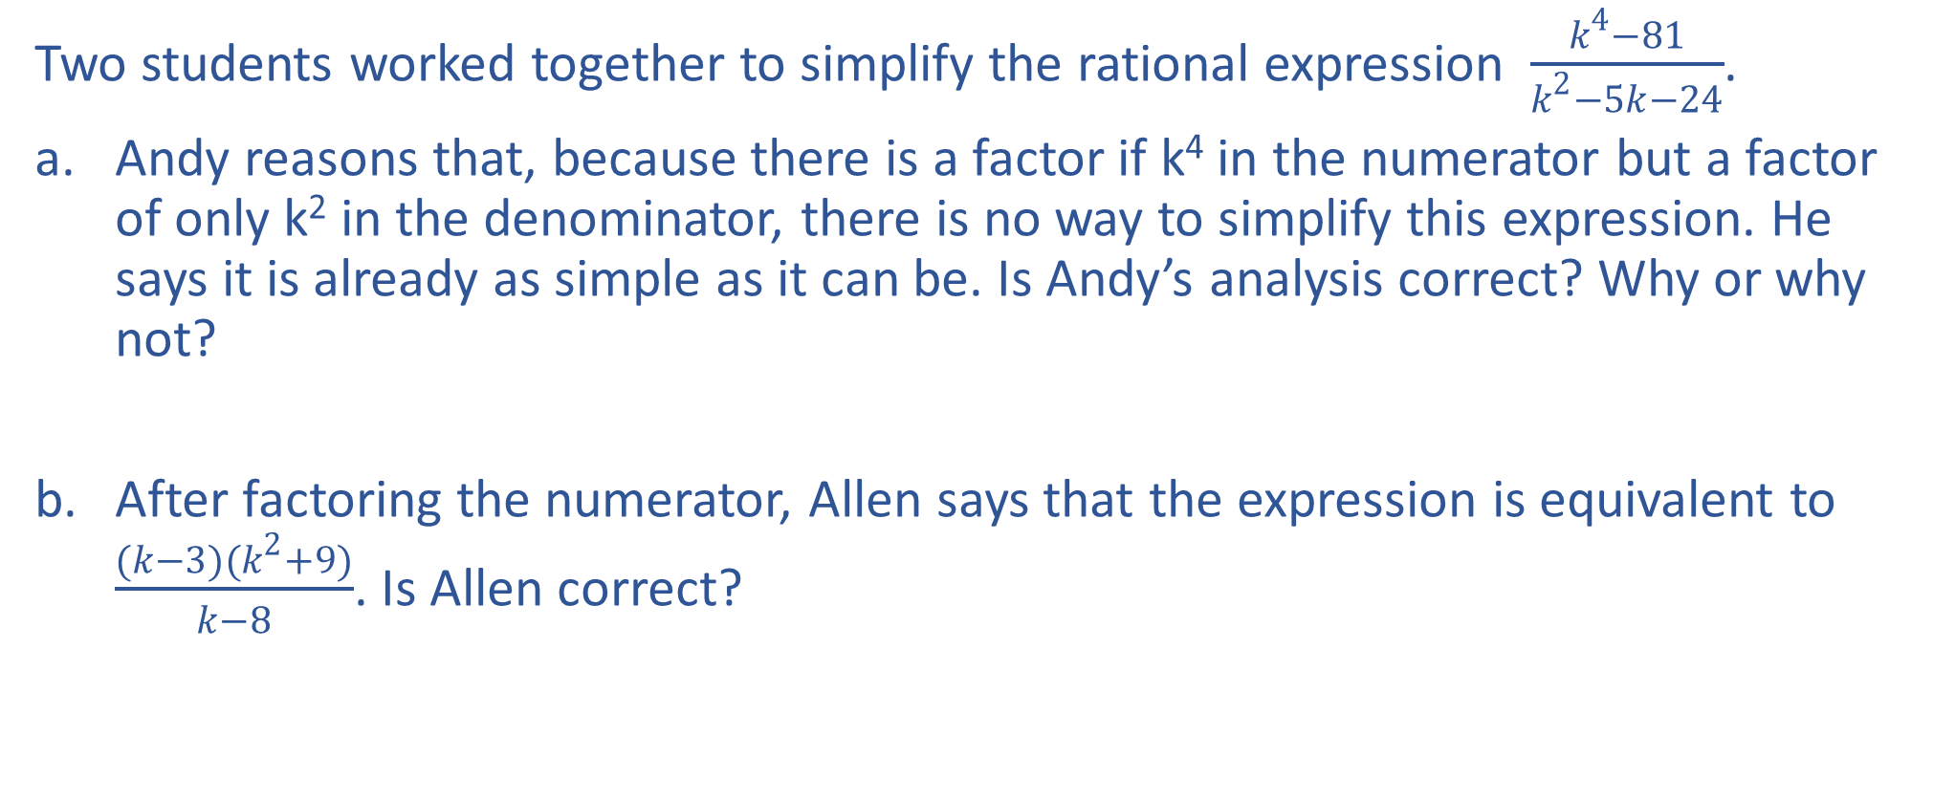
Study Guide #9
Two students worked together to simplify the rational expression $\frac{k^{4}−81}{k^{2}−5k−24}$.
Andy reasons that, because there is a factor if k⁴ in the numerator but a factor of only k² in the denominator, there is no way to simplify this expression. He says it is already as simple as it can be. Is Andy’s analysis correct? Why or why not?
After factoring the numerator, Allen says that the expression is equivalent to $\frac{(k−3)(k^{2}+9)}{k−8}$. Is Allen correct?

Slide 3

Study Guide #11
States take a census, or a count if its population, every 10 years. The census is used to estimate the population’s growth rate. North Carolina’s population today is 9,943,964 people, and the 10-year growth rate is approximately 12%. North Carolina’s population can be estimated at any year t using the equation y = y₀ ▪ ${(1+r)}^{\frac{t}{10}}$, where y₀ is the initial population and r is the 10-year growth rate. What will be the town’s approximate population in the year 2030?

Slide 4
Study Guide #12
Two cars initially cost $20,000. The first car depreciates at a rate of 13% every 2 years. The second car depreciates at a rate of 16% every year. Which car should you purchase if you want the car with the higher value in the future?

Slide 5
HOMEWORK QUESTIONS?

Slide 6
Grudgeball! – Study Guide
Your team versus all the other teams! All teams start with 7 X’s.
Teams take turns answering questions.
When it’s your team’s turn, you have 2-4 minutes to answer the question that appears on the board. If you get the question correct, you get to erase 2 X’s from the other teams. You can erase 2 X’s from the same team, split up the X’s from two different teams, or commit suicide and erase your own X’s.
Also, if you get the answer correct, you have the opportunity to shoot the “Grudgeball.” If you make it in from the 2-pt. line, you get to erase 4 X’s. If you make it in from the 3-pt. line, you get to erase 5 X’s. If you miss, you still get to erase 2 X’s.
If you get it incorrect, the other teams get a chance to steal. If your team steals and gets the answer correct, you add 1 X to your total.
If your team’s X’s are all erased before the game is over, you still get a chance to earn X’s back by stealing questions (for 1 X) or by getting the correct answer on your team’s turn (for 4 X’s).
Top 3 teams with the most X’s at the end of the game wins!
  7 COLLEGE CREDITS for 1st place
  5 COLLEGE CREDITS for 2nd place
  3 COLLEGE CREDITS for 3rd place

Slide 7
PRACTICE ROUND
2 + 2 =
4

Slide 8

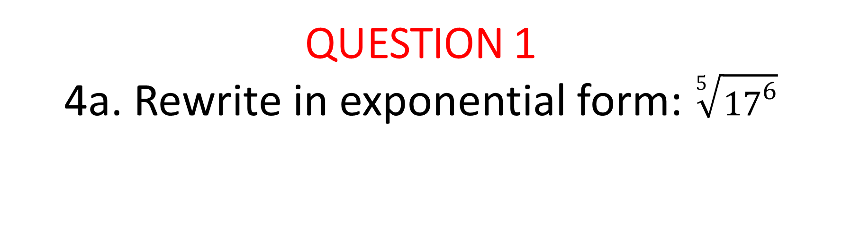
QUESTION 1
  4a. Rewrite in exponential form: $\sqrt[5]{{17}^{6}}$
$${17}^{\frac{6}{5}}$$

Slide 9

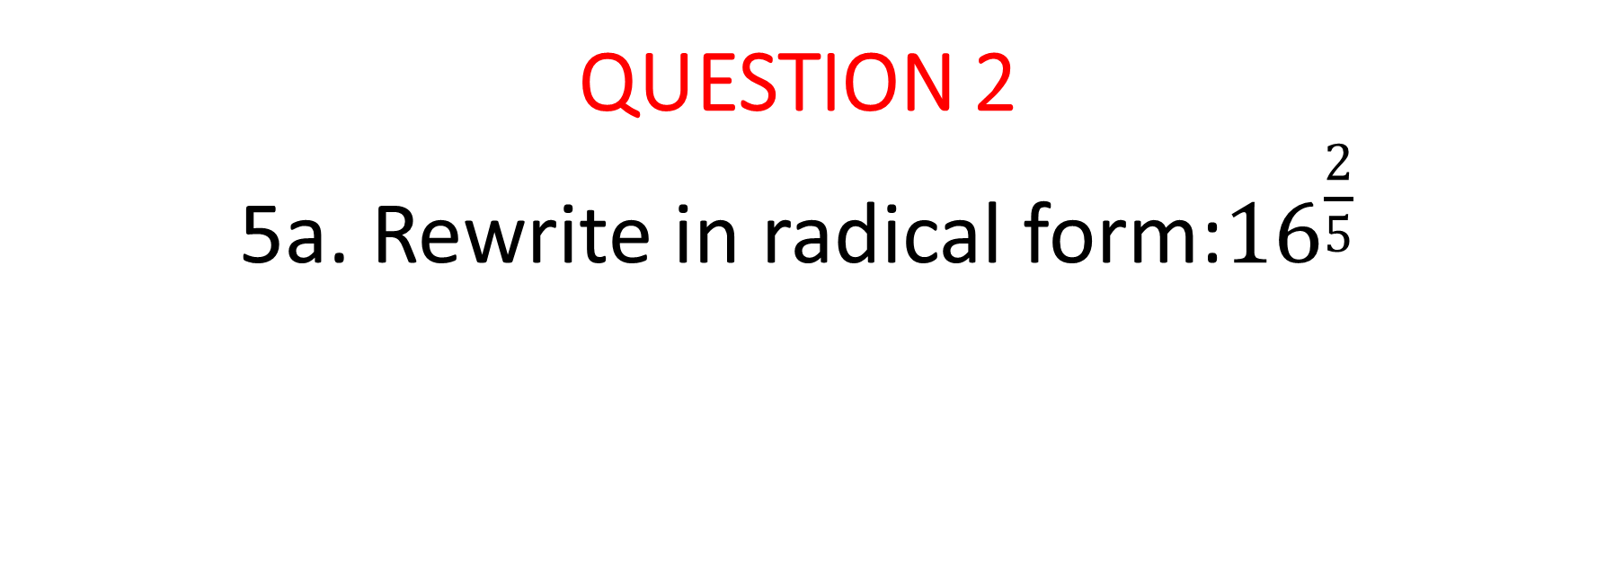
QUESTION 2
  5a. Rewrite in radical form:${16}^{\frac{2}{5}}$
$$\sqrt[5]{{16}^{2}}$$

Slide 10

QUESTION 3
  1. Given the equation for slope-intercept form y = mx + b, solve for slope (m).
$$m= \frac{y−b}{x}$$

Slide 11

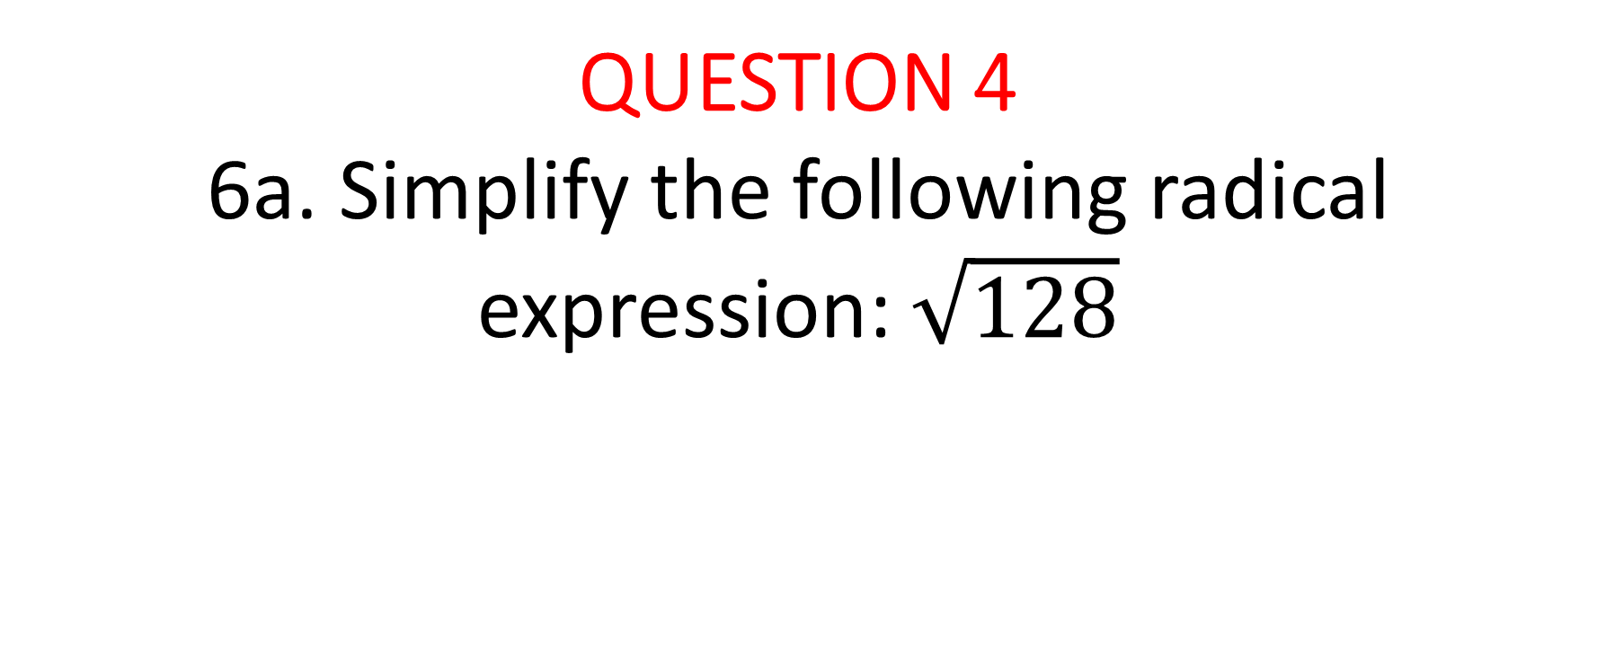
QUESTION 4
  6a. Simplify the following radical expression: $\sqrt{128}$
$$8\sqrt{2}$$

Slide 12

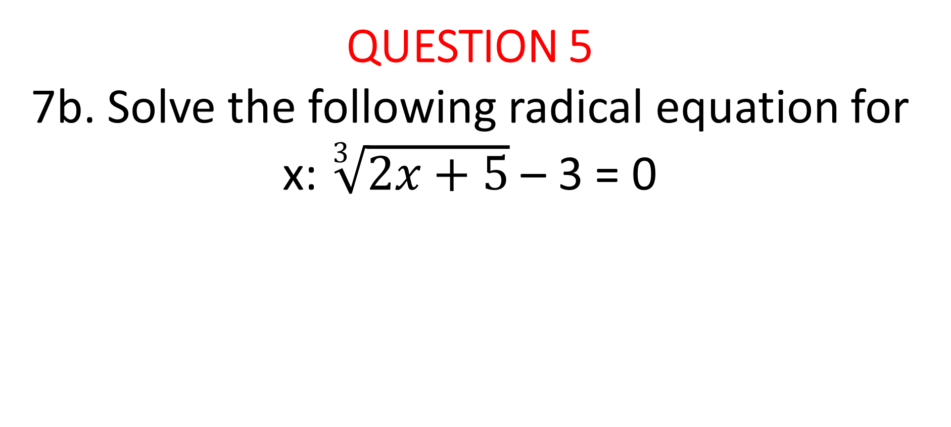
QUESTION 5
  7b. Solve the following radical equation for x: $\sqrt[3]{2x+5}$ – 3 = 0
$$x=11$$

Slide 13


QUESTION 6
8. Is the following equation sometimes, always, or never true? Explain.
$x−1=\sqrt{{\left(x−1\right)}^{2}}$
$$sometimes; \\ always works except for$$
$$when x=0$$

Slide 14

QUESTION 7
3. You are driving to visit a friend in another state who lives 440 miles away. You are driving 55mph per hour and have already driven 275 miles. Write an equation in terms of time and find how many hours do you have to drive before you reach your destination.
$$T= \frac{D}{R};$$
3 hours

Slide 15

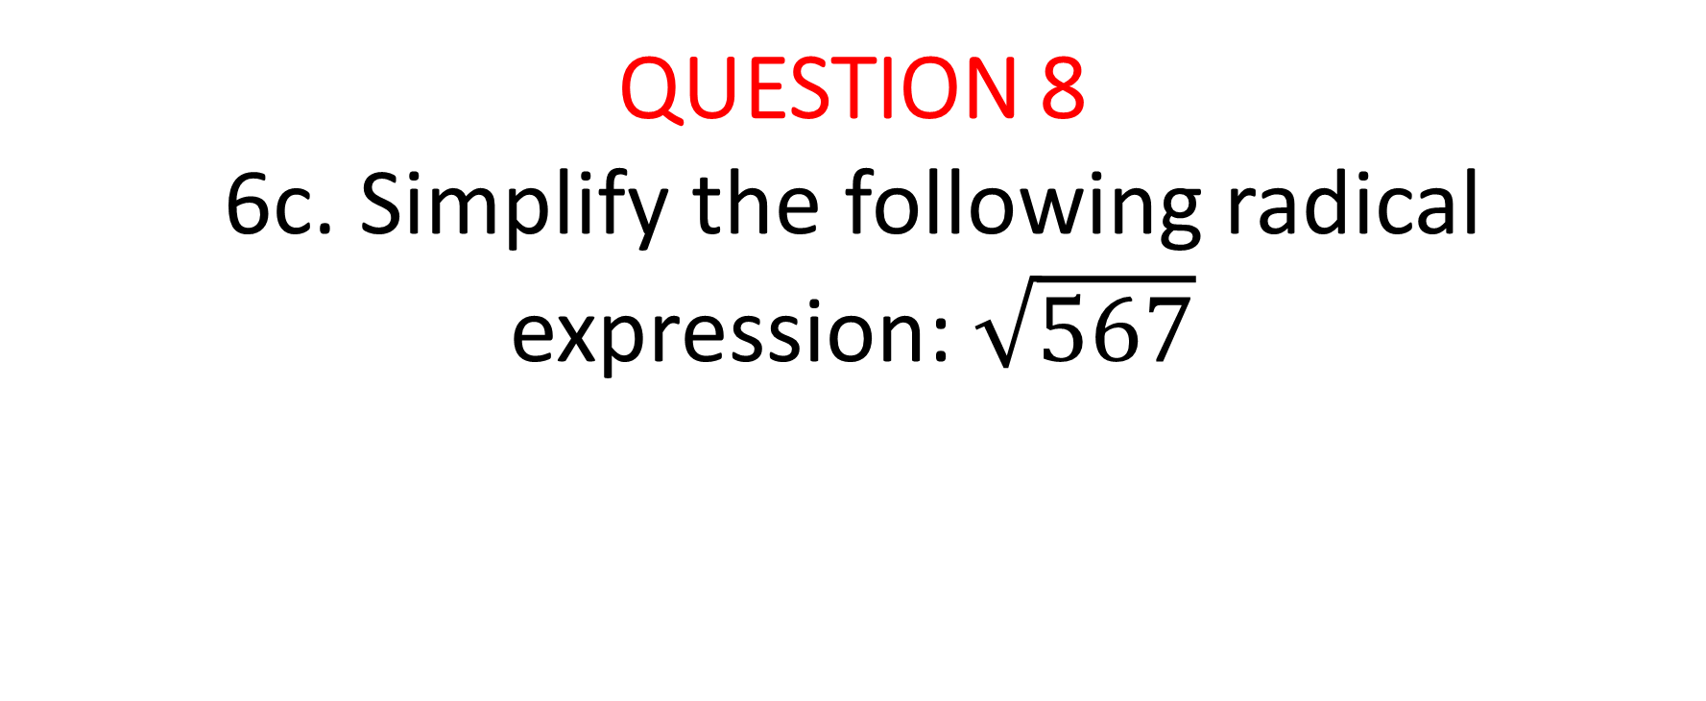
QUESTION 8
  6c. Simplify the following radical expression: $\sqrt{567}$
$$9\sqrt{7}$$

Slide 16


QUESTION 9
  7a. Solve the following radical equation for x: $\sqrt{3n}= \sqrt{4n−1}$
$$x=1$$

Slide 17

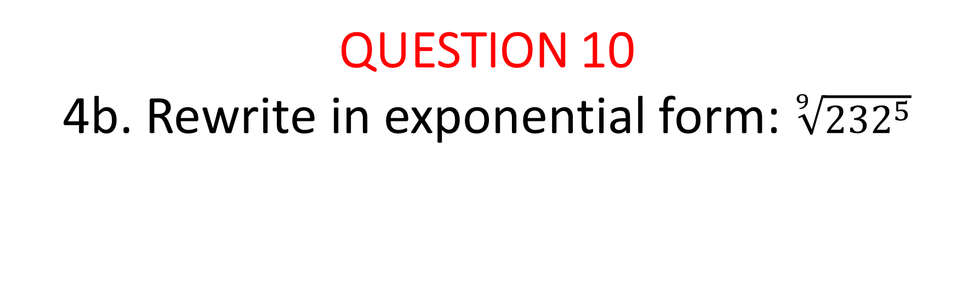
QUESTION 10
  4b. Rewrite in exponential form: $\sqrt[9]{{232}^{5}}$
$${232}^{\frac{5}{9}}$$

Slide 18
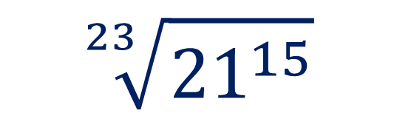
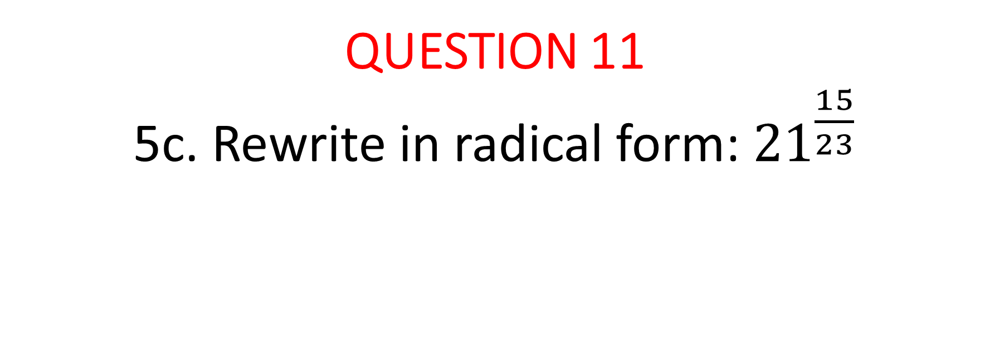
QUESTION 11
  5c. Rewrite in radical form:${ 21}^{\frac{15}{23}}$
$$\sqrt[23]{{21}^{15}}$$

Slide 19
OTHER STUDY GUIDE QUESTIONS?

Slide 20
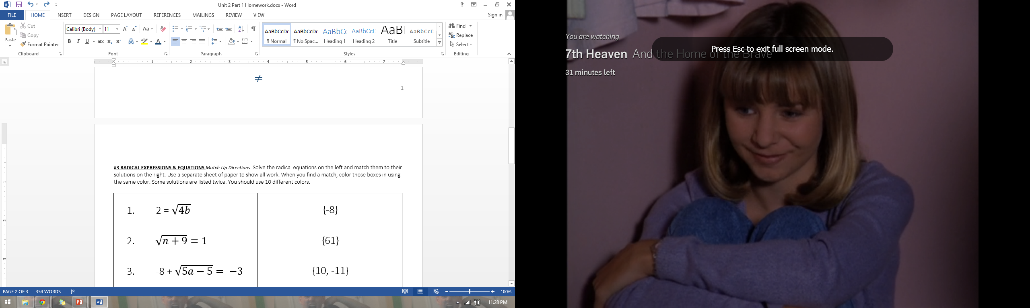
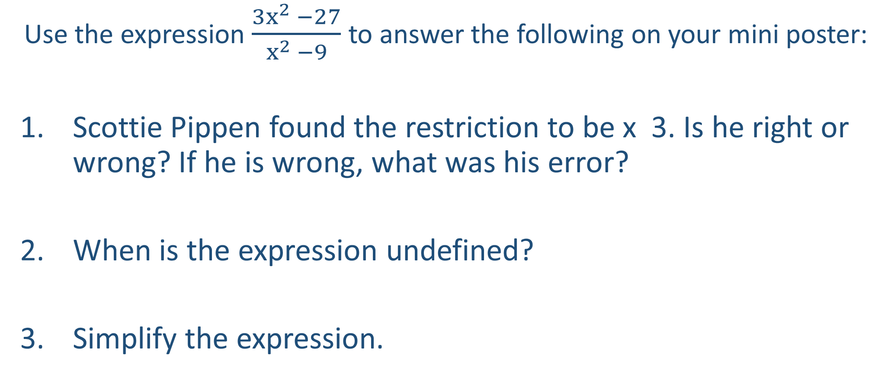
With your partner…on whiteboard
Use the expression $\frac{{3x}^{2} −27}{x^{2} −9}$ to answer the following on your mini poster:
Scottie Pippen found the restriction to be x 3. Is he right or wrong? If he is wrong, what was his error?
When is the expression undefined?
Simplify the expression.

Slide 21
Exit Ticket – on looseleaf
Write a summary of your notes for all objectives in Unit 2. In your own words, write about:
  How you would solve literal equations (#4)
  How to rewrite expressions with rational exponents in radical form and how to rewrite radical expressions in rational exponential form (#3)
  How to simplify a radical expression (#5)
  How to solve a radical equation (#1)
  All parts of an exponential growth or decay equation (#6)

